Slide 1


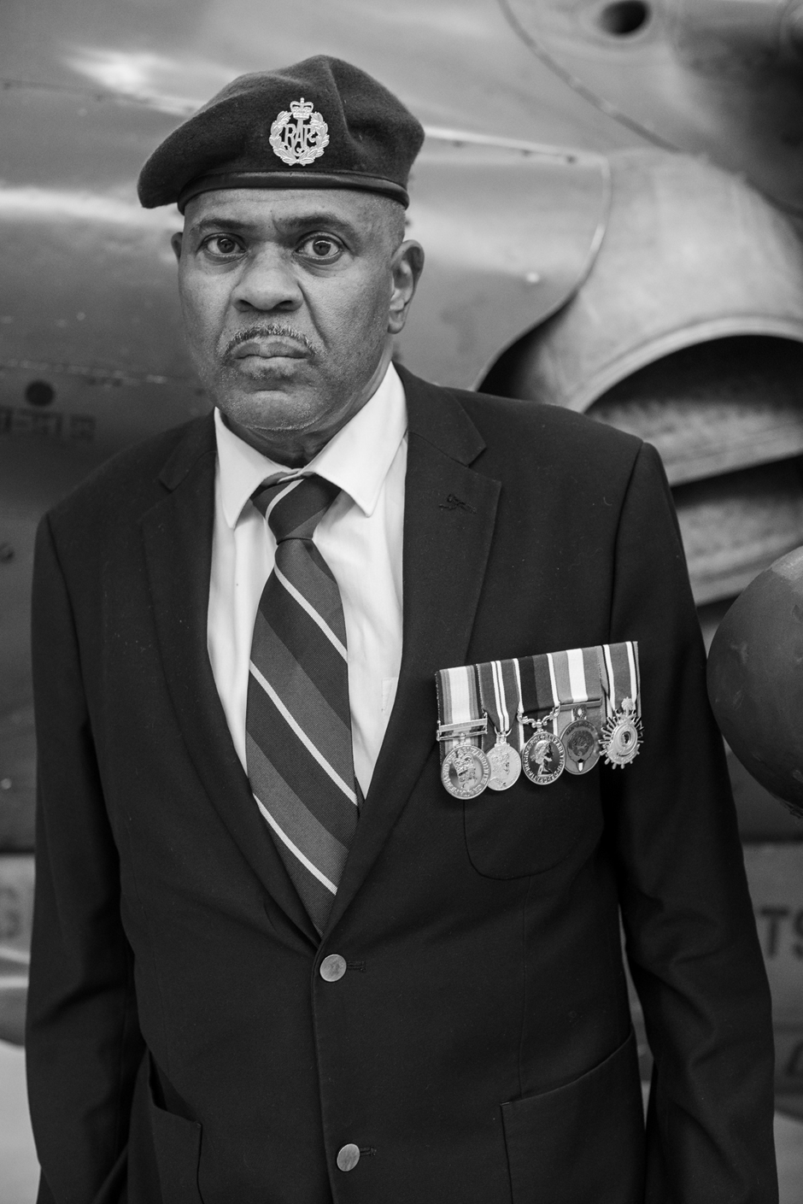
What does evidence reveal about how Bryan Scott was treated in the RAF?
Notes:
Bryan was born into a small family in Handsworth, Birmingham in 1962.

Slide 2
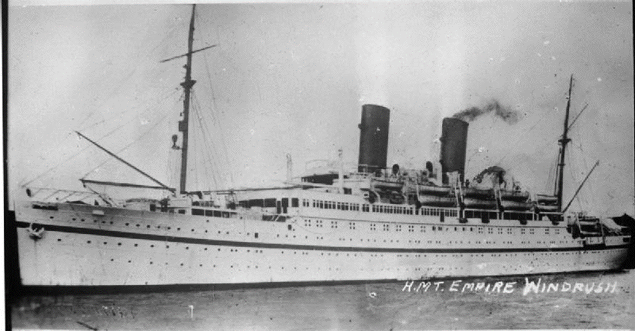
Notes:
Bryan`s parents were from Jamaica and part of the Windrush Generation who migrated to Britain to help rebuild the country after the Second World War.

Slide 3
Selective Education
Children who passed the exam went to Grammar schools
All children sat the 11+
Exam
All local children attend
Primary School
Children who failed went to Secondary Modern schools
Notes:
Bryan went to a good local primary school and sat the 11+ exam to decide whether he would go to grammar school or a secondary modern school. Grammar schools were meant for clever children who might go to university and get in to well paid jobs and careers. Any child who failed went to secondary modern schools instead which were for everybody else. How you performed could affect the rest of your life. Less was expected of secondary modern pupils. You were much less likely to go to university or get a well-paid job. Bryan believed he failed the 11 plus exam at the time. But the grammar school lied to him. After two years Bryan found out that he had passed the 11 plus after all. It was the racist headteacher of the grammar school who decided that black pupils like Bryan should not go there, even if they passed the exam. It was not the first time that Bryan was held back because of the colour of his skin.

Slide 4
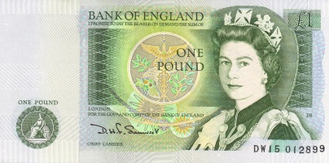




Notes:
. Bryan joined the ATC (Air Training Corps) as a cadet and was recruited to the RAF when he left school at 16 in 1979. He was partly attracted to the RAF by the prospect of good pay, travel and training. Bryan became a weapons technician in the air force.

Slide 5
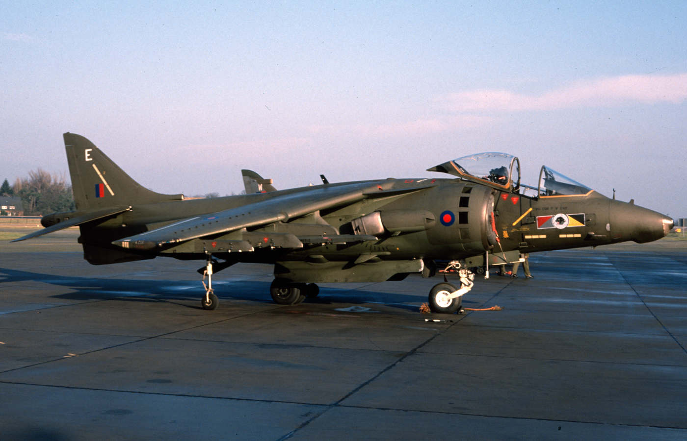
Notes:
Bryan was stationed at British RAF bases and served at RAF Gutersloh in Germany for six years, helping with Harrier jets. There were several RAF bases in Germany in the 1980s, set up to help control the country after the Second World War and to help deter an attack on Western Europe by the Soviet Union (Russia).

Slide 6
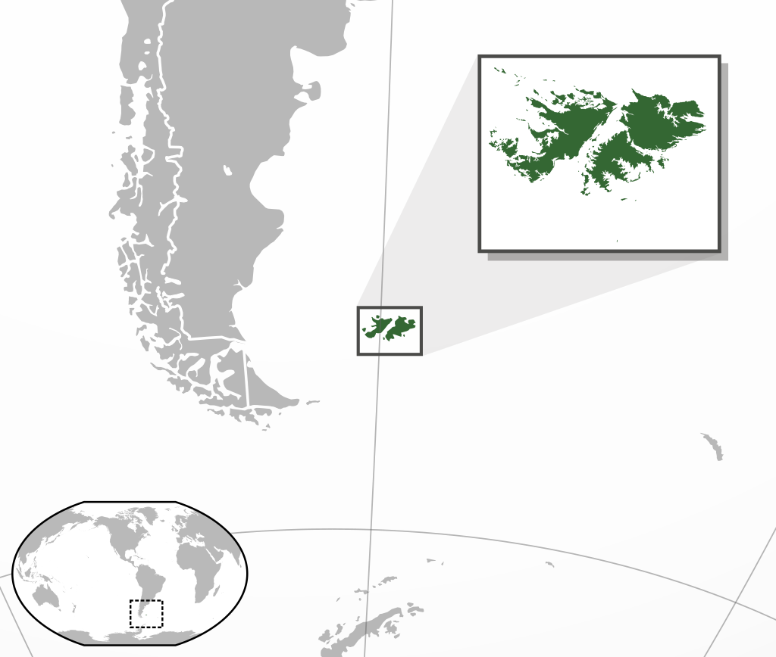
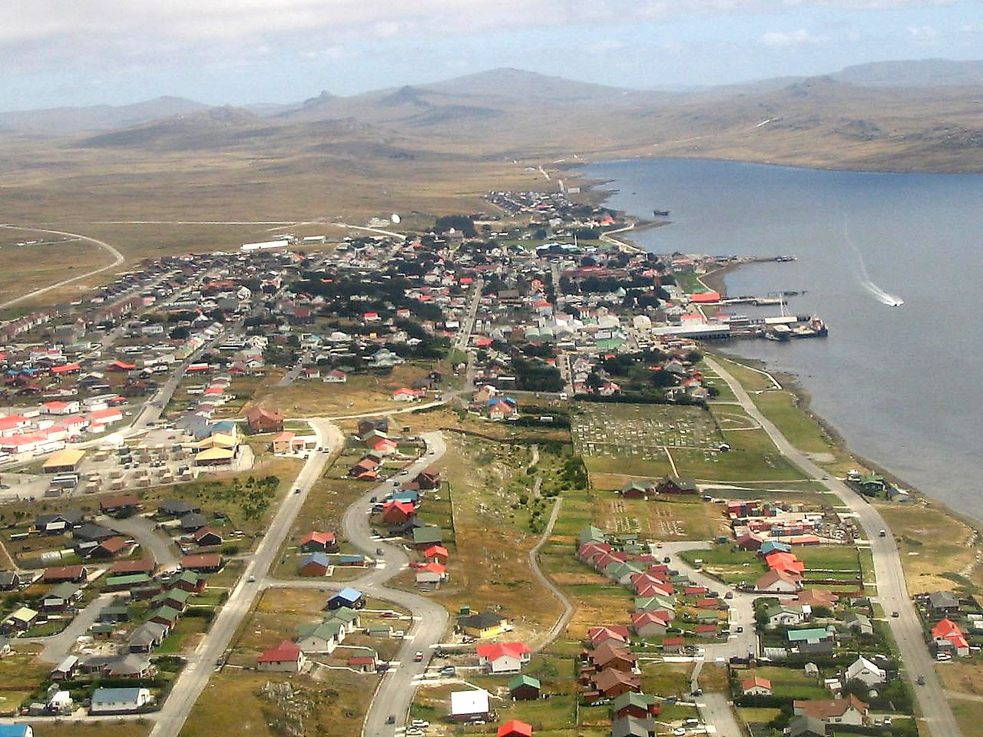
Falkland Islands
Notes:
In 1982 Britain fought an unexpected war against Argentina in 1982 in the Falklands islands off the tip of South America . Bryan never went there himself but he worked on RAF planes that were sent to fight.

Slide 7
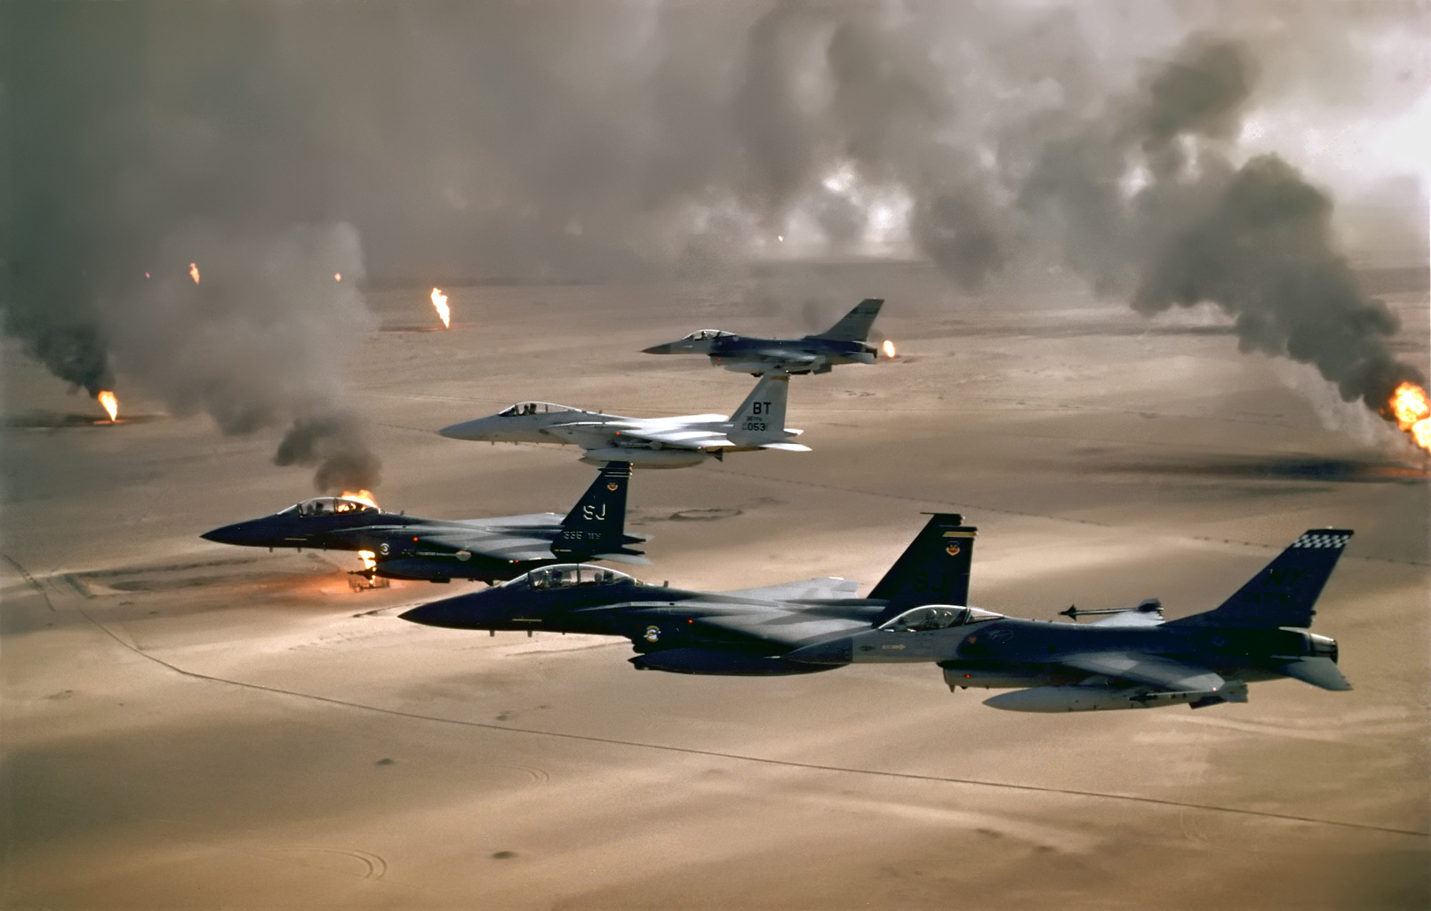
Notes:
In 1992 Bryan also worked on RAF aircraft that were sent to fight in the First Gulf War in the Middle East against Iraq`s cruel dictator, Saddam Hussein.

Slide 8


Notes:
Bryan retired from the Royal Air Force in 2003 after 24 years. He reached the rank of sergeant but like some other black veterans he noticed that white airmen often got faster promotion. Was this because of racism? If it was, it was hard to prove. Where would he find the evidence?

Slide 9
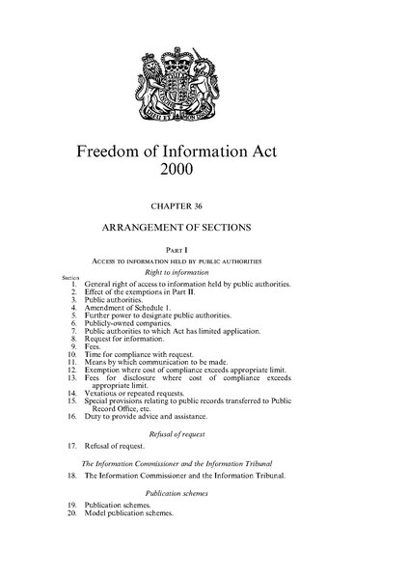

Notes:
In 2000 Parliament passed the Freedom of Information Act. This gave British people the right to request documents and information held by government bodies, including the Royal Air Force but it allowed for sensitive or secret information to be held back.. Bryan had never seen the annual assessment sheets where comments were made on his performance as an airman. Promotion depended on what was said each year. Slower promotion meant less pay and a smaller pension. Perhaps these would be evidence of why Bryan`s promotion was delayed? Instead, when he received copies of these papers from his service career parts of them were redacted or blacked out. Why would this have been done if there was nothing to hide? Bryan believes the blanks hide comments which might point to his racist treatment by the air force. However, this is difficult to prove as the documents have been deliberately censored.

Slide 10
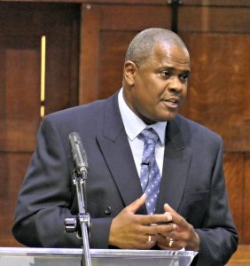
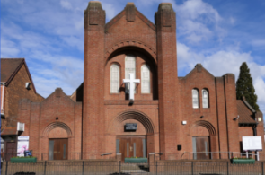
Notes:
After he left the RAF Bryan trained to be a Baptist minister in Bristol and went back to lead the church he was brought up in at Cannon Street Baptist Church in Handsworth.

Slide 11
