Slide 1

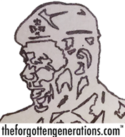
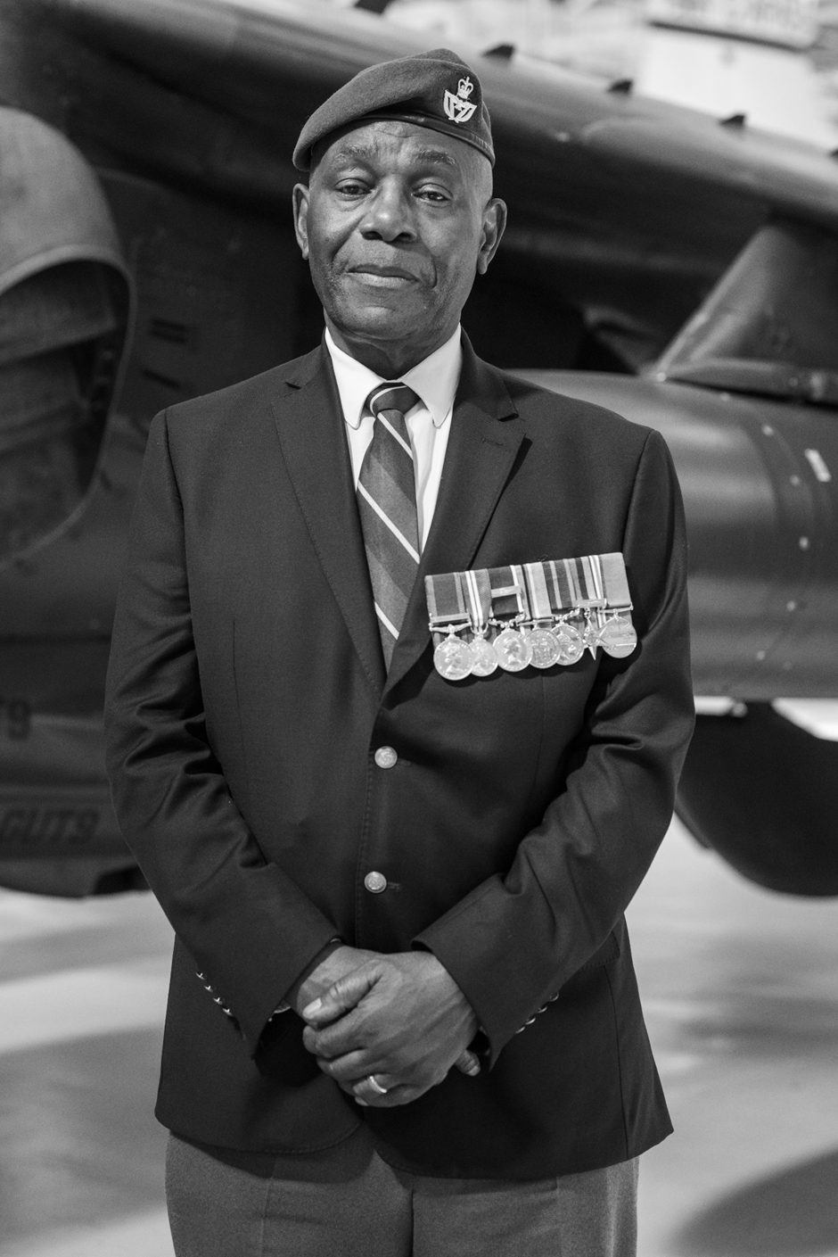
How did Donald Campbell become a Black Briton and Brummie?
Notes:
Donald Campbell was born as the third child to a family with five children in Jamaica on 21st July 1951.

Slide 2

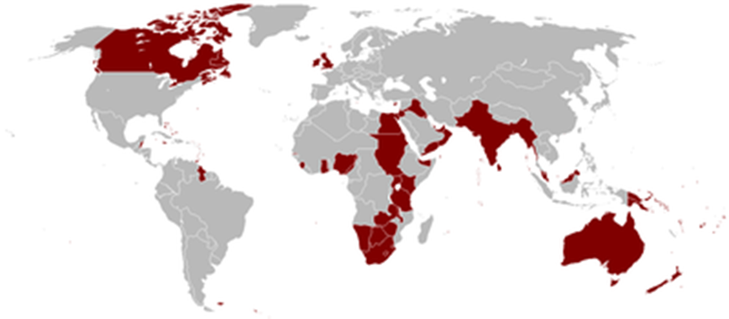
The flag of Jamaica when it was a colony of the British Empire
Notes:
It was still a colony of the British Empire although adult Jamaicans could vote by then and elect their own MPs who partly governed the island under the British.

Slide 3
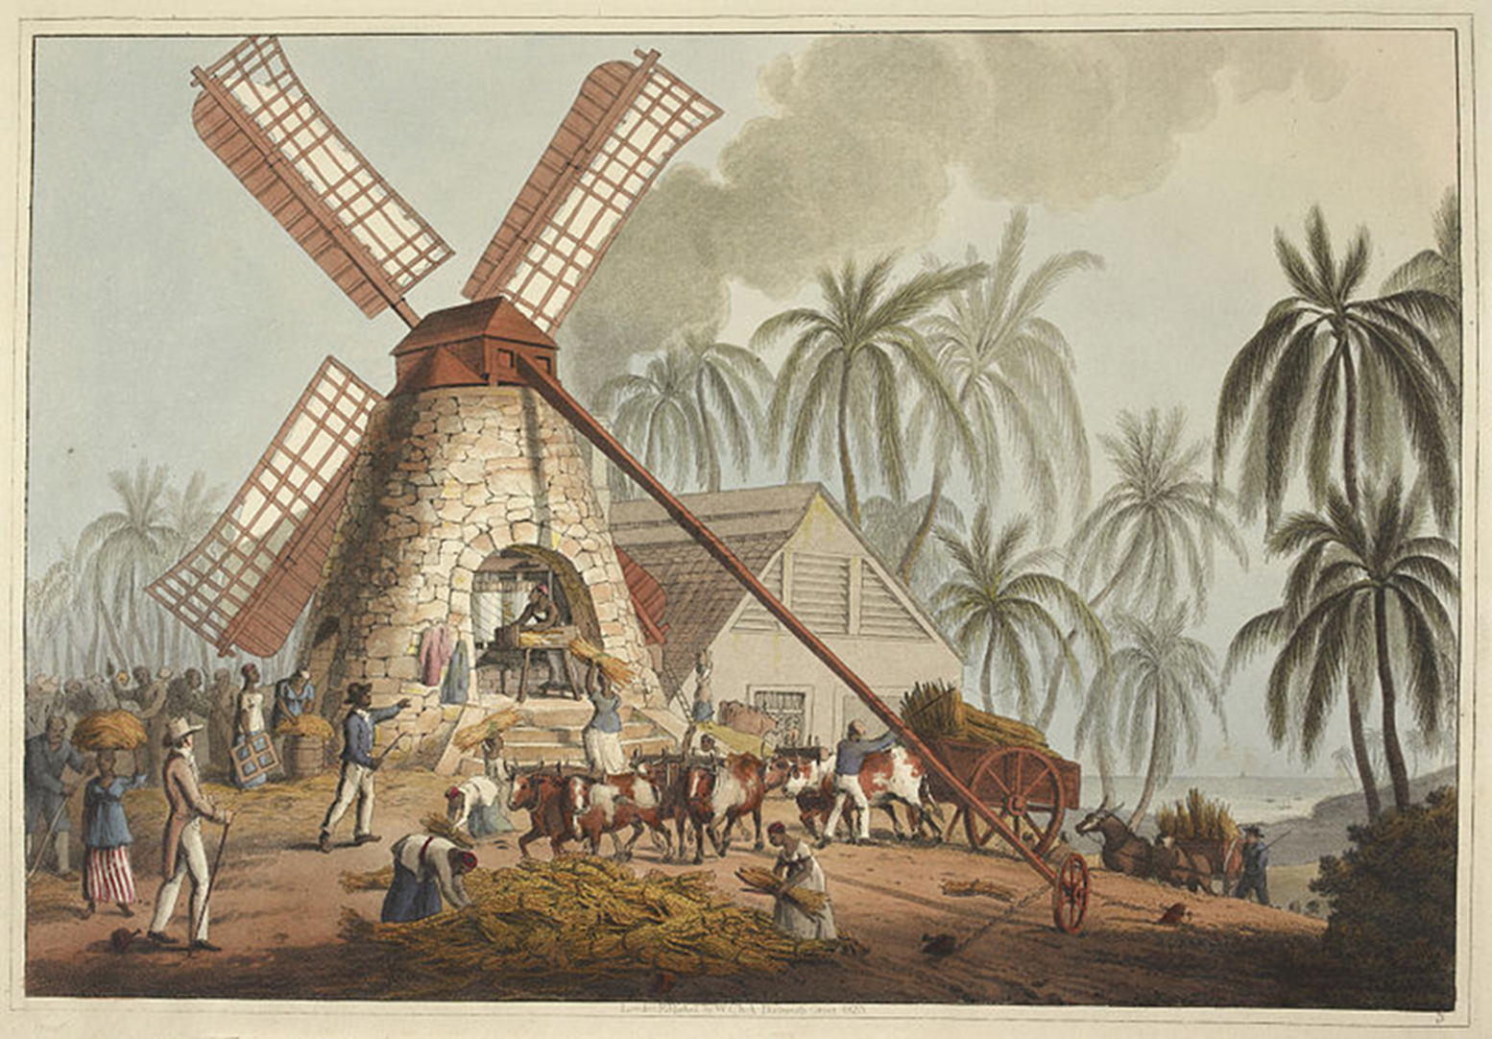
Notes:
Donald’s family were part of the 80% of the population descended from enslaved Africans brought over by the British in the past to harvest crops on the island’ s plantations.

Slide 4
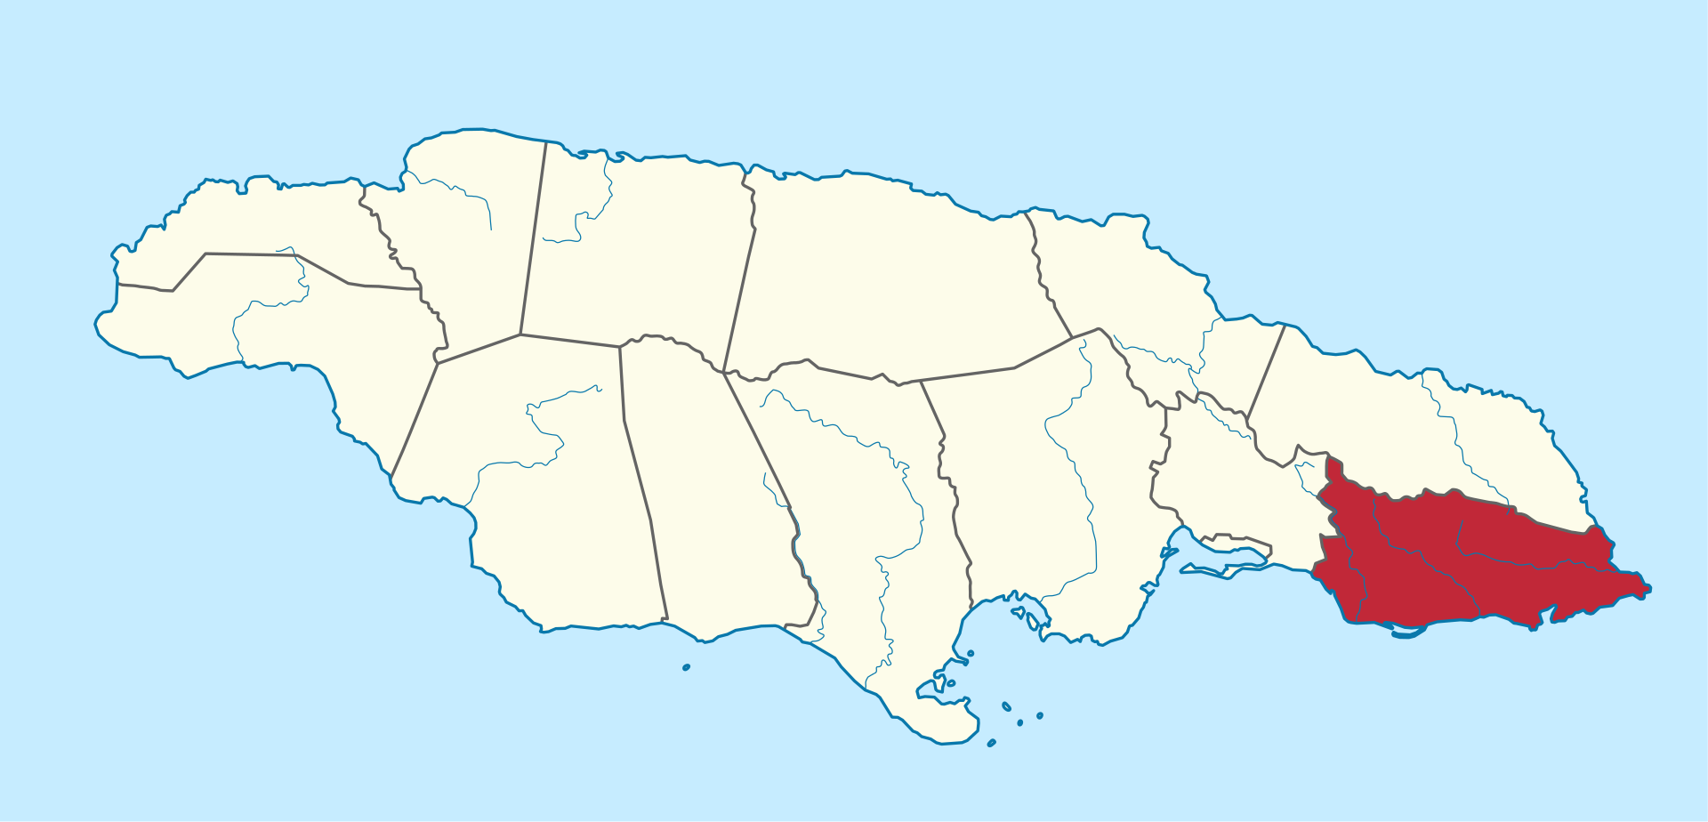
Donald`s family lived in St Thomas Parish, Jamaica.
Notes:
Young Donald was very close to his mother from the beginning. At the age of three, he was left with an uncle in Kingston, Jamaica’s capital and cried from morning to night refusing to eat, standing at the front door of the house until his mother returned.

Slide 5
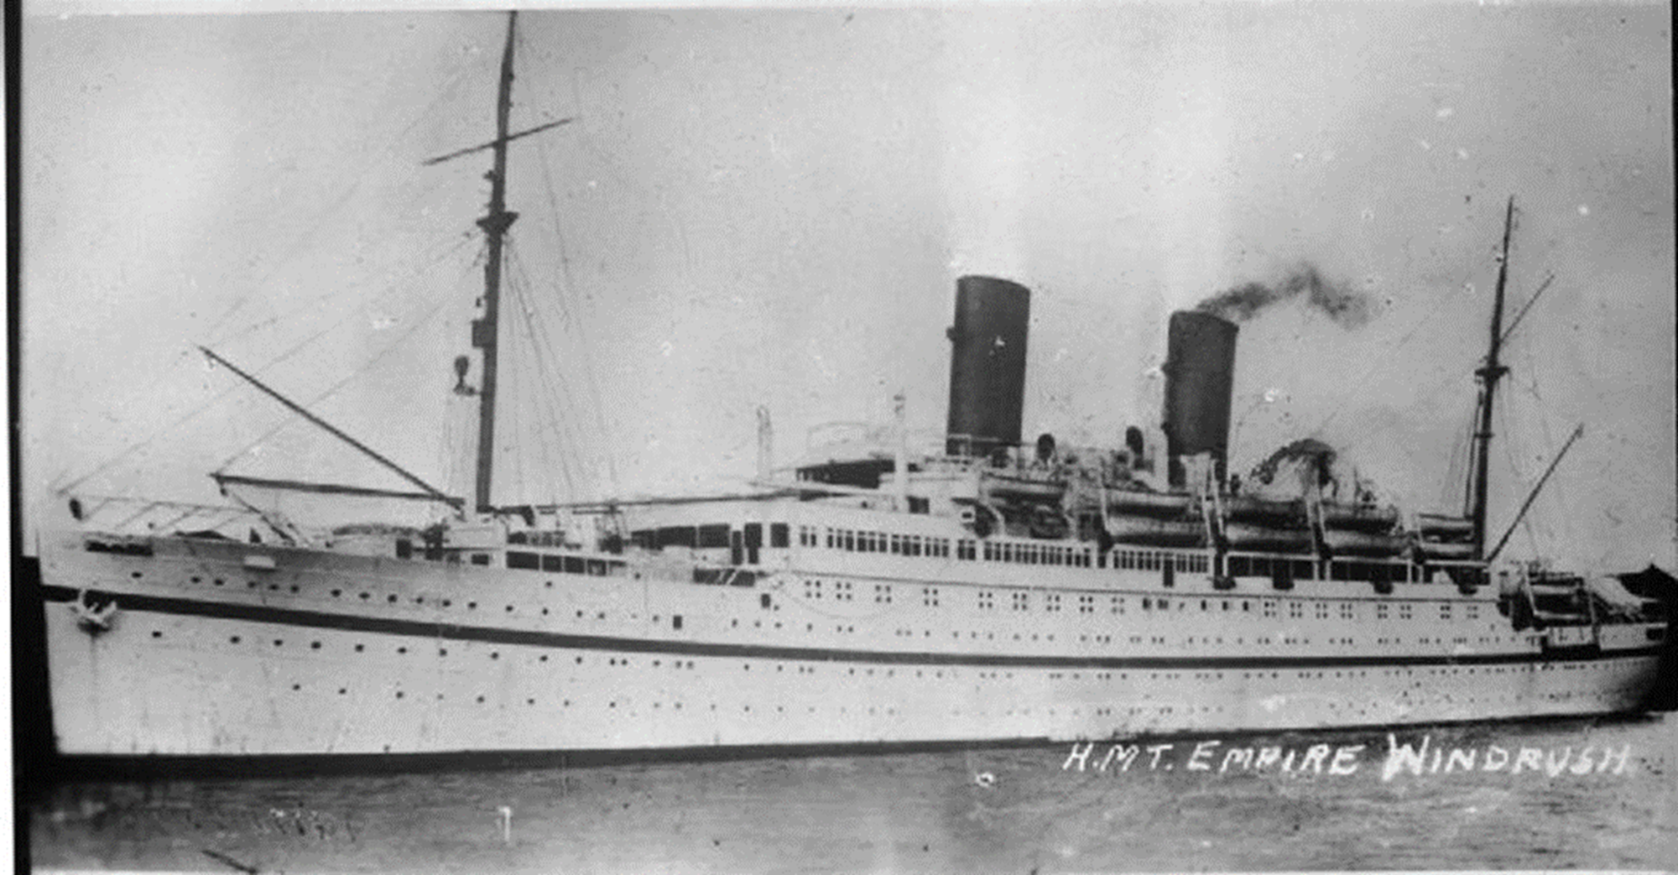
Notes:
This ship is the SS Empire Windrush which carried some of the first black Jamaican migrants in 1948 to look for work in England and help rebuild Britain after the German bombing of the Second World War. Donald`s parents were part of that same generation but they flew from Jamaica to Britain by plane. It was very hard for Donald when his mother left him when he was just seven years old (his father had already left Jamaica when he was four).

Slide 6
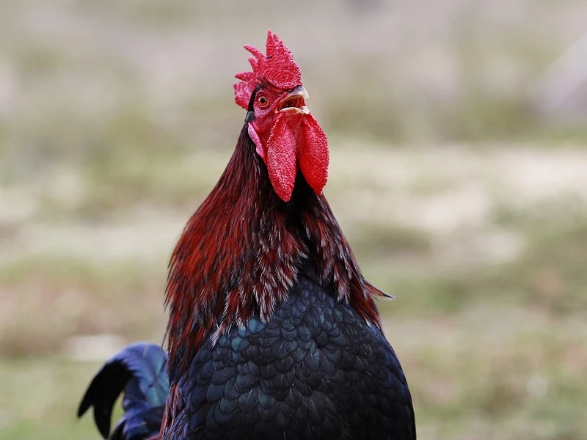
Notes:
Donald was sent to live with his kindly godparents and he became part of their family, but it did not stop him longing for his mother. (His parents did not forget their son but it was too expensive and too far for visits). Life was hard in the Jamaican countryside then and there was never enough money or work but Donald still remembers how good parts of his childhood were. He would be woken by a cockrell crowing loudly between four and five in the morning as the tropical heat grew under clear blue skies so that you would never have to wear a coat or a jumper.

Slide 7
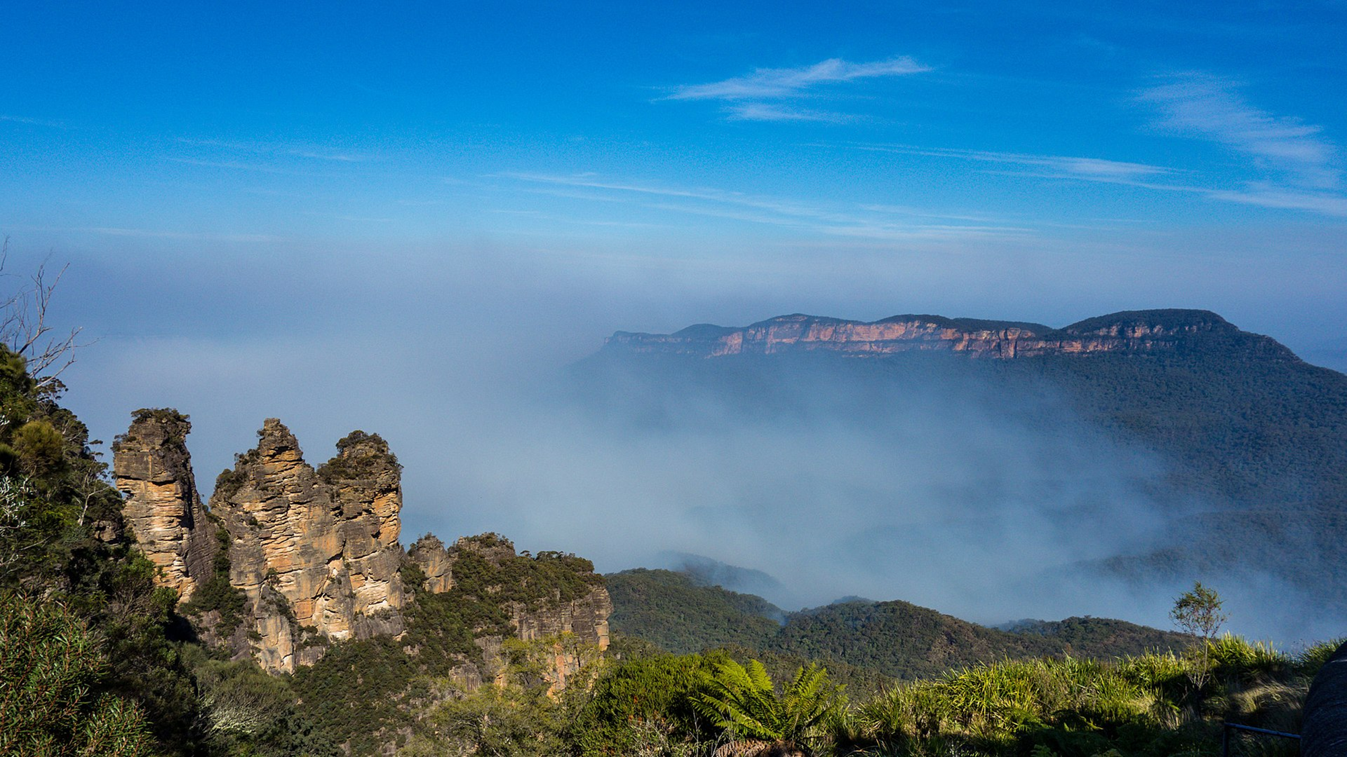
Notes:
The rocky heights of the beautiful Blue Mountains where runaway slaves once hid from the British (and fought against them), plunged into lovely valleys of lush green trees and fields of sugar cane.

Slide 8
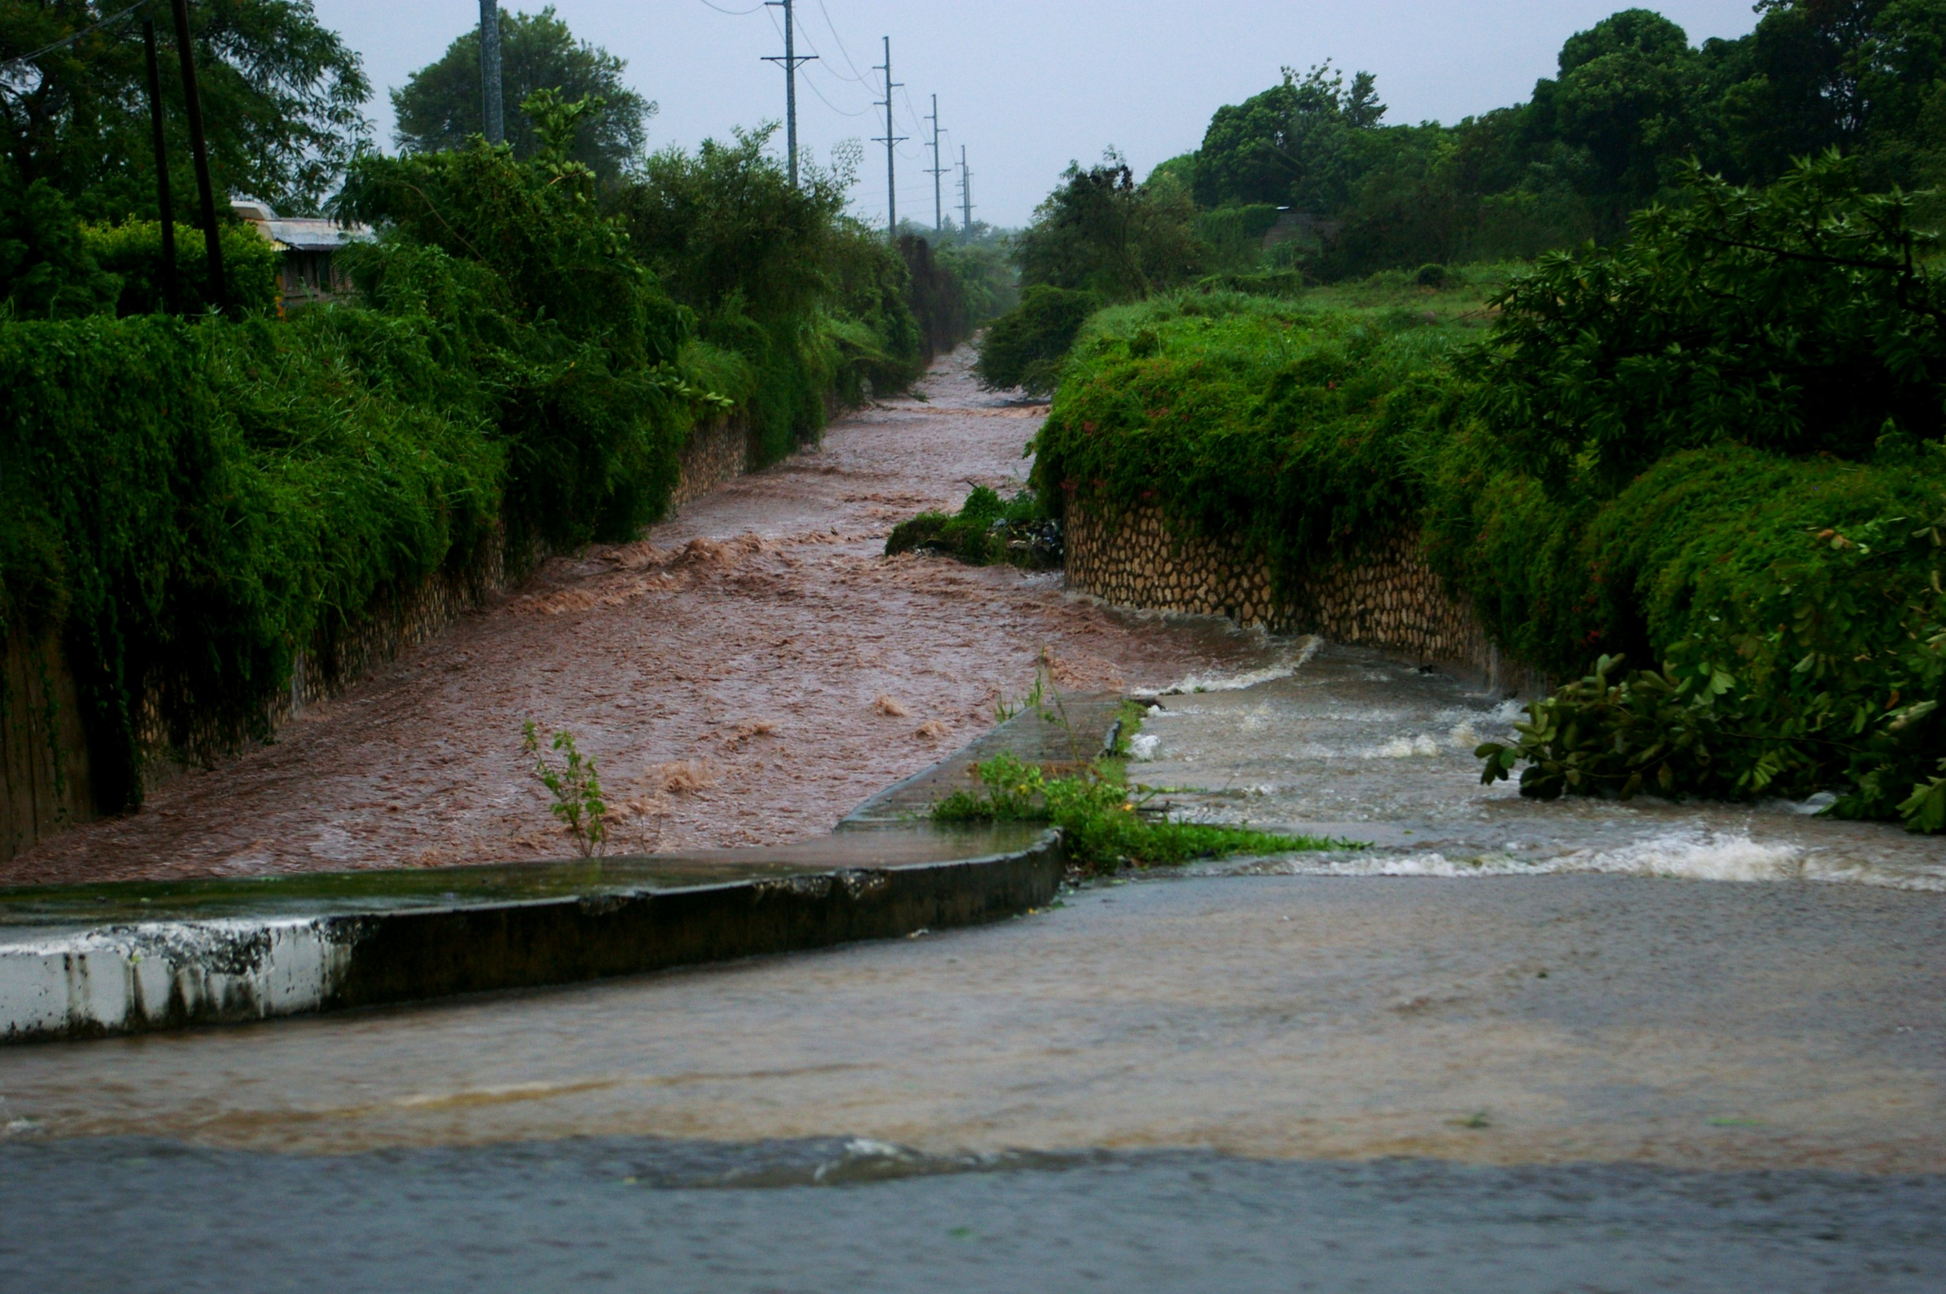
Notes:
During storms torrential rain would batter the zinc- covered roofs of the colourfully painted houses This caused the powerful waters of the rivers to rise, surging over the bridges which made it impossible to cross from bank to bank as usual.

Slide 9
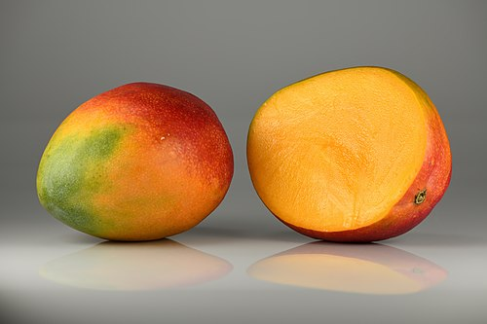
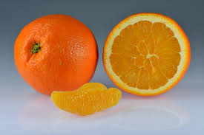
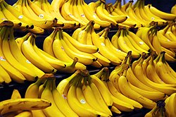
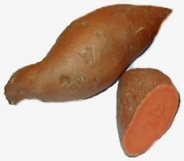
Notes:
Fruit such as mangoes, oranges and bananas could be easily picked from the trees and the fertile soil yielded yams and other vegetables.

Slide 10
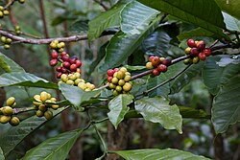
A coffee tree
Notes:
Native cocoa trees and coffee trees (originally imported by the French from Africa) grew wild.

Slide 11
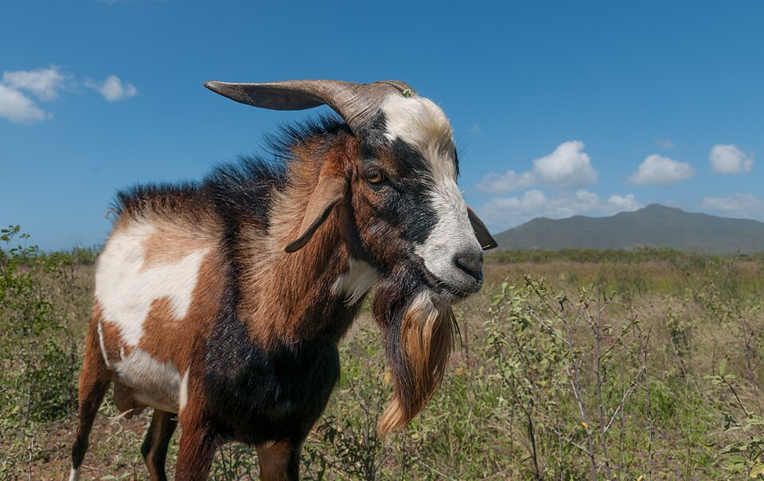
Notes:
With the other children in his godparent`s household, Donald did regular chores such as washing dishes and tending animals. He was even given his own goat too look after as a pet.

Slide 12
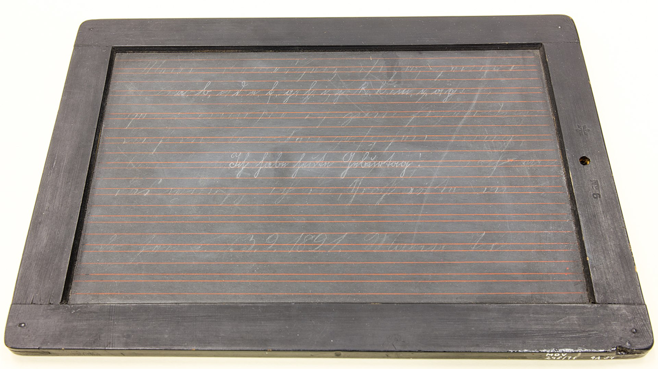

Notes:
In term time Donald went to school with the other children where the black Jamaican teachers were very strict. There was no uniform, but every child was expected to be clean and tidy (Donald wore smart shoes which arrived in a barrel of other goods shipped home to him by his hardworking parents in Birmingham). In infant School Donald learned to read and write using a slate and a piece of chalk, just like pupils used to use in a Victorian school in Britain. Donald got frustrated because he loved to write but had to rub out what he had just written so that he could continue writing (it was better when he could use exercise books in the junior school).

Slide 13
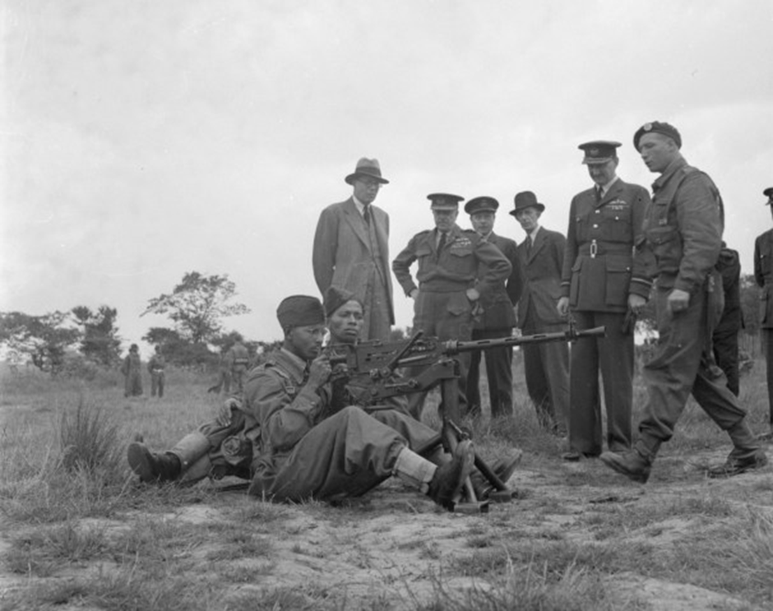
Notes:
His headmaster had been injured serving in the RAF during the Second World War, one of the 6000 volunteers from the Caribbean colonies who fought for Britain.

Slide 14
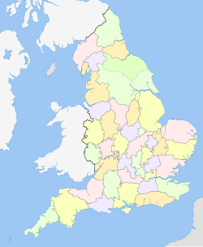
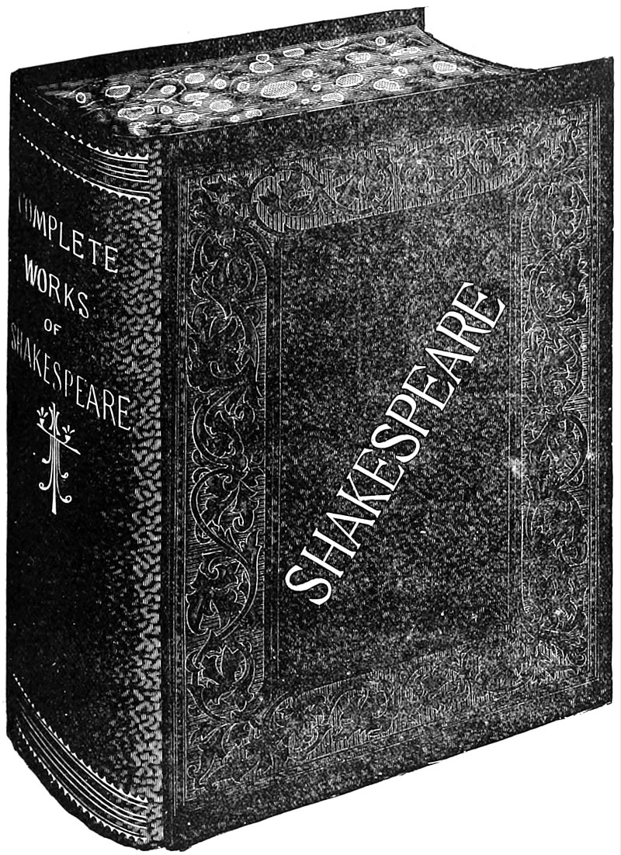
Notes:
He learned all about British history, geography and culture at school but not much about Jamaica itself or Africa, from where his ancestors came originally. He only learned later that his Scottish surname Campbell would have been given to his family because they had originally been `owned` by British plantation owners from Scotland called Campbell (few, if any Black Jamaicans know the original African family or tribal names of their enslaved ancestors).

Slide 15
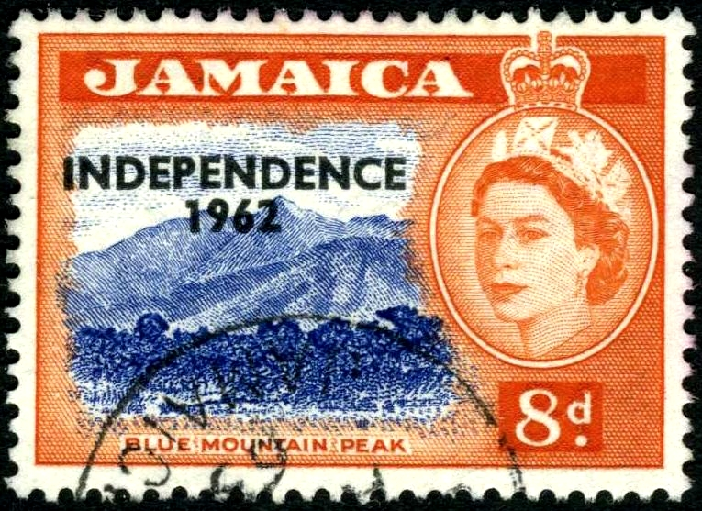
Notes:
When Donald turned 11 Jamaica became an independent country although Queen Elizabeth II remained the head of state. He remembers the celebrations of August 6th 1962 well which involved loud music and lots of drinking and smoking by Jamaican men. Donald really wasn’t old enough yet to understand how important this event was in his young country’s history.

Slide 16
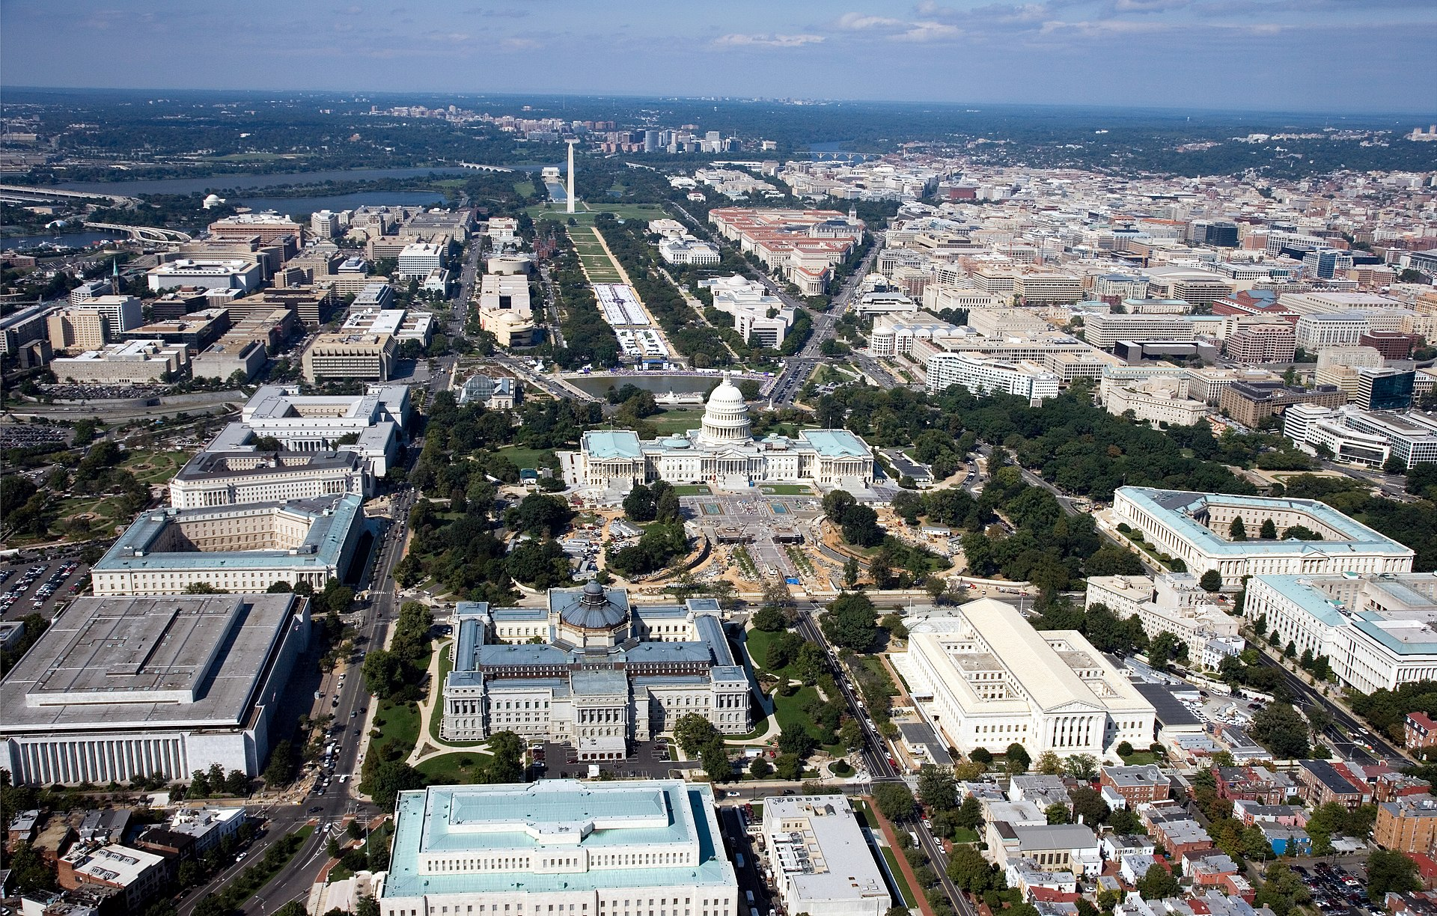
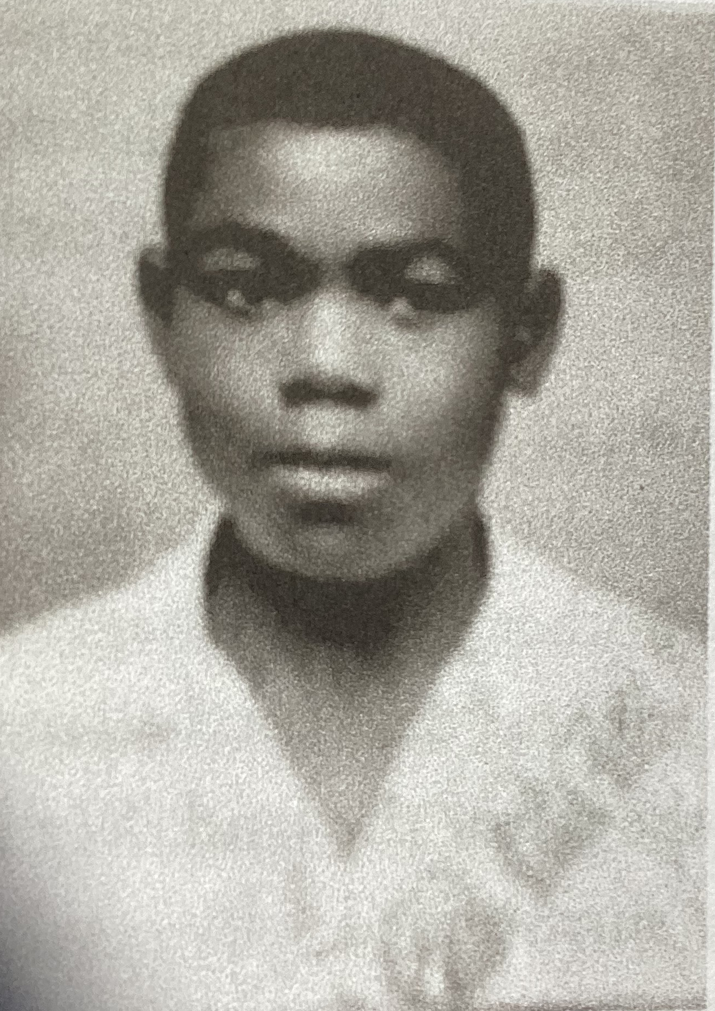
Donald at 13
Washington D.C. (USA)
Notes:
In February 1965 the day came, which young Donald had yearned for years. His parents summoned him to Britain and he would be reunited with his beloved mother. He would get to see the British streets Jamaican children believed were paved with gold. Taking an `iron bird` (a plane) from Kingston Airport, Donald flew to the American capital Washington DC on the first stage of his journey. He experienced bitter winter cold for the first time, just dressed in shorts and tee shirt.

Slide 17
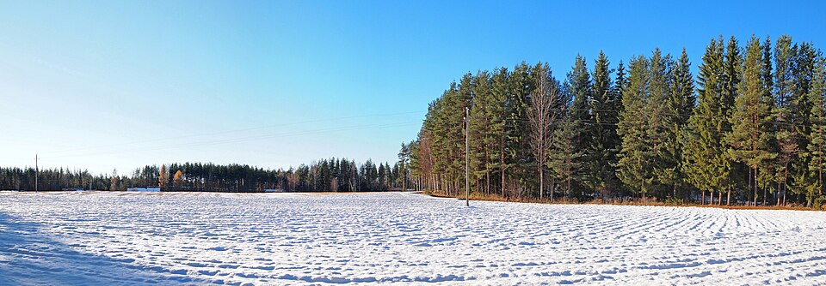
Notes:
When his parents met him at London’s Heathrow Airport he was overjoyed to see his mother again. But on the long motorway journey back to Birmingham under winter sky skies ,Donald was fascinated by mile after mile of white fields covered in snow which he had never seen or experienced before.

Slide 18
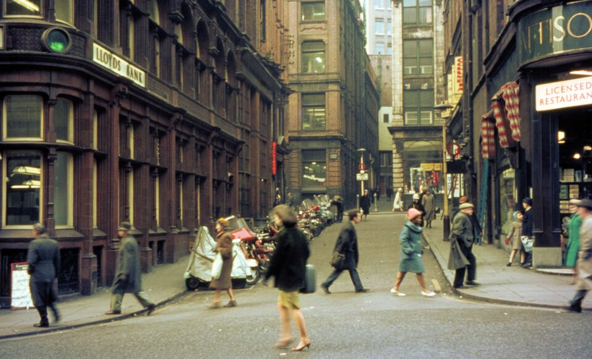
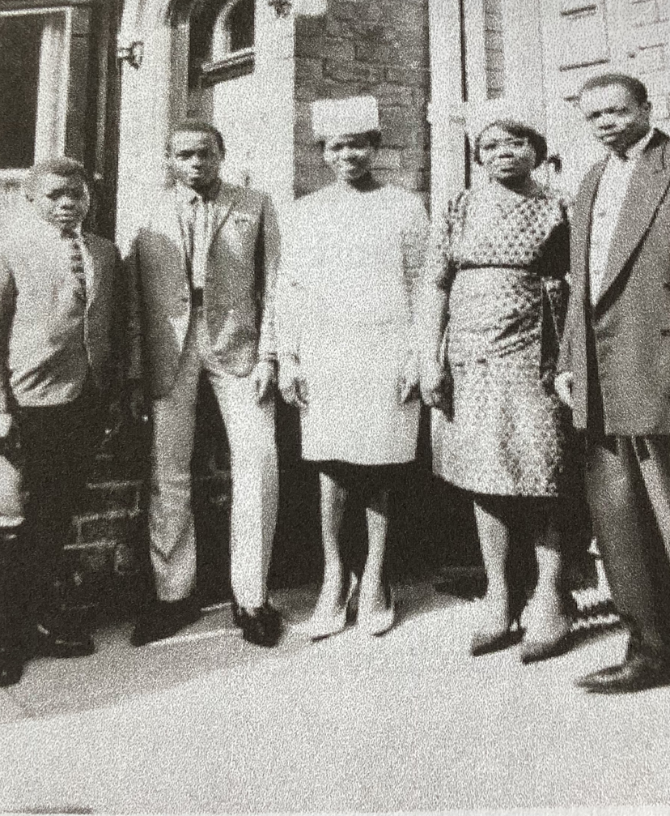
Donald`s family outside their Birmingham home. He is the boy on the left.
Birmingham in the 1960s
Notes:
Life in grey Birmingham, with its skyscrapers and streets sometimes smothered in smog from dirty chimneys was so different to the green Jamaican countryside. Instead of picking fruit from the trees you had to buy them in shops. Used to the tropical heat of home, Donald would leave doors wide open after he went through them. Annoyed Brummies would ask “were you born in a barn?” because he let out the heat on cold days. White neighbours might twitch their curtains as he passed (he only gradually learned that they did this because he was black). Once Donald went out to play in the snow in his slippers. He got chilblains as a result. He didn’t do that again.

Slide 19
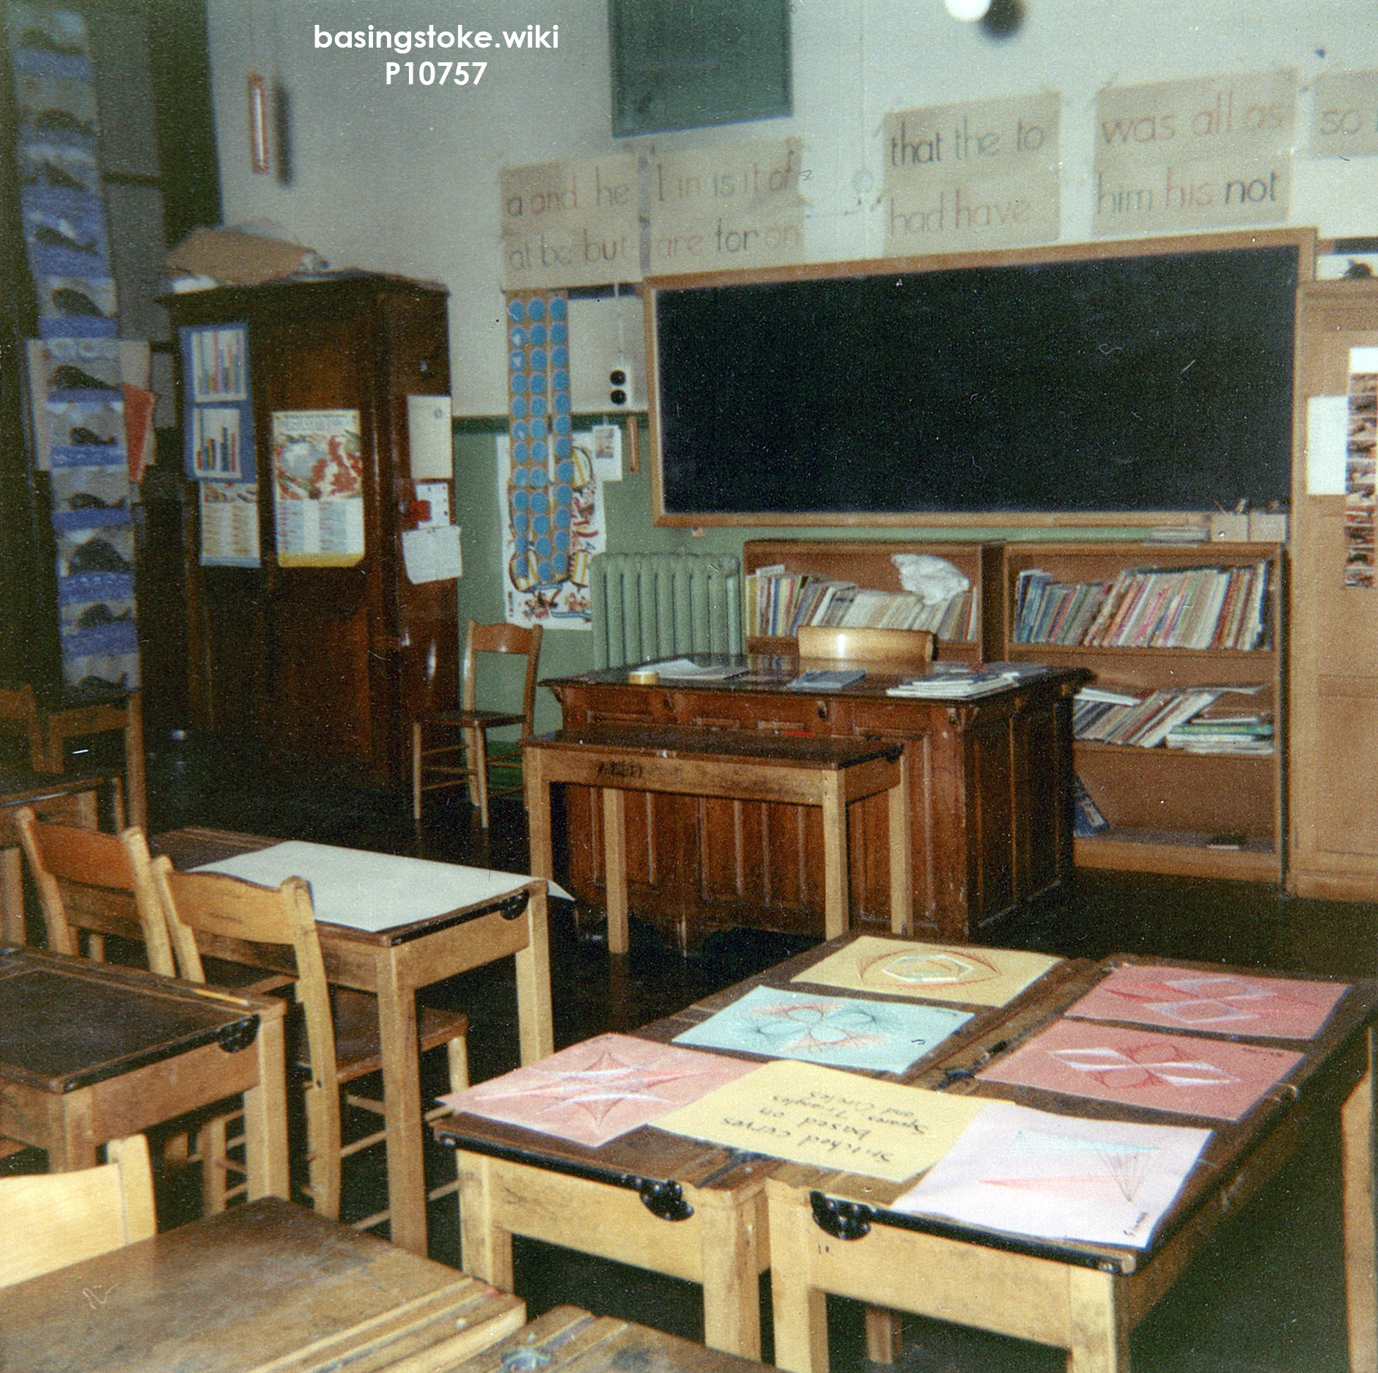
A 1960s classroom
Notes:
Donald’s parents sent him to the nearest school where he was put in a low set by his white teachers with other migrant children from Africa, the Caribbean and South Asian countries. Despite becoming the head boy of his class, Donald fell behind because his British education was poorer than his schooling in Jamaica. Most white teachers did not expect black pupils to be good at anything apart from sport.

Slide 20
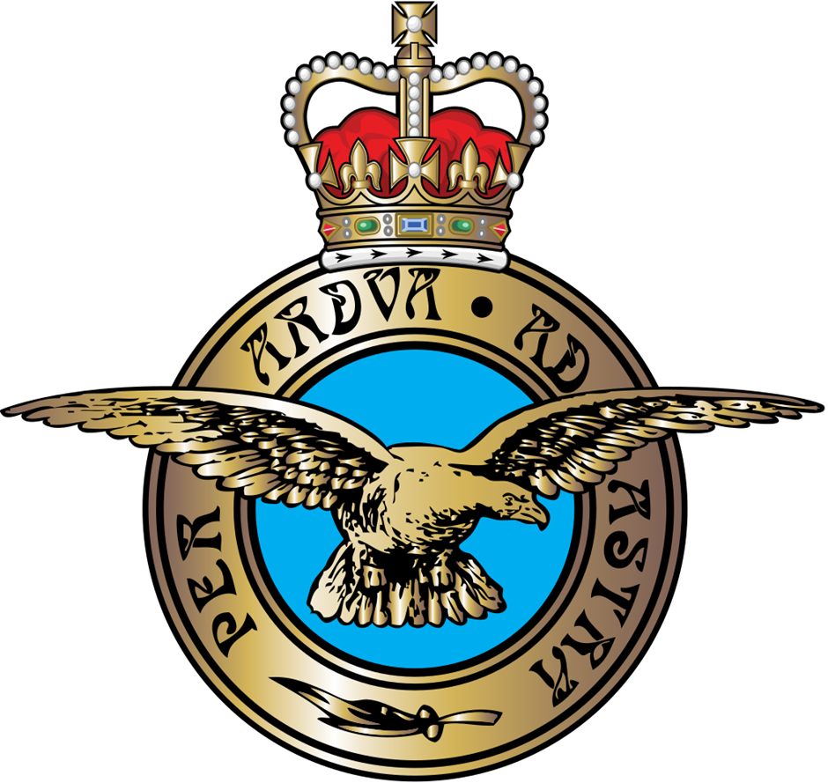
The Latin wording Per Adua Ad Astra means `Through adversity (struggle) to the stars`.
Notes:
Donald left school at 16 with no qualifications and did a couple of dull jobs before he joined the RAF two years later. He yearned to travel, not just in Britain but anywhere and the air force gave him those opportunities, meeting people he would never have met otherwise.

Slide 21

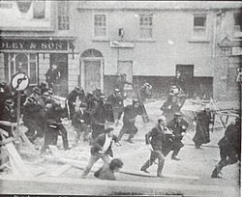
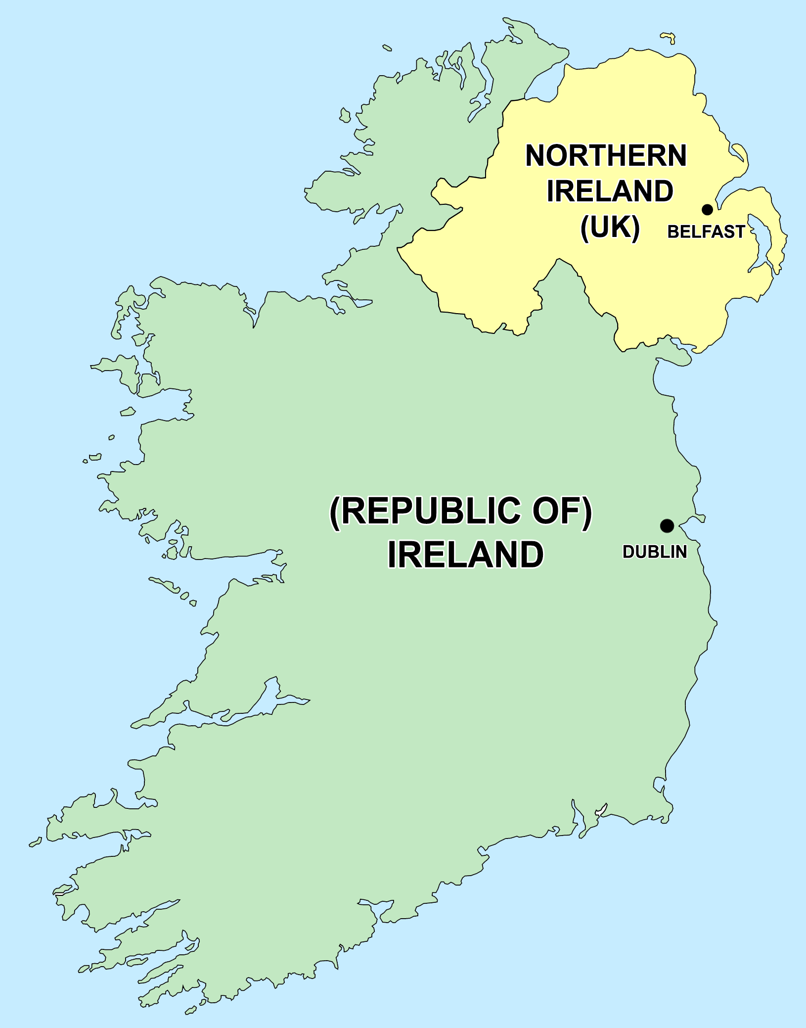
Riots in Northern Ireland
Notes:
In 1970 Donald did guard duty on a base in Northern Ireland, where British forces were trying to keep the peace between Catholics and Protestants there.

Slide 22
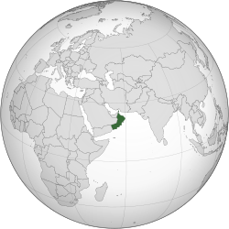
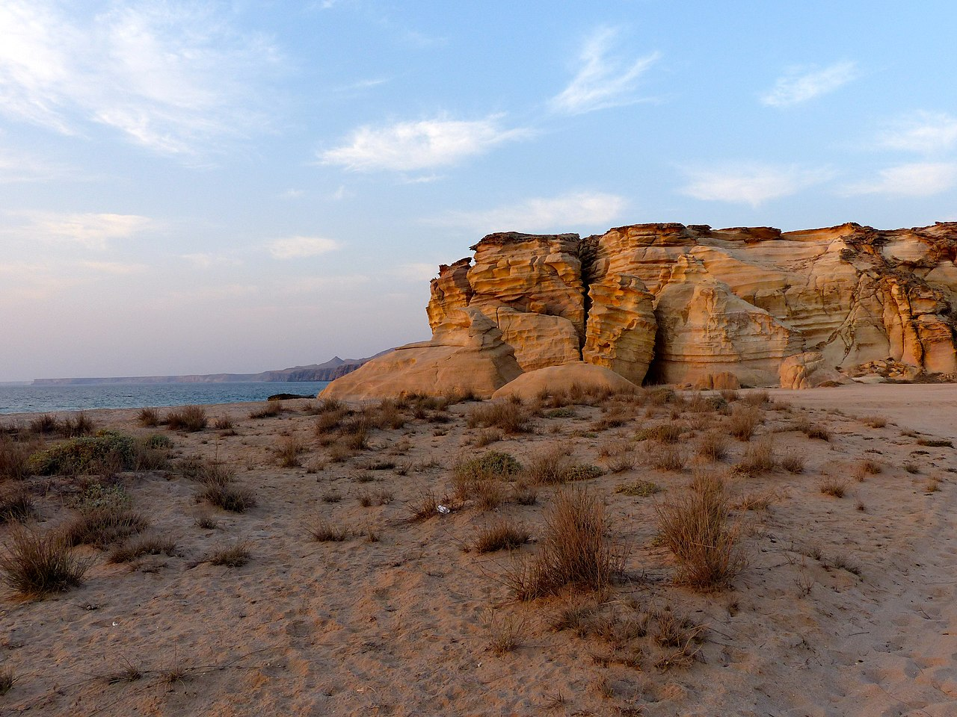
Oman
Notes:
He flew to an RAF base in the Arabian desert in Oman…

Slide 23
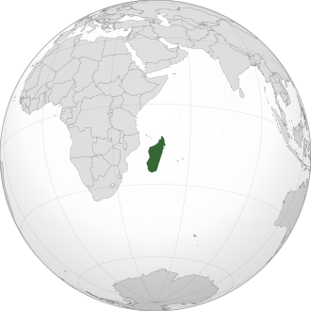
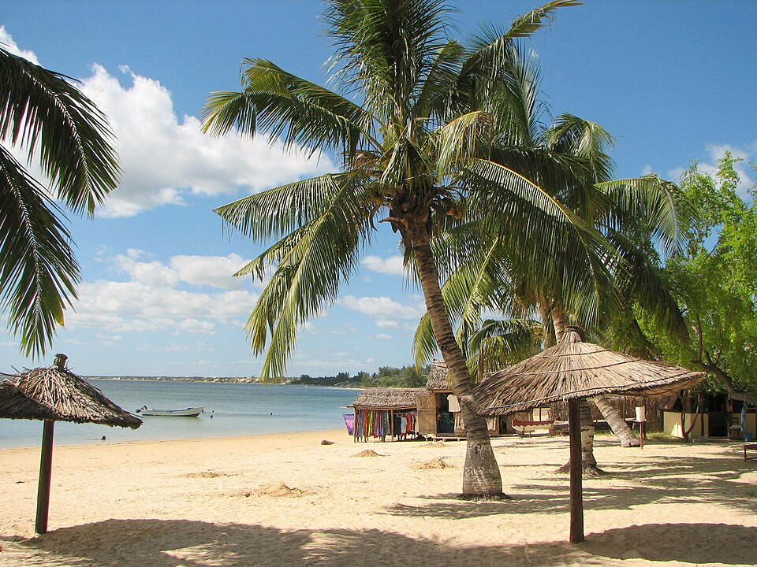
Madagascar
Notes:
…and talked to French-speaking black Africans on the beaches of Madagascar who looked like him but who couldn’t believe Donald was British.

Slide 24
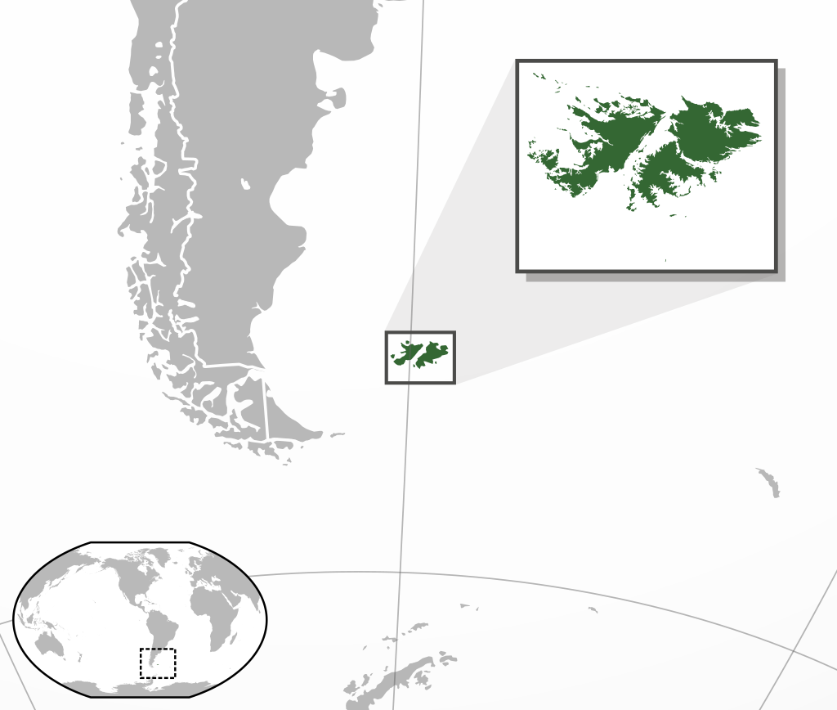

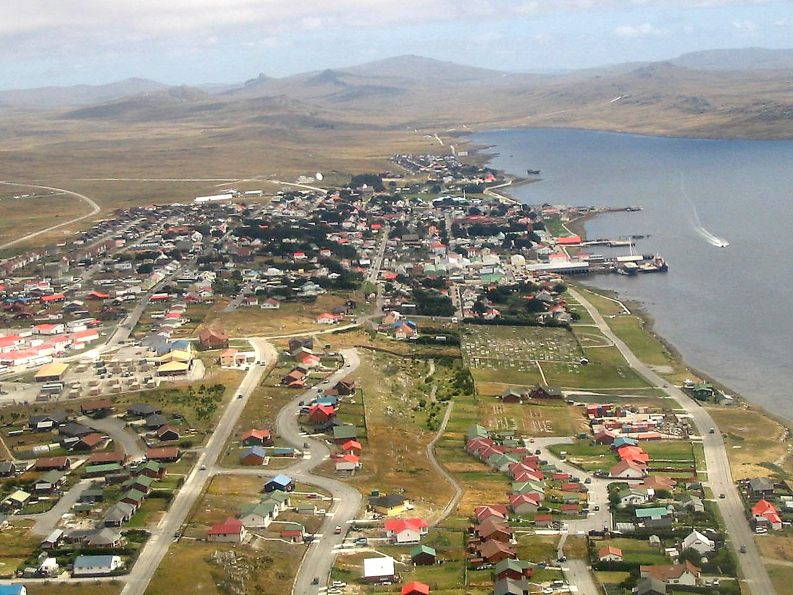
Falkland Islands
Notes:
Donald spent years on RAF bases in Germany and also visited the Falklands islands off the tip of South America where Britain fought an unexpected war against Argentina in 1982. It was hard for Donald and his family that he spent so much time away from home. His son would have headaches which went away when Donald returned to their house.

Slide 25
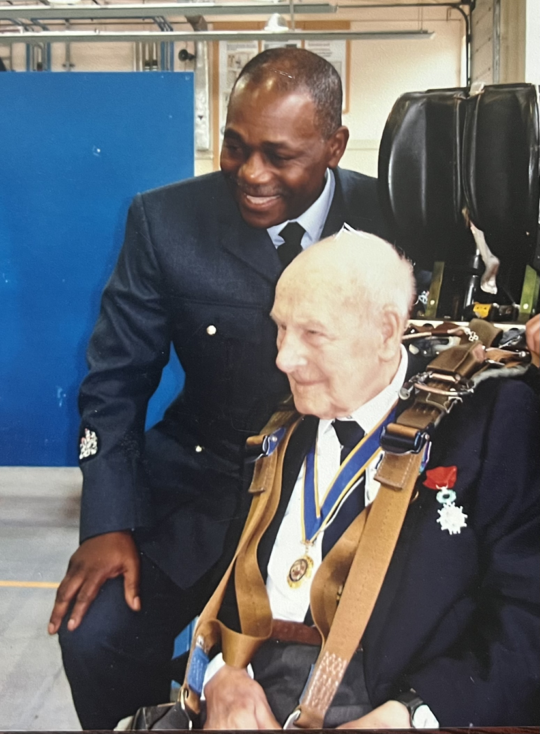
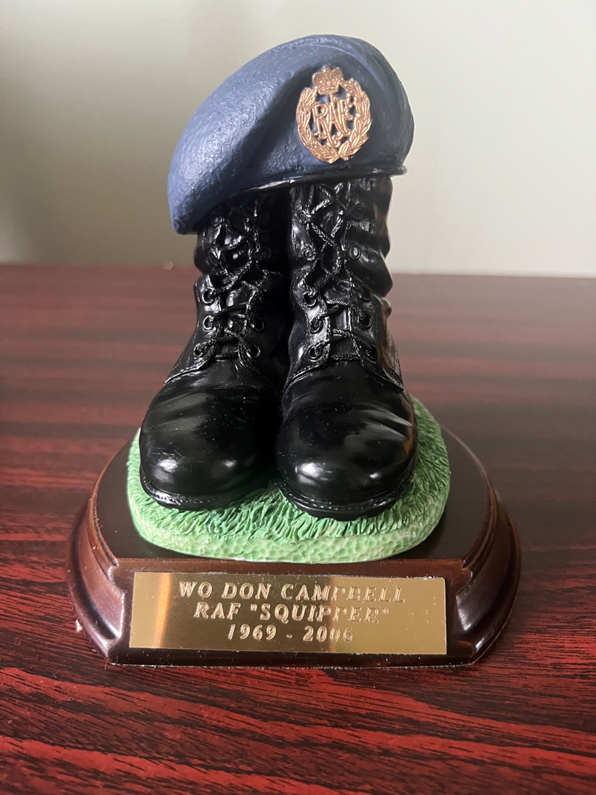
Harry Ellingham here.
Notes:
Eventually Donald was promoted so that he ran a training school for RAF staff at Cosford, near Birmingham. Before he retired in 2006, Donald was honoured to meet Harry Ellingham, one of the original founders of the RAF from the First World War. Donald was also given this souvenir of his RAF service between 1969 and 2006.

Slide 26

Notes:
Donald remembers the racist way he was sometimes treated in the air force (it took him longer to get promoted than white colleagues ). However, he is very proud to have served his Queen and Country and is grateful for the training and opportunities for travel it gave him. (For Donald the RAF was like going to learn at a university – the university of life!)

Slide 27


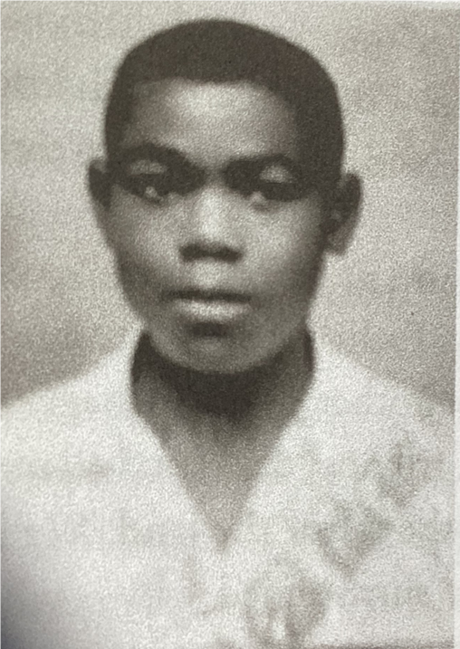

How did Donald Campbell become a Black Briton and Brummie?
Thanks to National Lottery players
Notes:
Over a long life, Donald has been transformed from being a Jamaican teenager to become a proud Black Brummie and Briton.

