Slide 1

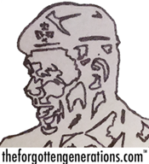
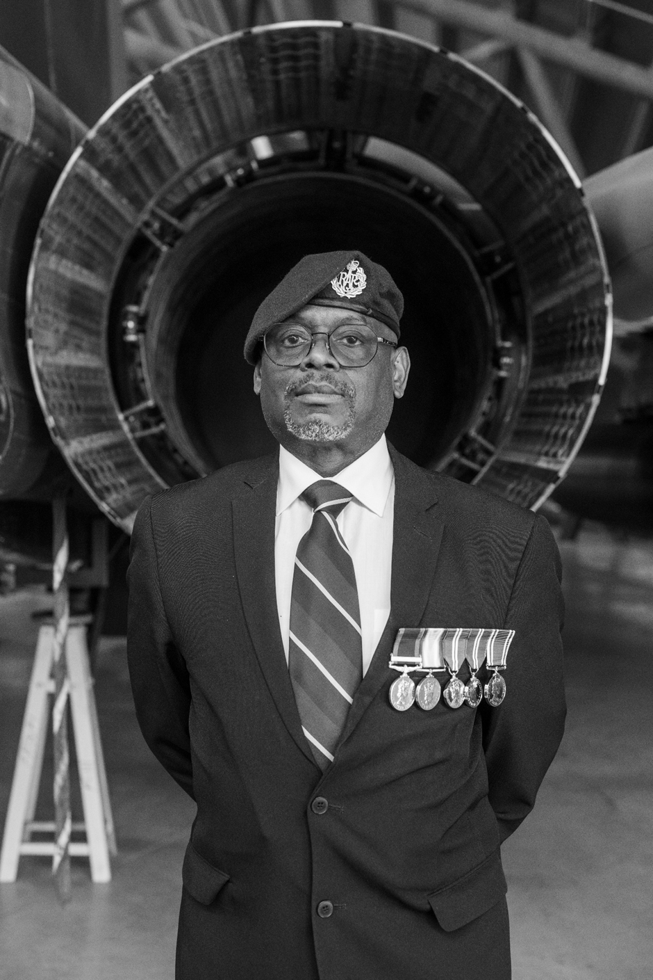
What made life difficult
for Jeff Nelson in the RAF?
Notes:
Jeff Dean Nelson was born in West Bromwich on 21st March 1963.

Slide 2

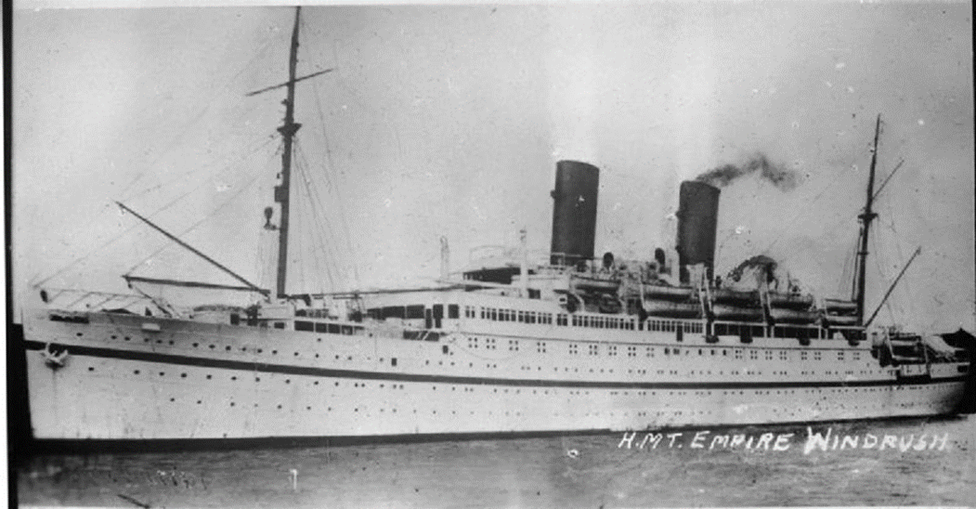
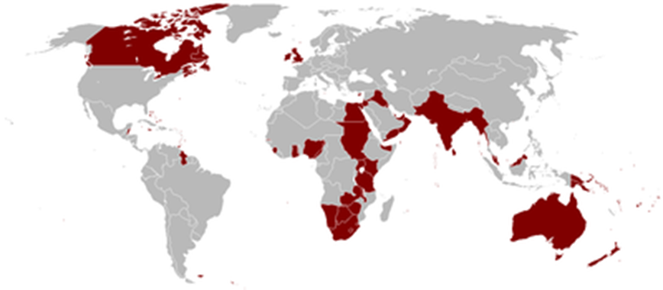
The flag of Jamaica when it was a colony of the British Empire
Notes:
Jeff`s parents migrated to Britain in the 1950s from Jamaica when it was still a colony of the British Empire. They were part of the Windrush Generation, helping to rebuild the country after German bombing during the Second World War.

Slide 3
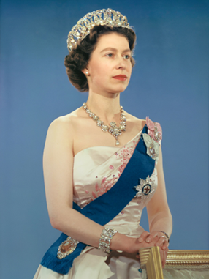




The Queen`s English
Jamaican Patois
Leave me alone
Let mi
Look at that
Coo Deh
Thank you
Tanks
Children
Pickney
Notes:
The family lived on an entirely white estate and was isolated from the black community. Jeff was strictly brought up and was taught to speak in the Queen’s English, not Jamaican patois (dialect). The Queen`s or King`s English is an old- fashioned term for the kind of English spoken by most upper and middle class people in Britain. At one time, for example all BBC presenters were expected to use it on radio and television. Jamaican patois is the language spoken by most ordinary Jamaicans. It includes words from Spanish (Spain was the first European country to rule Jamaica), English, African languages brought by enslaved Africans and some from the original Carib peoples who lived in the islands before the arrival of Europeans or Africans.

Slide 4
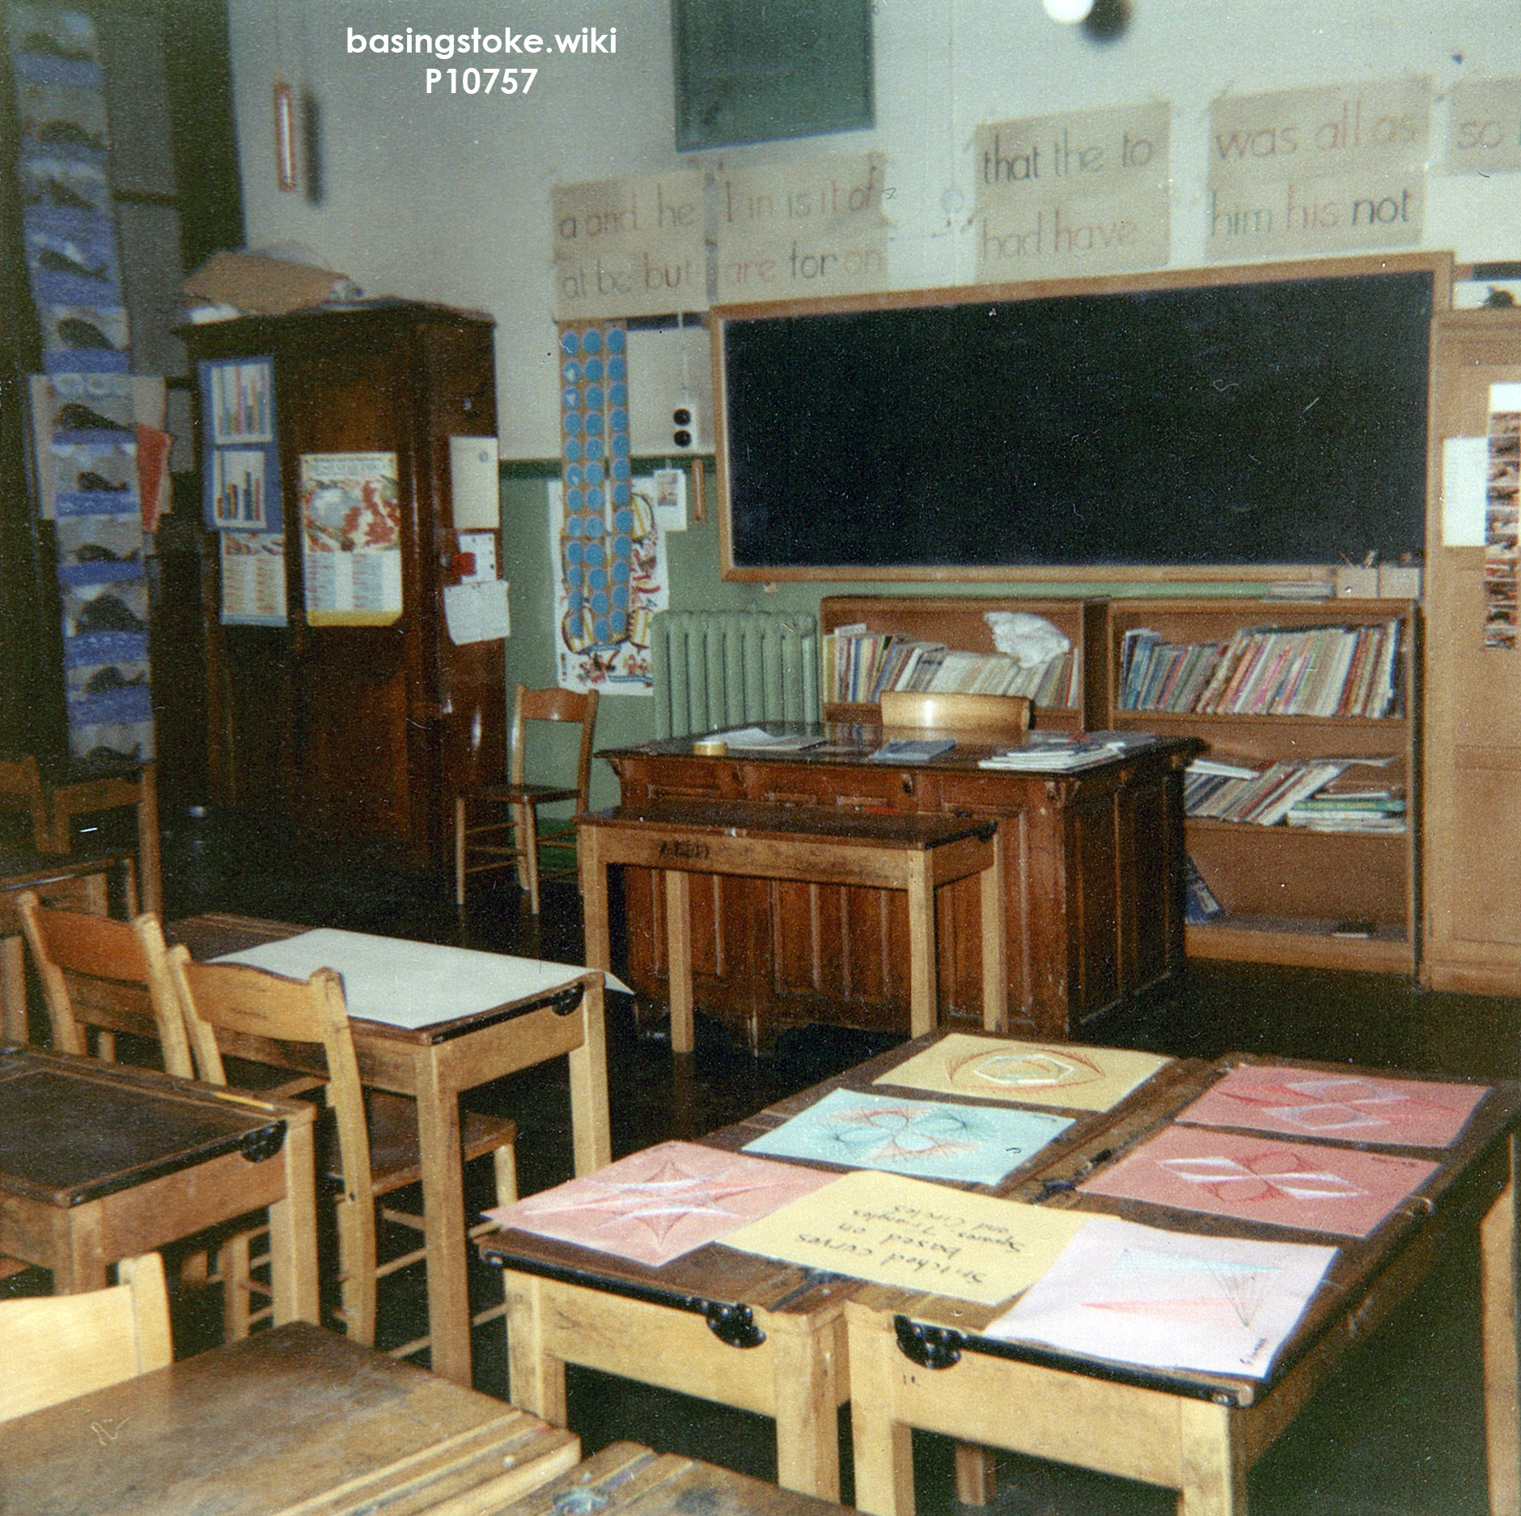
A 1960s classroom
Notes:
Jeff experienced harsh schooling, where white teachers expected little from him (they usually only thought that black children were good at sport).

Slide 5
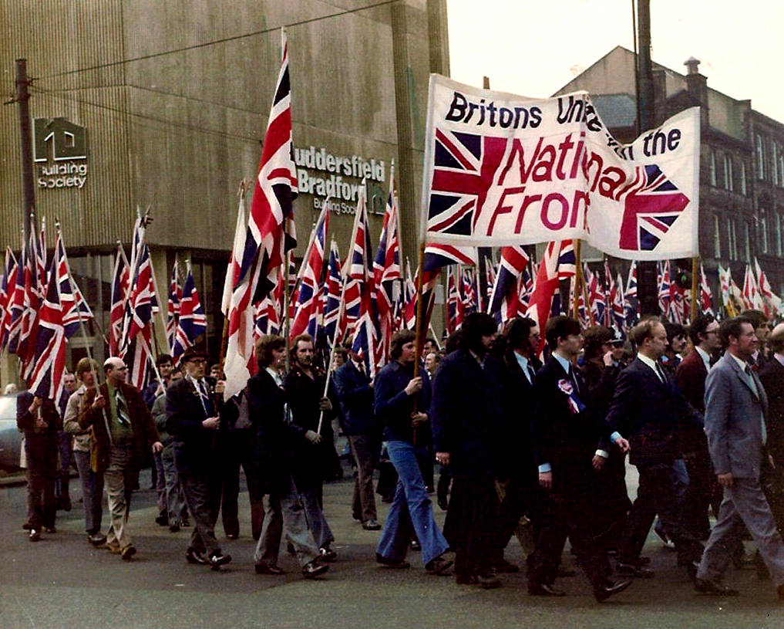
Notes:
As a boy growing up in the 1970s, Jeff was aware of the National Front, a party of white racists who wanted to offer £1000 to migrant families of colour to return to their original countries. To them, it was impossible to be black and British at the same time.

Slide 6
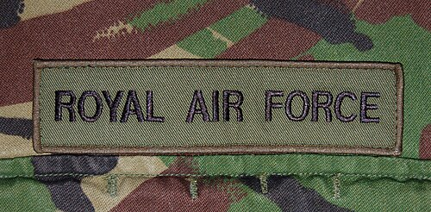
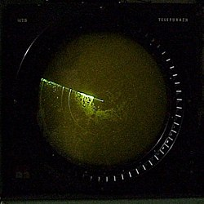
Notes:
At home Jeff was inspired by the knowledge of his father’s service in the RAF. He liked the look of the uniform and the idea of learning a trade. Jeff left home at 16 with no qualifications and was recruited to the air force in 1980 at 17 as an aerospace `systems` operator. This meant he learned how to use radar which can detect planes and aircraft on a screen.

Slide 7


Notes:
Jeff was one of only a few black recruits. He was bullied because of his skin colour and his short height. Despite this, Jeff learned a lot and played rugby for different RAF stations (bases). He really enjoyed sport.

Slide 8

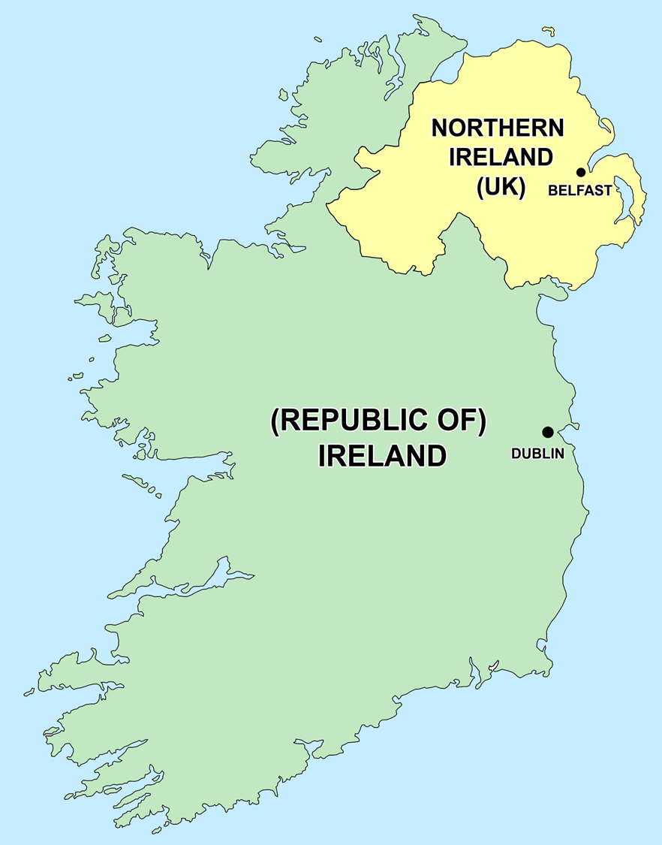

Notes:
Jeff was based in Northern Ireland between 1984 and 1986. During a rugby game there, playing against an army team, Jeff was violently shoved and a racist slur was used against him by a member of his own team. His head of department, an RAF officer was also on the same RAF team but did nothing to stop Jeff being treated this way. This treatment shocked Jeff.

Slide 9
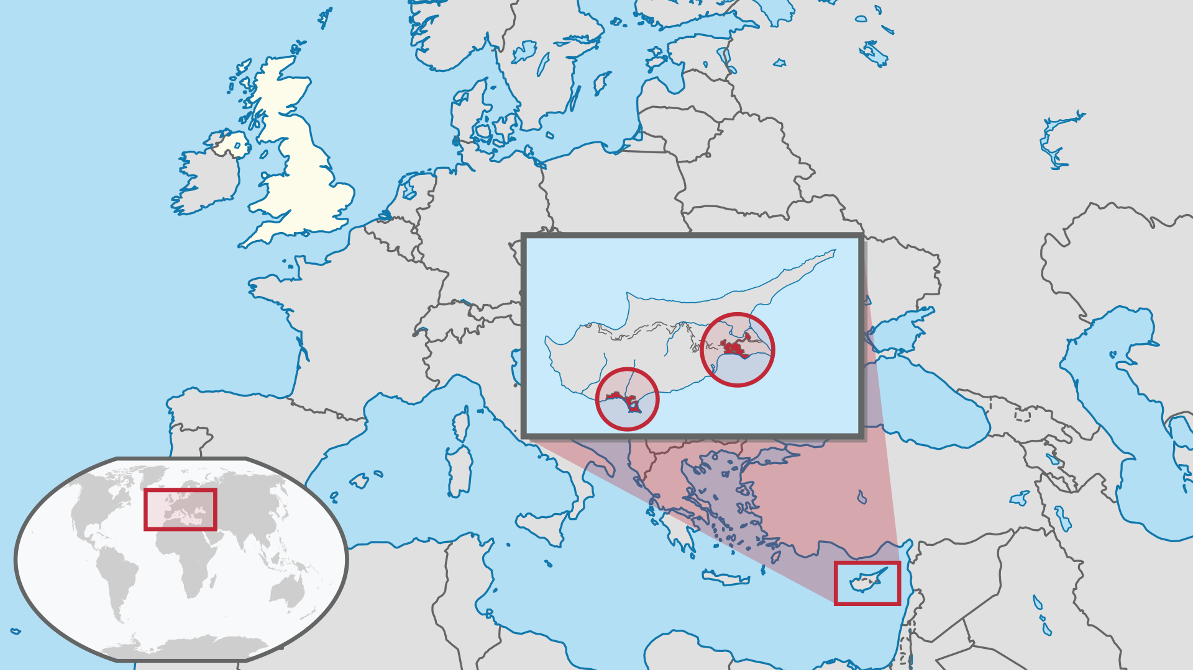


Britain
Akrotiri
Cyprus
Notes:
Between 1986 and 1989 Jeff served in the RAF at the British military base at Akrotiri in Cyprus, left over from the days of the British Empire when Britain ruled the island. Jeff was racially abused there too, as British military police looked on and did nothing. Jeff wondered whether he still had a future in the RAF.

Slide 10
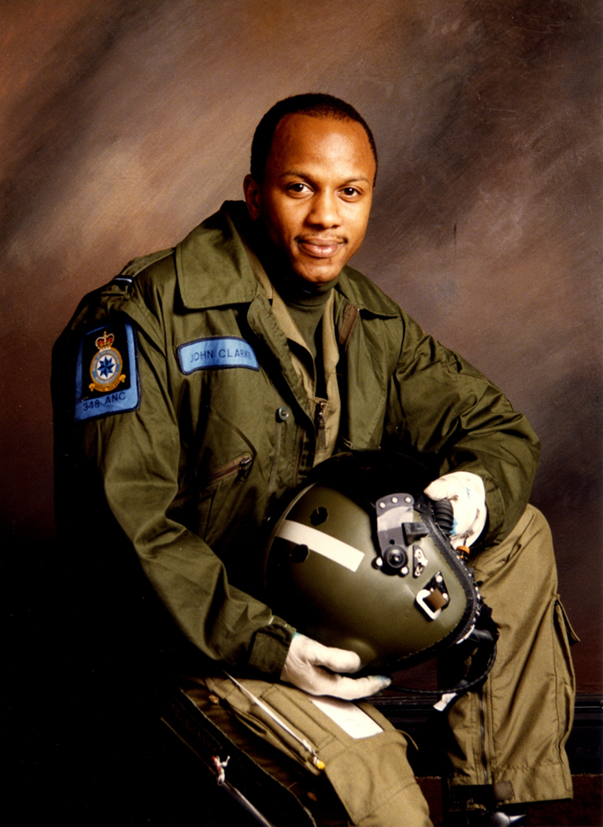
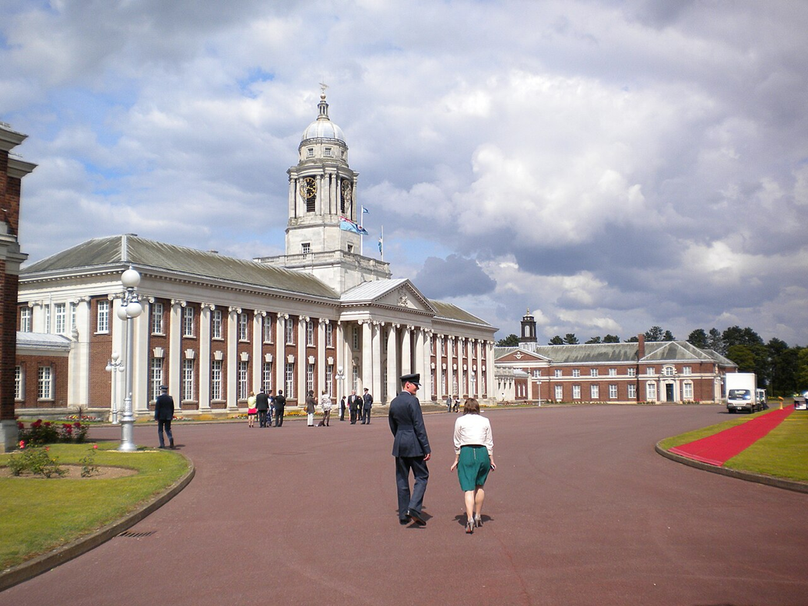
Cranwell College
John Winston Clarke
Notes:
Things seemed to change when Jeff met John Winston Clarke, a black recruit from a poor West Midlands family like himself. Unlike Jeff, John had gone to a good school and the RAF had spotted his talent when he joined up. They had helped him become an officer and train at RAF Cranwell, protecting him from racism. John saw the same potential for promotion in Jeff. Although Jeff was only a `Senior Aircraftsman` at the time, his friend John encouraged him to apply to become an officer like him. Jeff took extra qualifications and nearly got into Cranwell in 1993 but was on the borderline. He decided to apply again. Then he found out through his supervisor that the reason his assessors failed him as a borderline case was because of his colour. They even wrote this reason down as `skin pigmentation` (skin colour) on his form. The same air force that helped John to succeed in his career, failed Jeff.

Slide 11

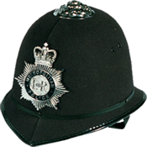
Notes:
Jeff retrained as a local policeman. White police trainers encouraged Jeff to stand up to racism amongst his colleagues. If Jeff came across racist behaviour and language, he directly challenged it. He had a happy career fighting crime and protecting people.

Slide 12



What made life difficult
for Jeff Nelson in the RAF?
Notes:
Despite his experiences, Jeff says his service in the RAF taught him resilience and gave him a determination to get an education and improve his qualifications.

