Slide 1

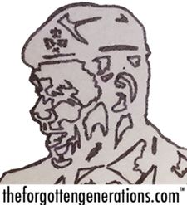
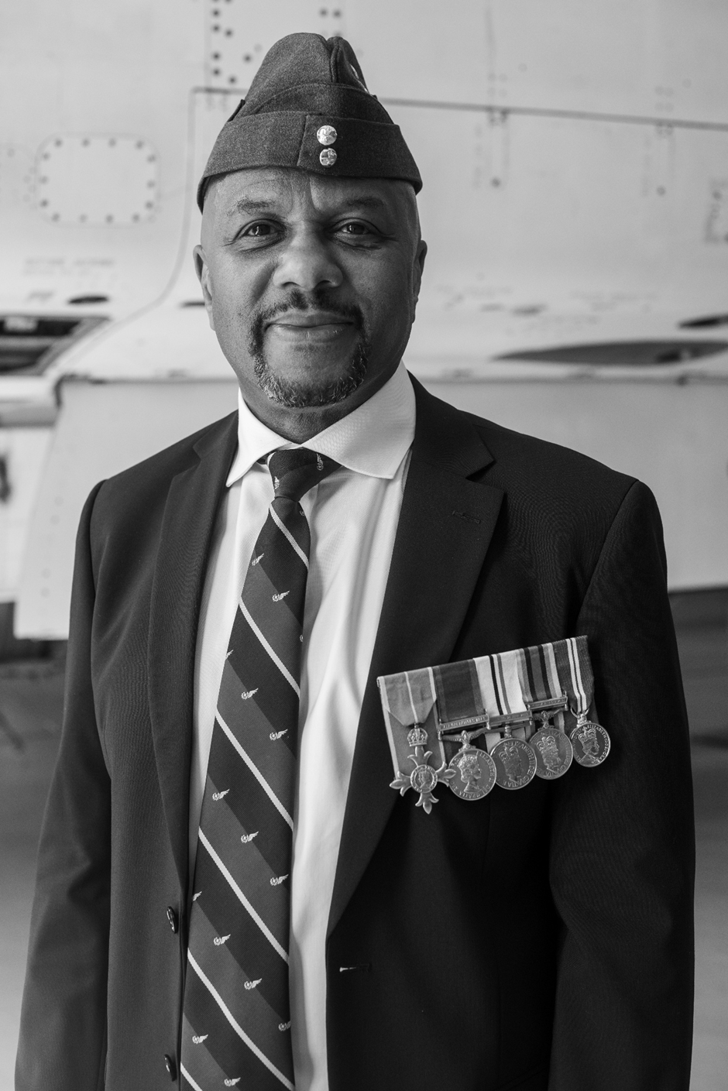
Why was John Winston Clarke
successful in the RAF?
Notes:
John was born in Smethwick, Birmingham in May 1963. He was the youngest of five brothers and sisters.

Slide 2
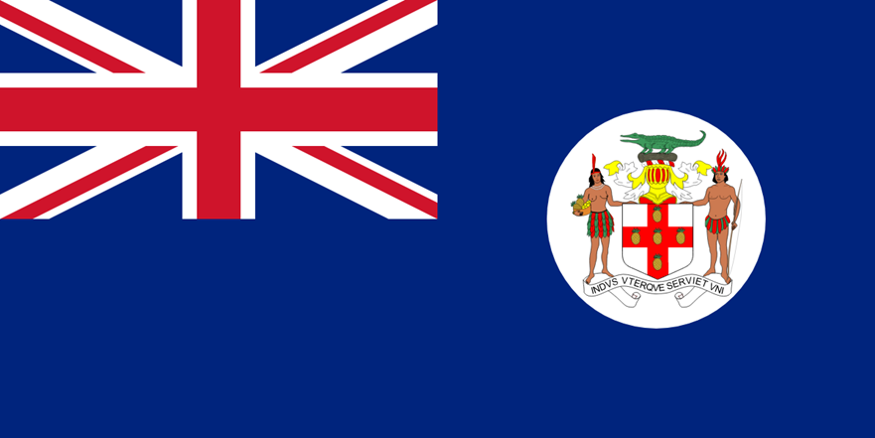
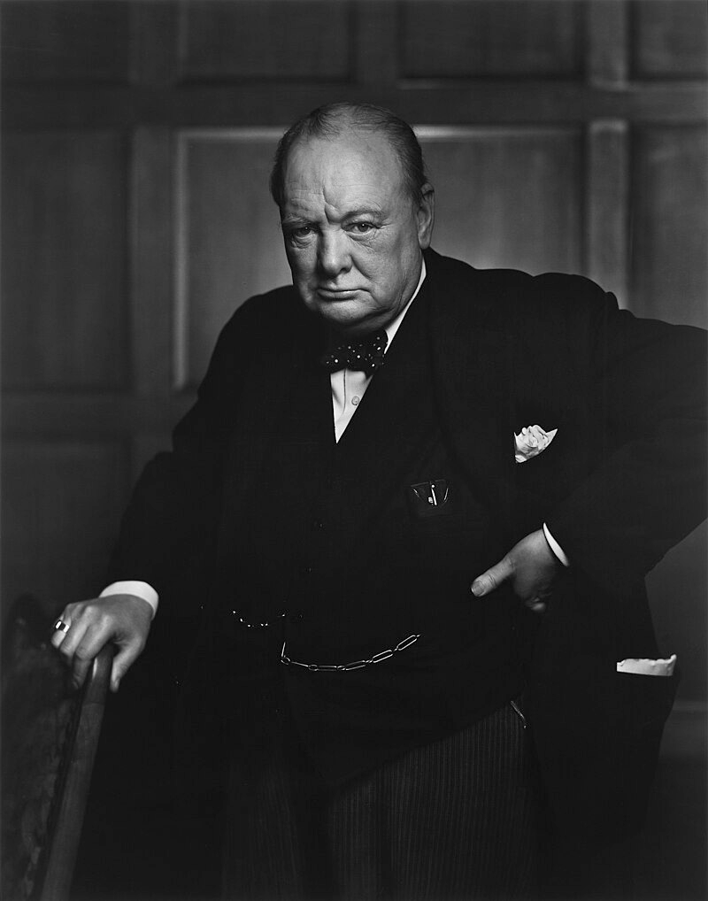
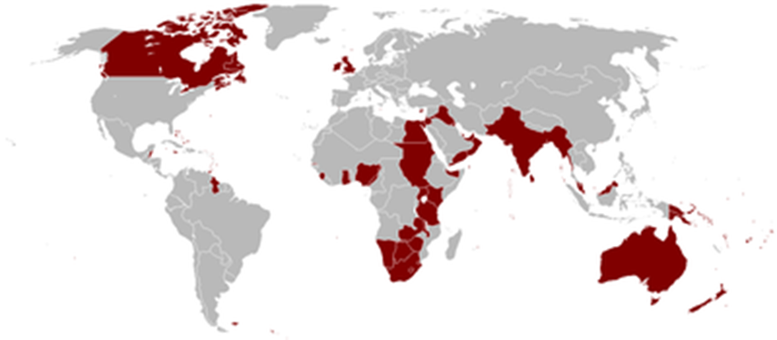
The flag of Jamaica when it was a colony of the British Empire
Notes:
His parents came from Jamaica when it was still a colony of the British Empire. John`s middle name of Winston was from Sir Winston Churchill who was prime minister during the Second World War.

Slide 3
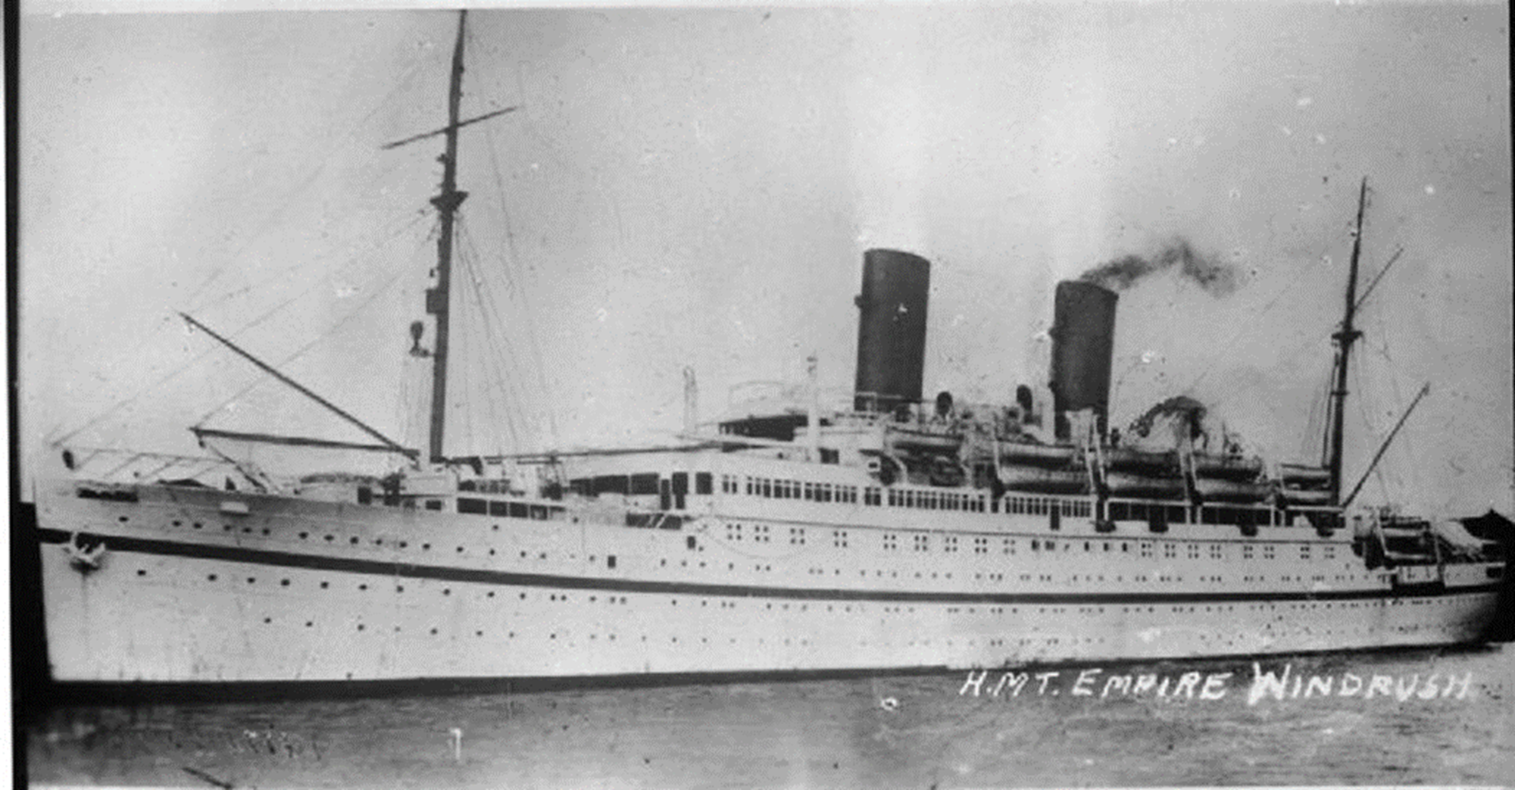
Notes:
John`s parents were part of the Windrush Generation who migrated to Britain to help rebuild the country after the Second World War. Unfortunately, John`s father died when he was only one year old. His mother had to look after the family on her own on the pay she got from working at Cadburys.

Slide 4
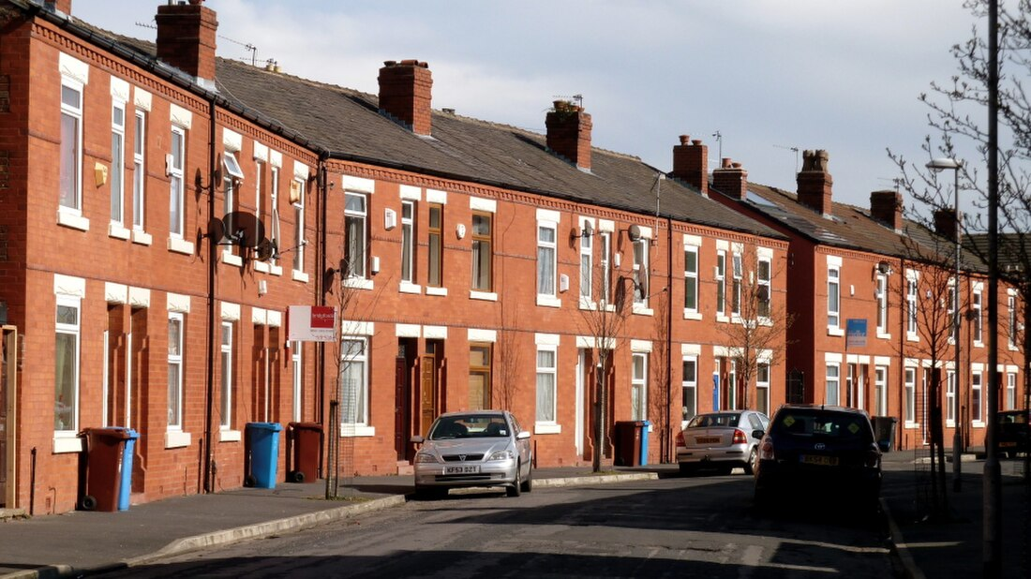
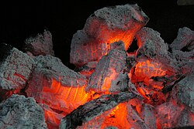
Notes:
The family lived in a small and cramped terraced house like this one. It was heated by coal fires and gas paraffin heaters, with a bath only once a week because it was difficult and expensive to heat water.

Slide 5
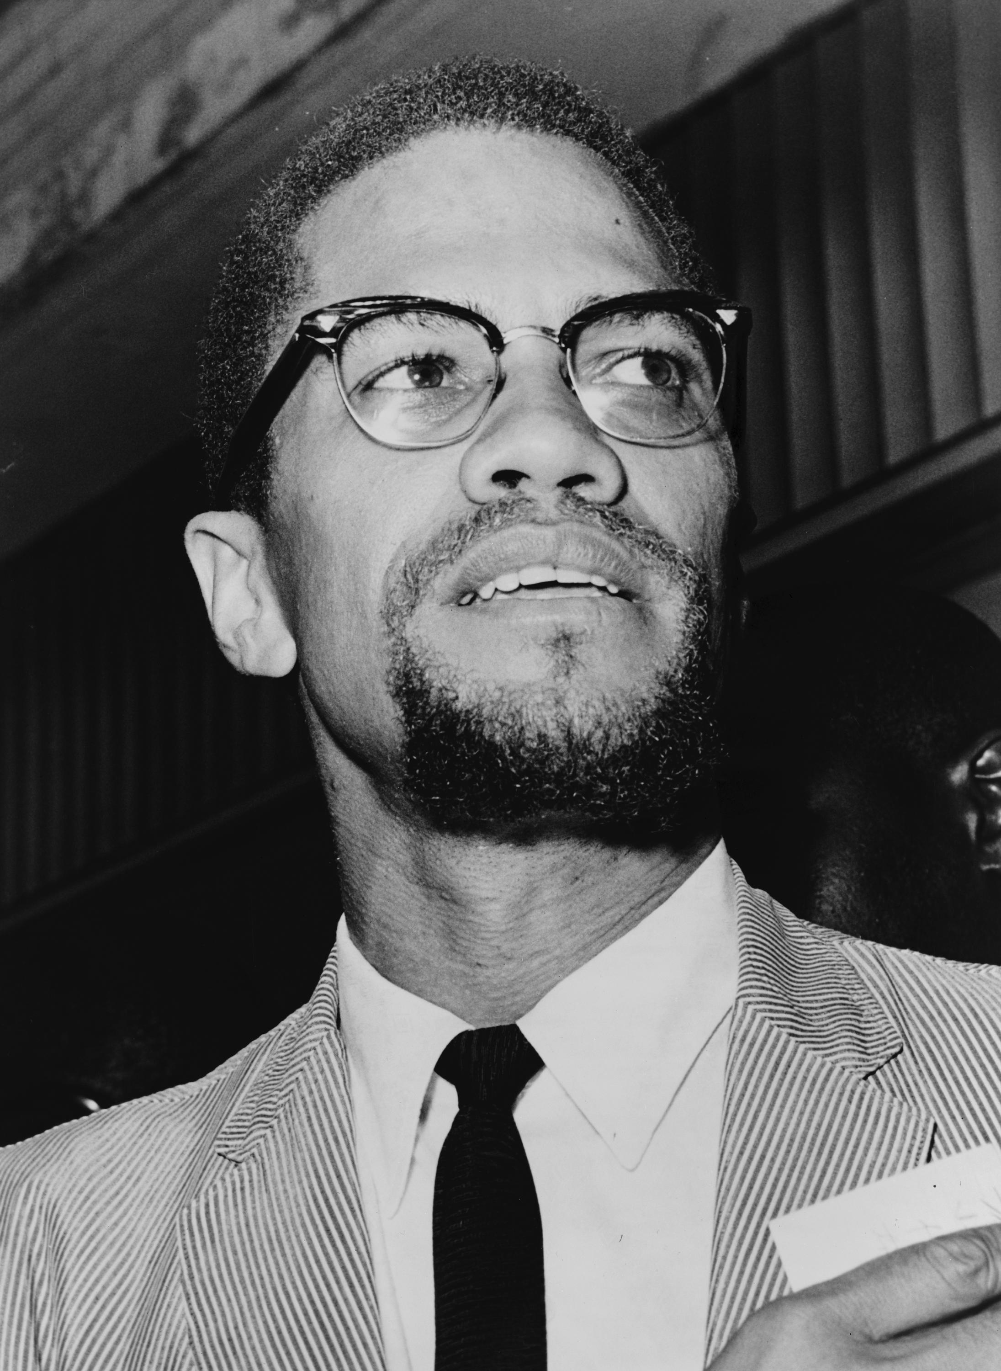
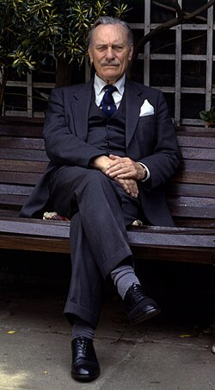
No Blacks
No Dogs
No Irish
Malcom X
Enoch Powell
Notes:
As a child John was aware of racism in the area. In the February of 1963, the year of his birth, the famous African-American civil rights leader, Malcom X visited Marshall Street nearby where some white families wanted to stop black families moving into local council houses. When John was four in April 1968 Wolverhampton MP Enoch Powell claimed in a racist speech that Britain would become a violent place if the government didn`t stop black and brown migrants coming to the UK. Until 1965 it was legal to bar people of colour from places like pubs and dance halls. You could still get racist notices in the windows of Birmingham houses with rooms to let. No Blacks, No dogs, No Irish they warned.

Slide 6



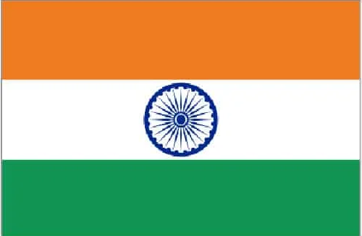


Notes:
However, where John lived in Smethwick there was a happy mix of neighbours originally from Asia, Scotland, Africa, Ireland and Jamaica. Everyone got on together as a community.

Slide 7
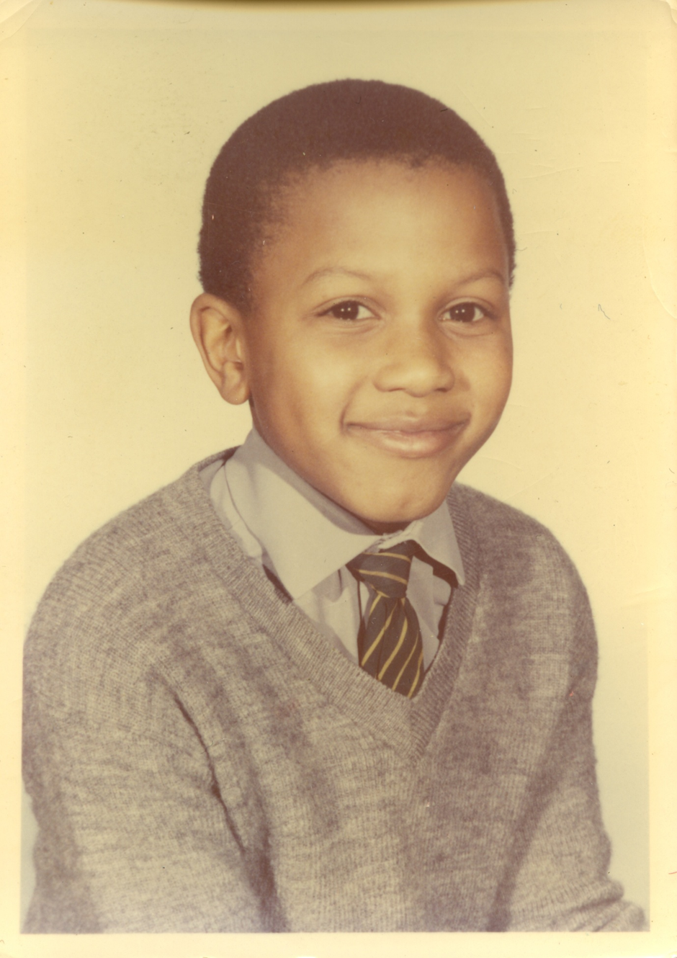
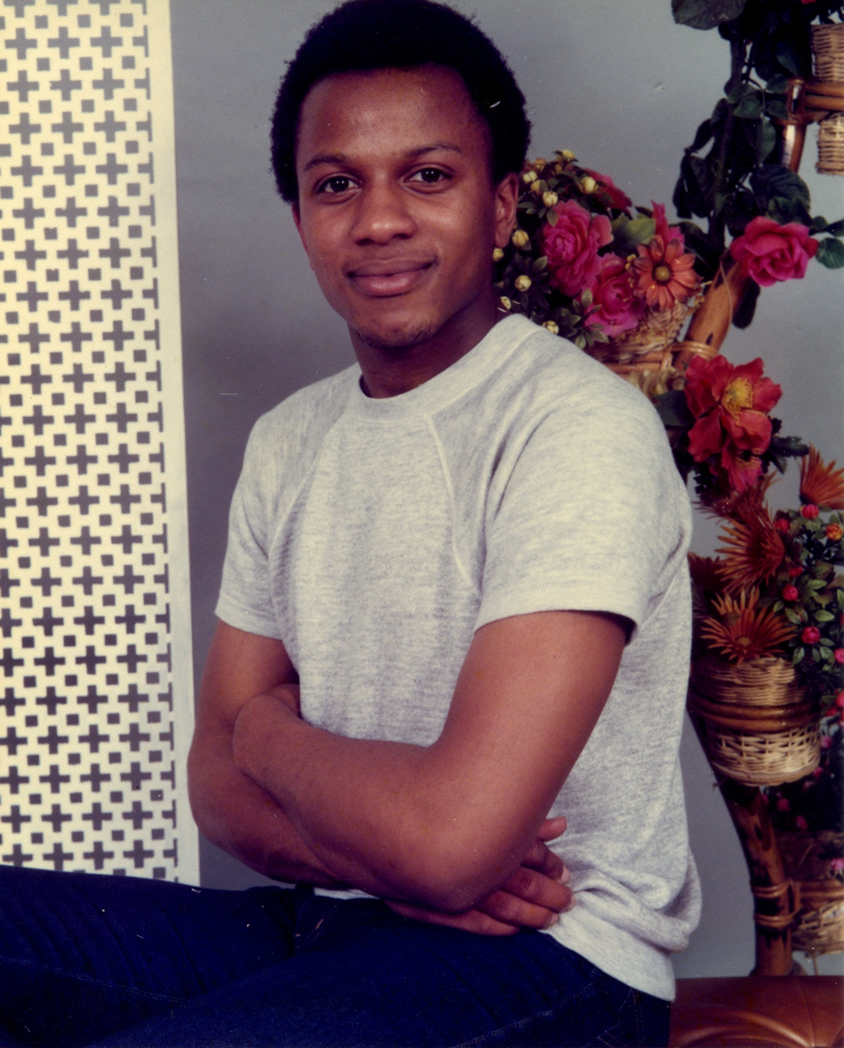
John when he was eleven in 1974 as he started secondary school.
John in 1980 when he was at Rowley Regis Sixth Form College
Notes:
John went to Waterloo Road Primary School and afterwards Shireland High School, Smethwick in 1974. This was the year that Shireland became a comprehensive school. This meant that the school took all pupils from the area, regardless of their ability. Before then local children set an exam called the 11+. Children who passed the exam, went to the grammar school and they usually did well at exams and had a better chance of getting well-paid jobs or going onto university. Children who failed the 11+ went to a different kind of school, called a secondary modern. Children who went there usually did less well at exams, got poorer paid jobs and usually didn’t go onto University. Some black pupils at this time were stopped from going to grammar schools even though they had passed the 11+. John did very well at school and was moved up a year group. If he had been a year younger, John might not have gone to grammar school, even though he had passed the 11+. If he had gone to a different school, teachers might have thought he could only be ever good at sport (many white teachers treated black pupils elsewhere like this). He might not have been taught well or moved up a year.
The headmaster of Shirelands was strict but fair and this helped John do well too. Next John did A-levels at Rowley Regis Sixth Form College.

Slide 8

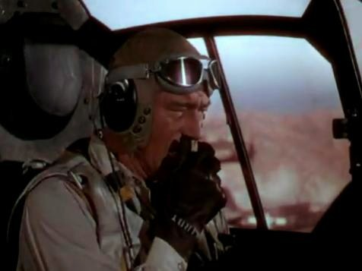
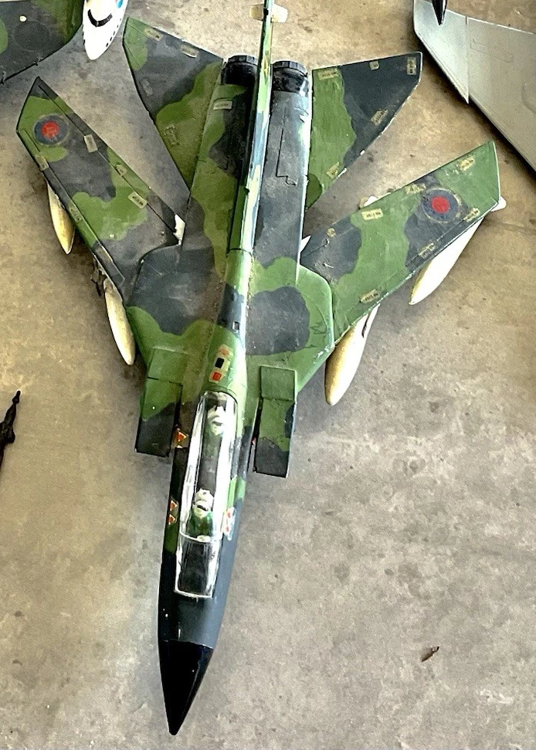
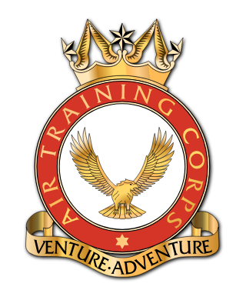
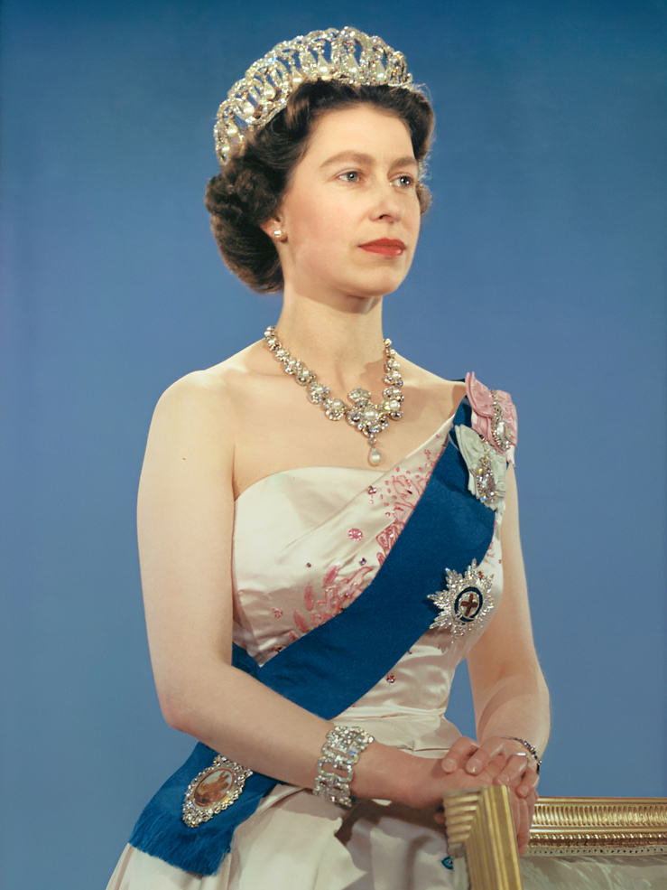
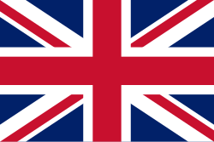
Notes:
At home John became fascinated with planes. He loved to watch an American film called the Dry Leathernecks where air force pilots lead by film star John Wayne came to the rescue of the army and navy. He watched films on television which showed the RAF as heroes of the Second World War, respected around the world. John made model aircrafts from kits. He became an Air Cadet which is a bit like scouts but for children who might be interested in joining the Royal Air Force when they are older. John fell in love with the idea of flying a plane. He had also been brought up to respect Queen Elizabeth the Second and want to serve his country. John had a clear idea that he would try to join the air force as an officer when he grew up.

Slide 9
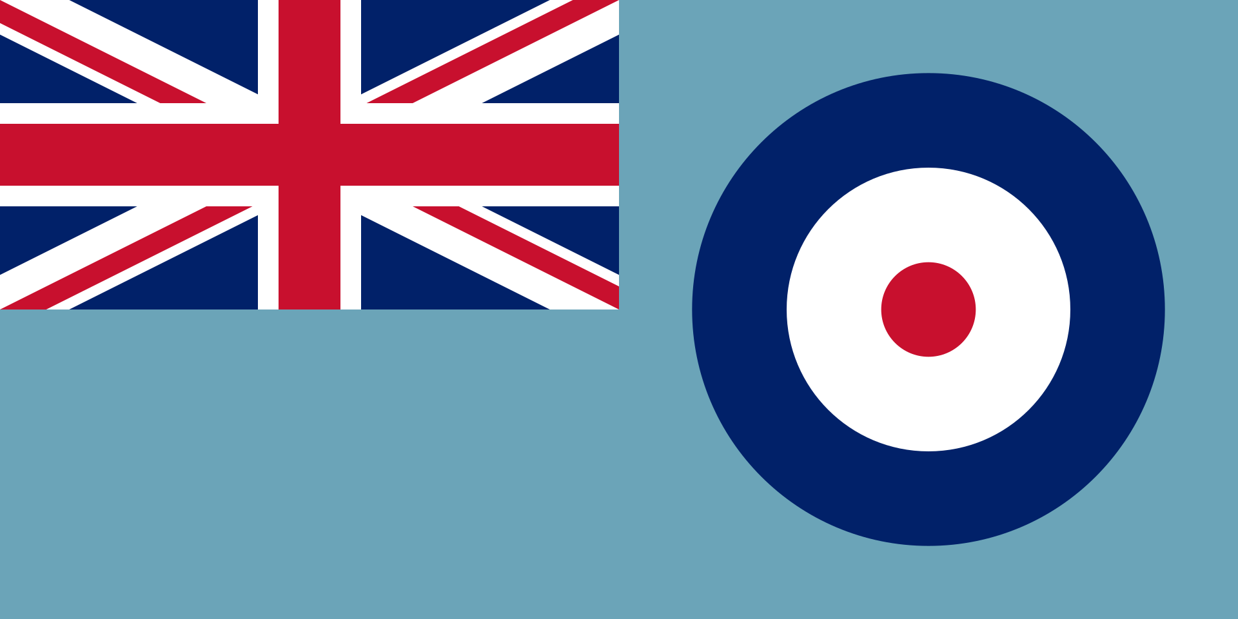
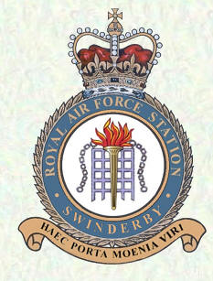
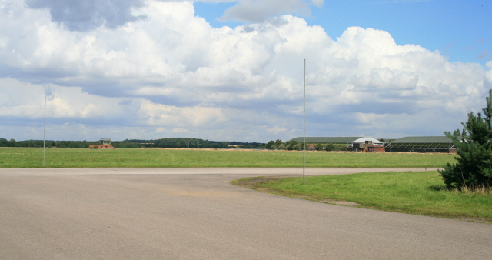
Notes:
As John left school he still wanted to be an RAF officer flying planes. However when he joined up, the RAF didn’t think he was quite ready yet to be trained as an officer at RAF Cranwell. But John was clever, ambitious and eager to learn. So, the RAF didn’t turn him down. They suggested that John train as an ordinary airman first at RAF Swinderby before trying to become an officer. That way he would get to meet RAF officers for himself, get to understand what they were like and watch what they did. Right from the start a white trainer also told white recruits in John`s class that they must treat John with respect. This meant that the RAF protected him from racism from the start of his career. That didn`t happen to all black recruits!

Slide 10
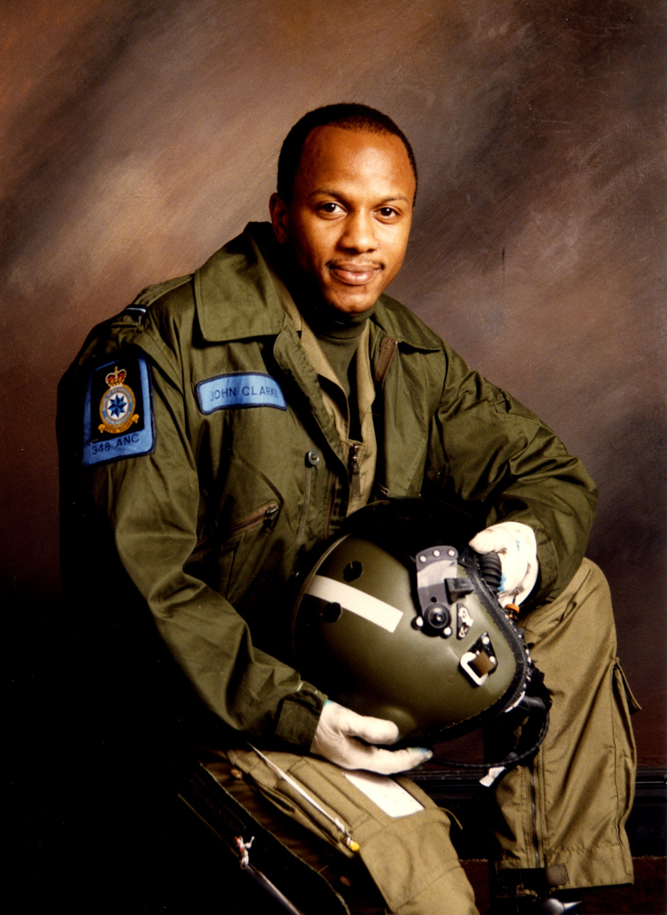
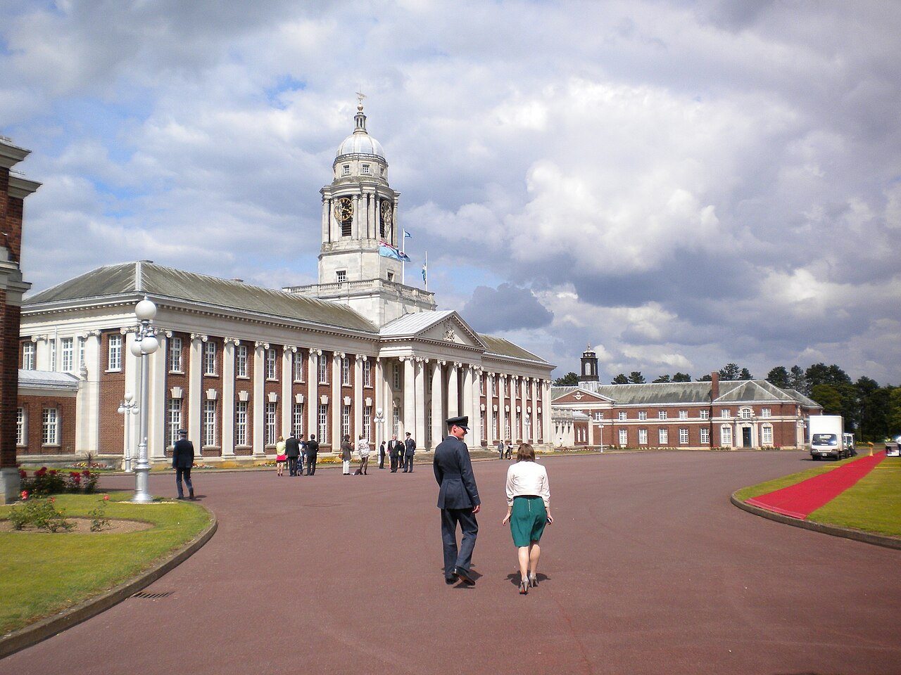
John in 1988
Notes:
After 4 years as an airman, John went to train as an officer at RAF Cranwell and qualified as a navigator in 1986. This meant that he was in charge of keeping the planes he flew in on the right route and travelling safely at the right height and speed, in the day or at night. It is a very skilled job. The RAF had been right about John`s potential! Also, he always felt protected from racism by his fellow officers throughout his career.

Slide 11
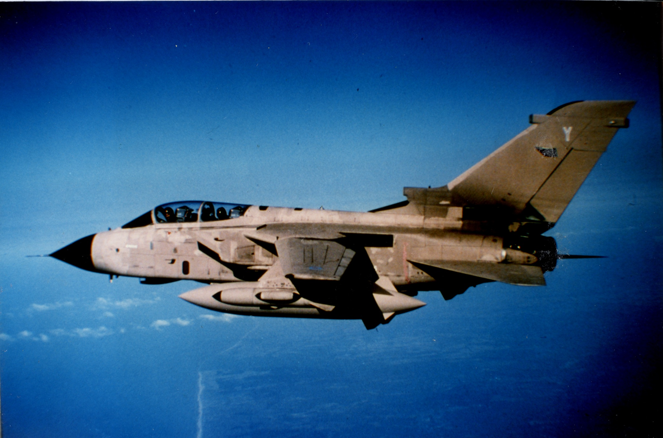
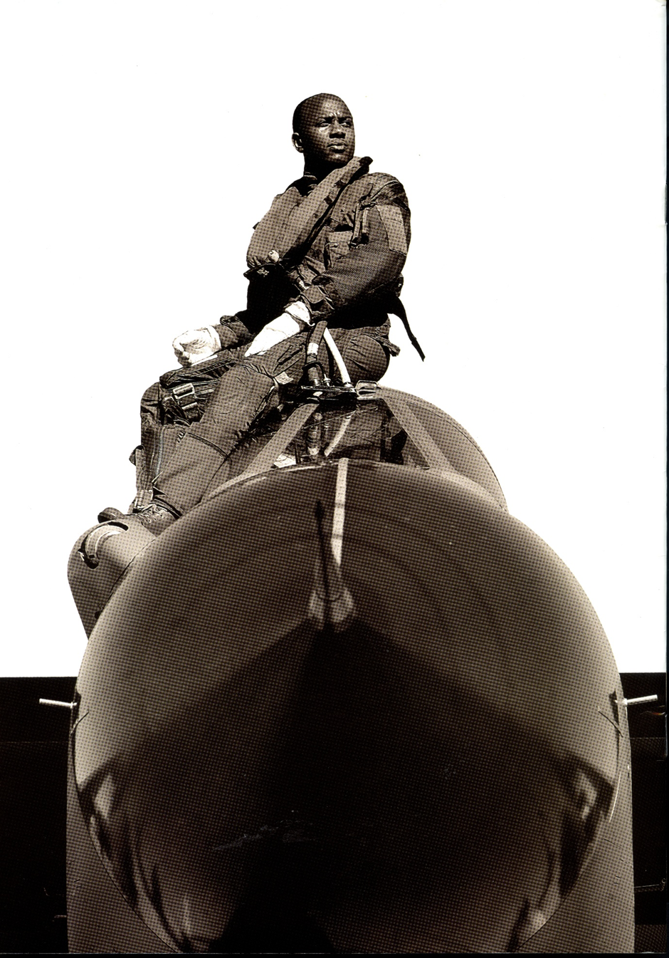
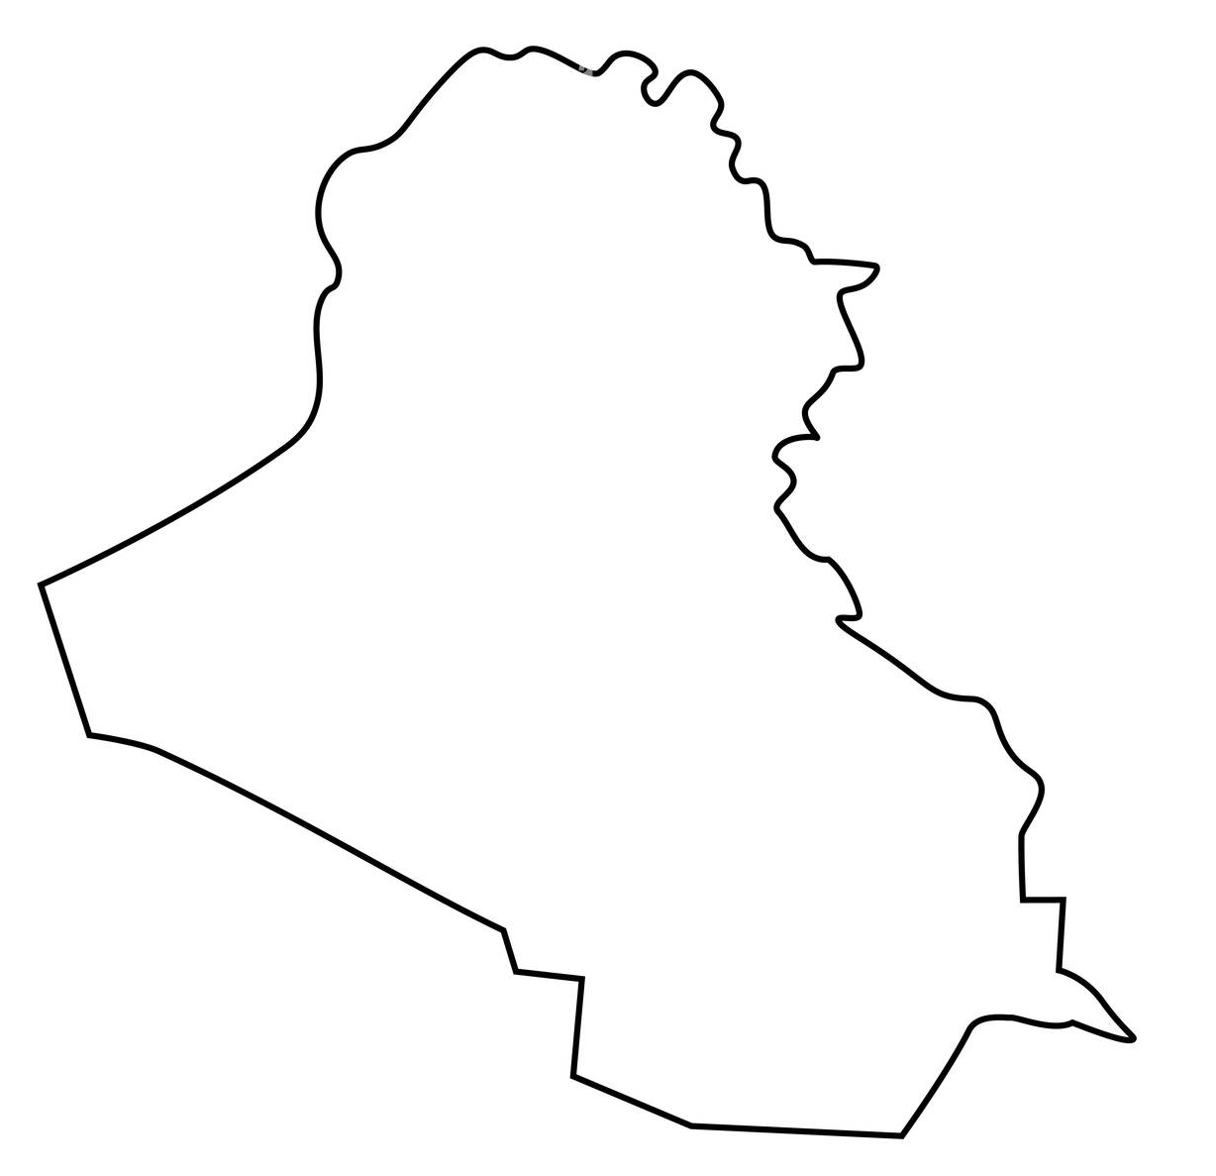

Northern No Fly Zone
Iraq
Southern No Fly Zone
Notes:
John was stationed at RAF bases in Britain and Germany flying Tornado aircraft. He said at the time in an interview “I was the first black guy on the squadron and yes, I felt I had something to prove” Between 1995 and 1998 there were times John flew in Tornado jets which patrolled the skies in the No Fly zones above Northern and Southern Iraq, stopping the air force planes of the country`s cruel dictator, Sadam Hussein from attacking rebels and ordinary Iraqis who opposed him.

Slide 12
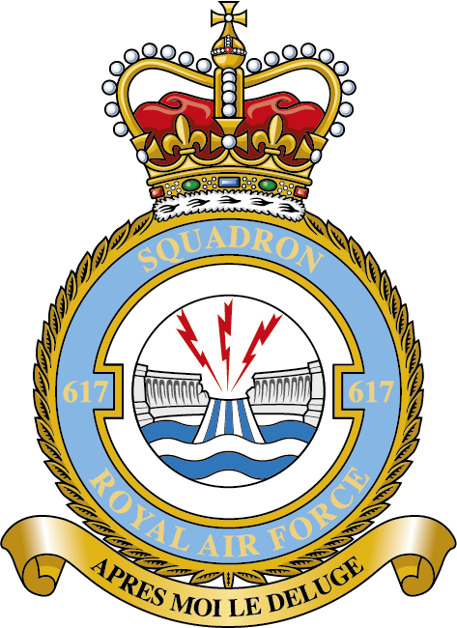
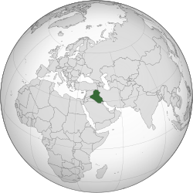

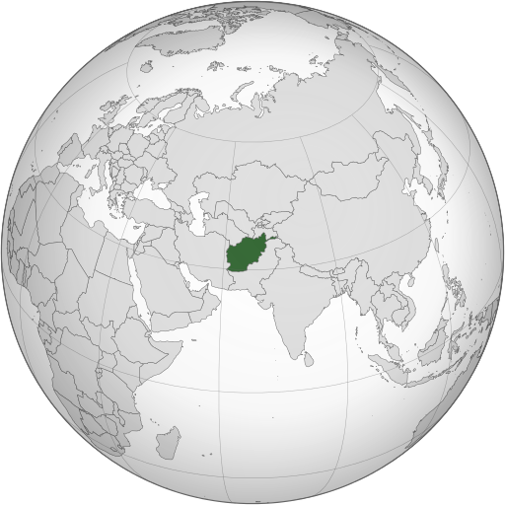

Iraq
Afghanistan
Notes:
Between 2002 and 2004 John was a member of No 617 Squadron , known as The Dambusters who were famous for bombing German dams during the Second World War. Members of the squadron, including John are very proud of this history. It was like John was now part of something he watched in war films on television when he was a boy. John took part in RAF bombing raids during the US and British invasion of Iraq in 2003 which overthrew the government of Saddam Hussein there. These mostly took place at night. Between 2005 and 2008 John helped British Forces get the equipment they needed to fight in Afghanistan in a war there.

Slide 13
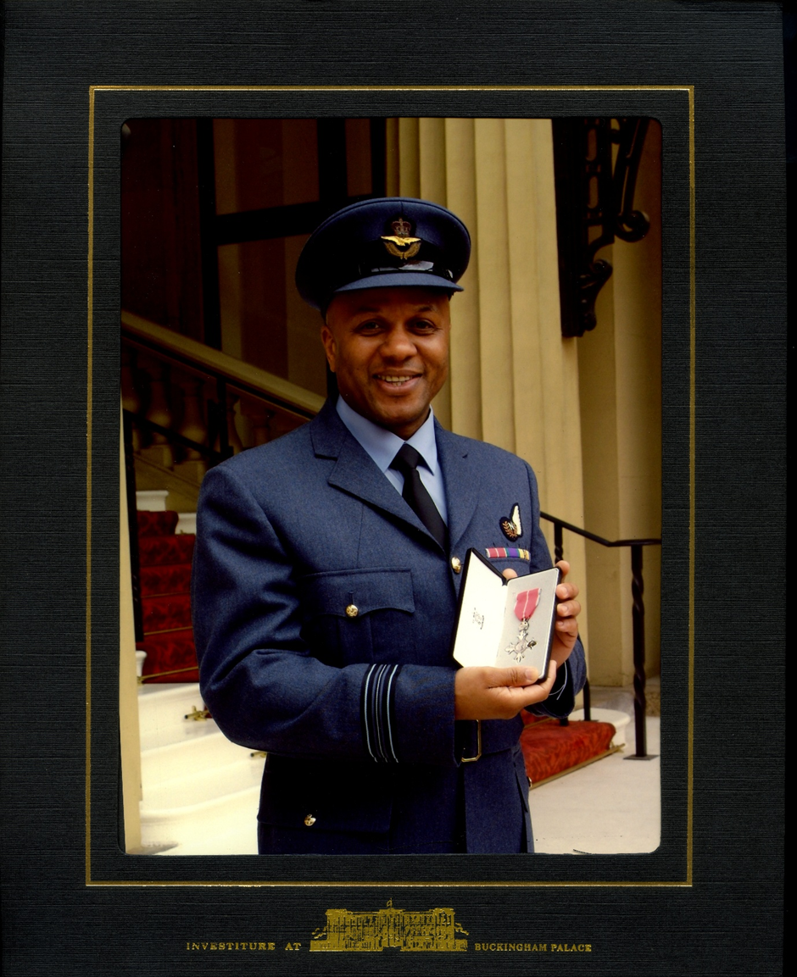
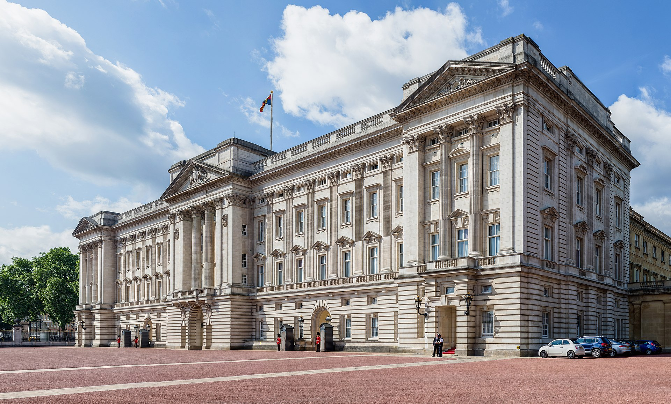
Notes:
In 2005 John was given a special award for his career in the RAF at Buckingham Palace which meant he could call himself MBE after his name. This means Member of the British Empire. John is very proud of this award. By the time he retired from the RAF in 2011, John had fulfilled his childhood dreams. From a poor family of Windrush migrants, John had become an RAF officer and one of only a few black Wing Commanders, travelling all over the world and sometimes bravely fighting in wars against Britain`s enemies of the time. It is a long way from Smethwick to Buckingham Palace!

