Slide 1
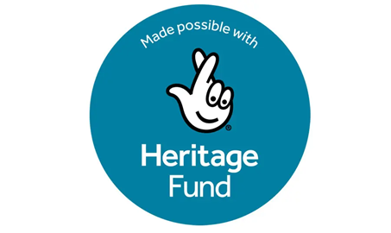
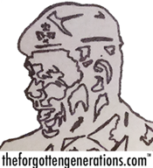
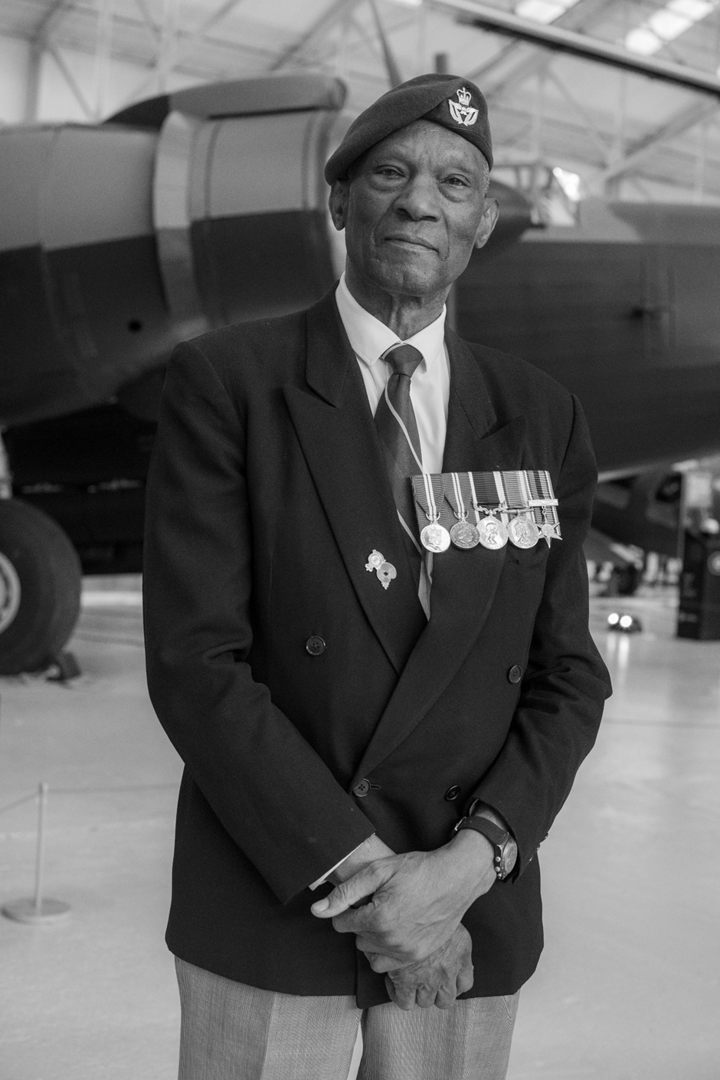
How did a`small islander` from the Caribbean
become a Black Briton?
Notes:
Kenneth Straun was born in 1943, during the Second World War on the Caribbean island of Saint Kitts.

Slide 2
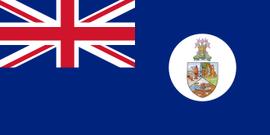
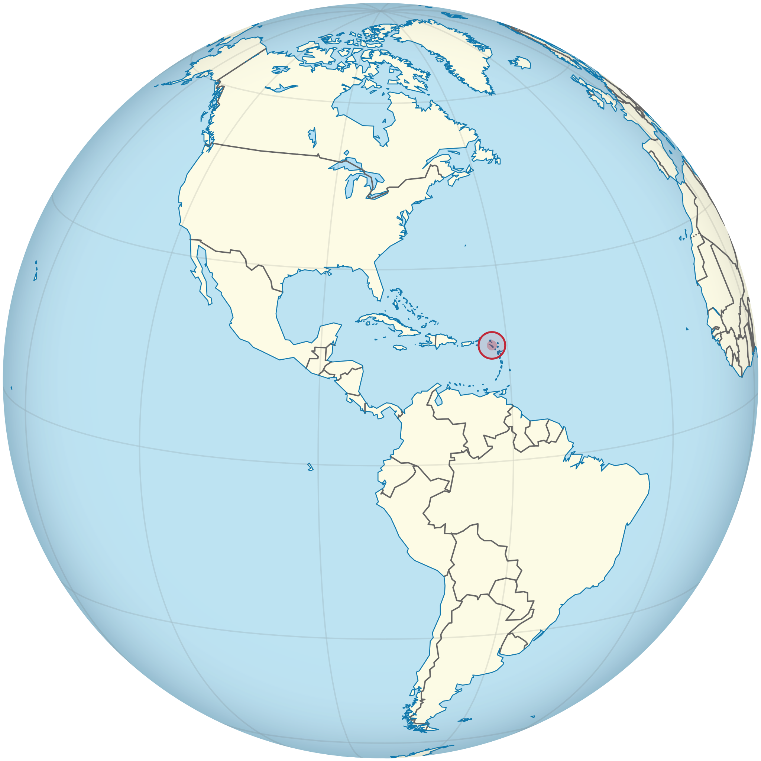
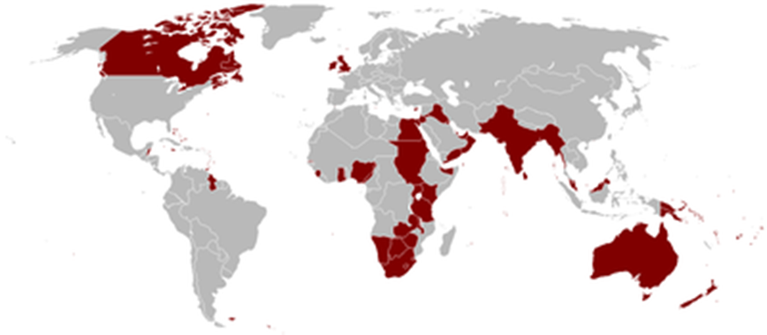
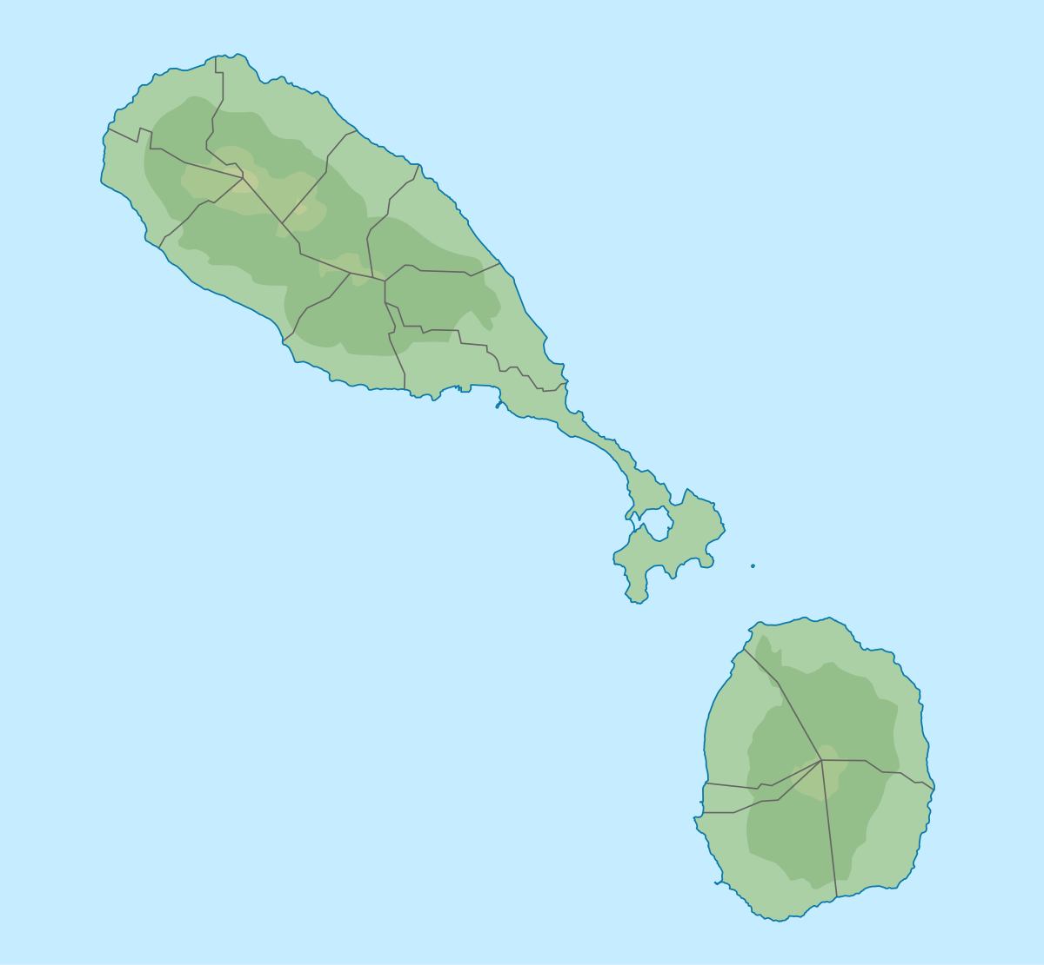
The flag of St Kitts-Nevis-Anguilla when it was a colony of the British Empire
St Kitts
Notes:
It is only a small, tropical island, just 23 miles long and 5 miles wide. The population is about 40,000 people. Today, it is part of an independent Commonwealth country called Saint Kitts – Nevis (Nevis is an even smaller Island close by).
When Kenneth was born, St Kitts was still a colony of the British Empire .

Slide 3
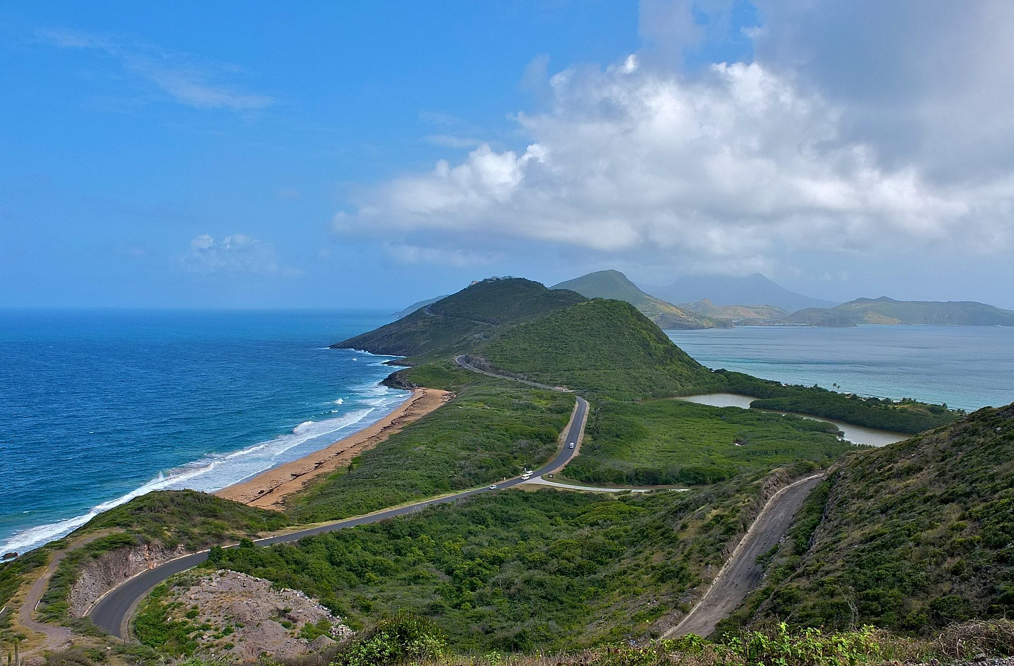
Notes:
St Kitts is a volcanic island with a high mountain in the centre surrounded by lush, green plains. It gets very hot and is sunny most of the time.

Slide 4
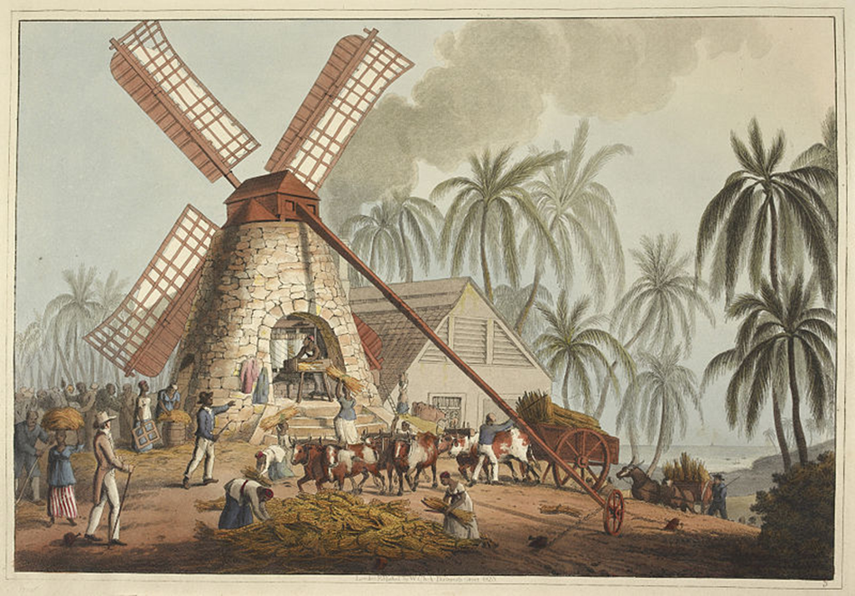
Notes:
The British had often treated people from St Kitts badly in the past. It was British traders who made slaves of thousands of Africans and (up to 1807) brought them across the Atlantic Ocean in terrible slave ships. In St Kitts Kenneth`s ancestors would have been sold like cattle and forced to work on the land with whips and cruel treatment. After slavery was banned in the British Empire in 1834, enslaved Africans were freed but colonies were still ruled by white people from Britain.

Slide 5
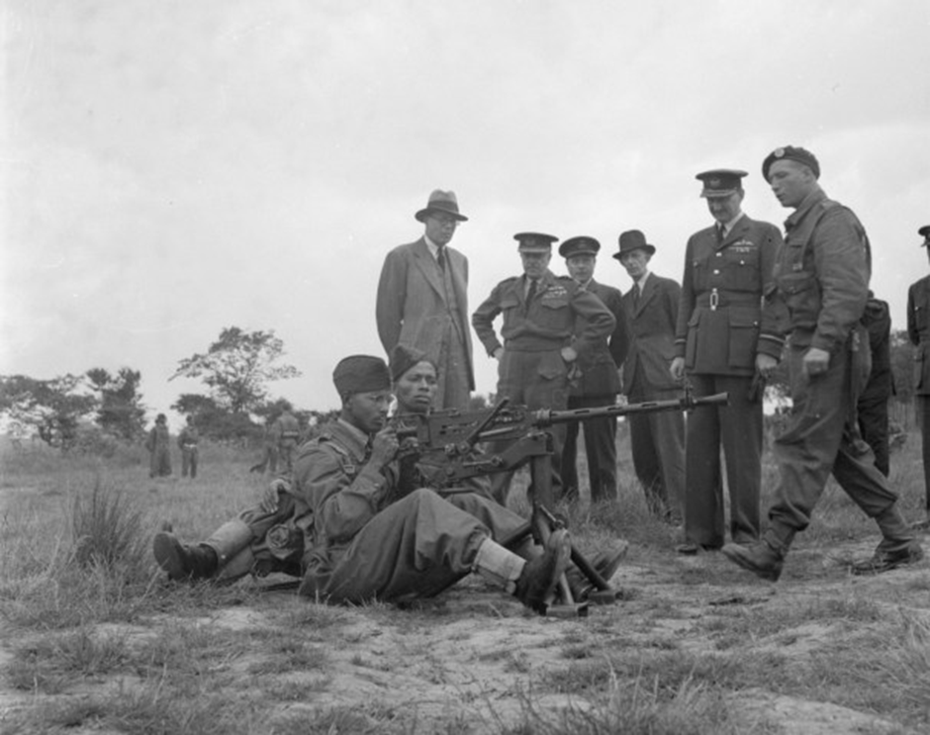
Notes:
Volunteers from Saint Kitts joined the Royal Air Force along with around 6000 others from Britain’s Caribbean colonies during the Second World War. People volunteered to serve their Mother Country.

Slide 6
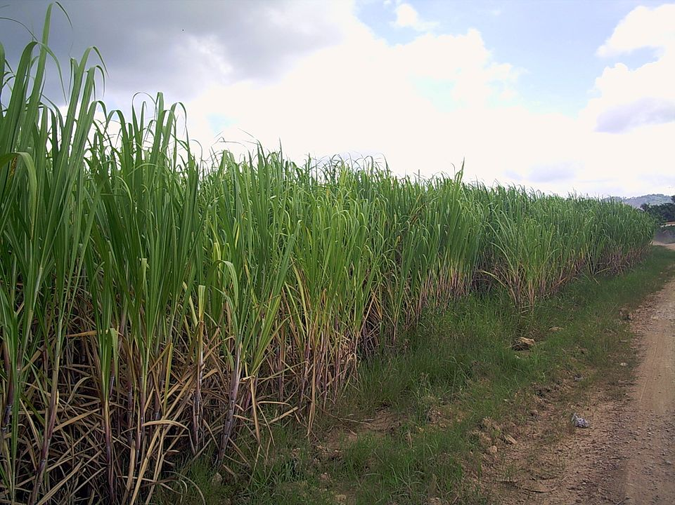
Notes:
Kenneth`s father was an overlooker on a plantation. This meant he was in charge of the fields of sugarcane and the poor islanders who worked on them on behalf of the plantation owner. Despite the low wages, harsh conditions, and the fact that most were descended from Africans originally enslaved by the British , the people were very loyal to the Mother Country. Everyone spoke English, the sport of cricket was popular and cars drove on the left, just like in Britain.

Slide 7
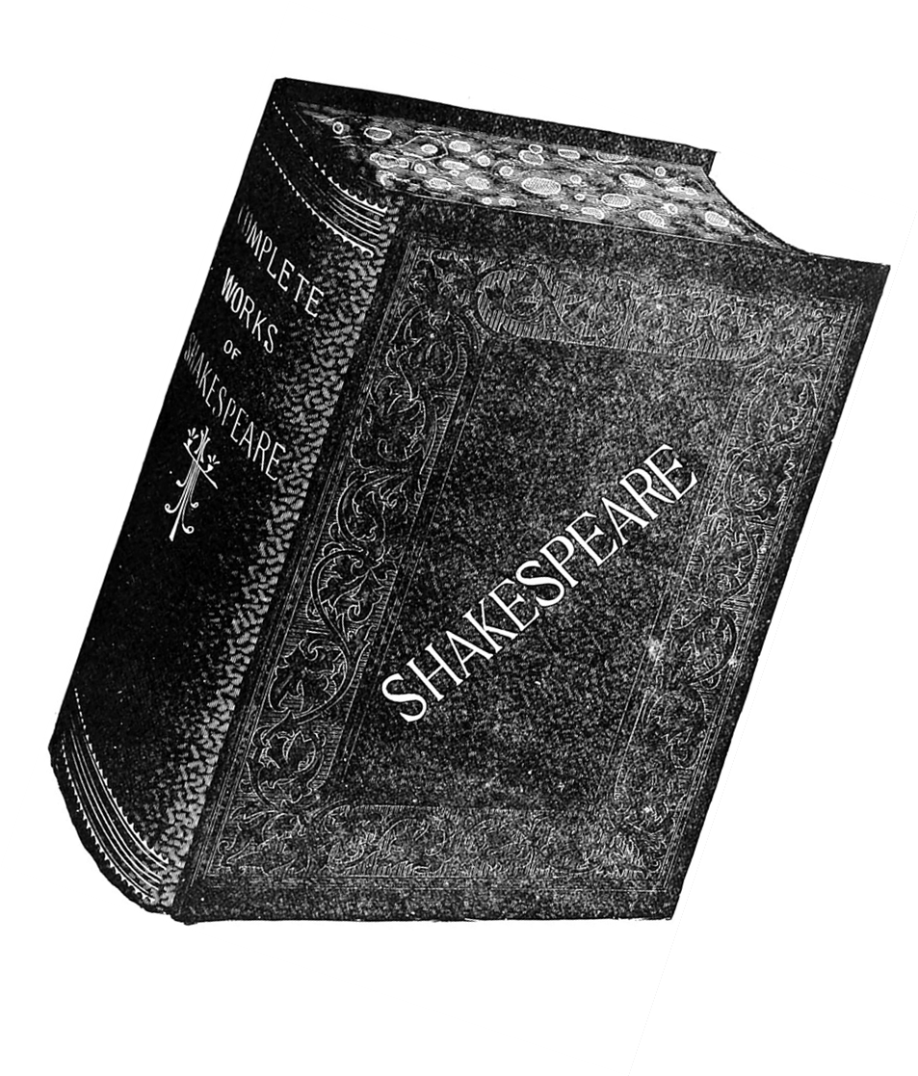
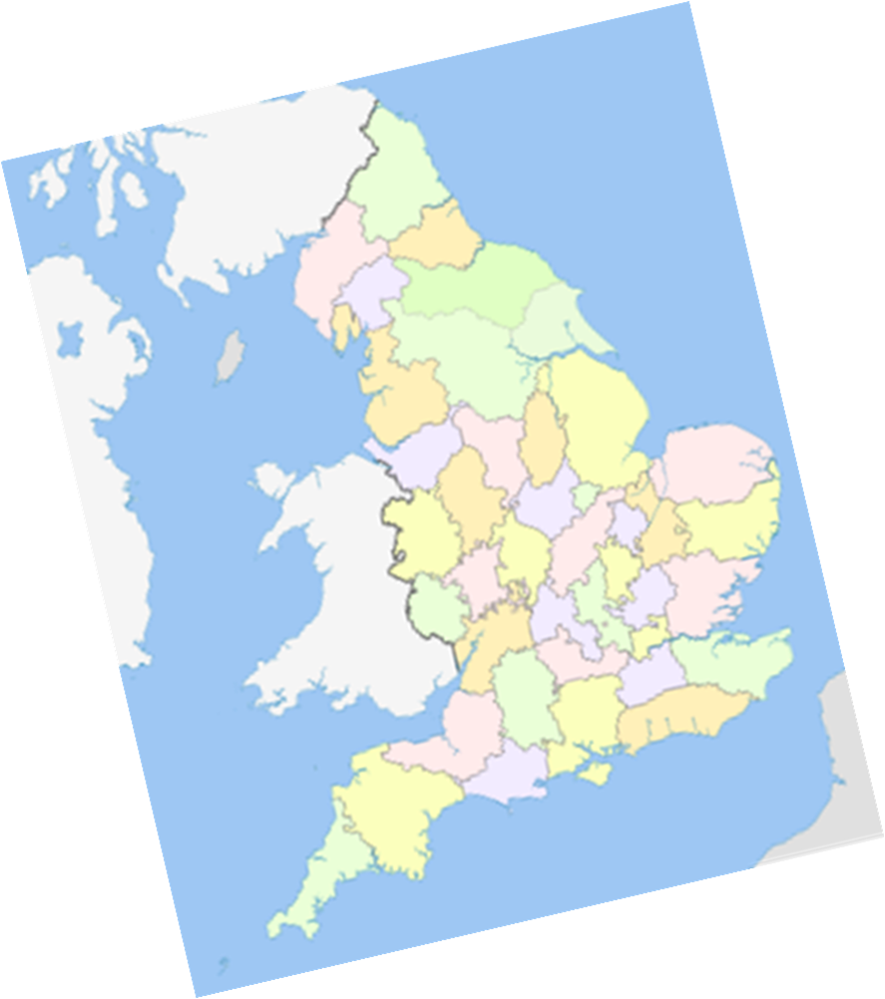
Notes:
Kenneth was brought up by his grandmother and remembers being pampered by her. He had a good education which involved learning lots about British history, geography and culture. Kenneth doesn’t remember being taught about St Kitts, the Caribbean or his African ancestors.

Slide 8
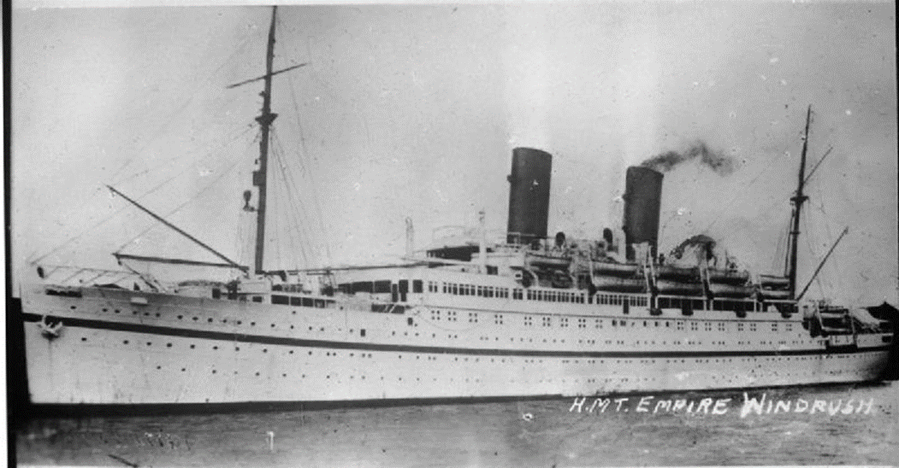
Notes:
Kenneth`s father migrated to Britain first as part of the Windrush Generation. Kenneth followed in 1961 and worked for three years in a factory in Wednesbury. Kenneth was deliberately not chosen for promotion because he was black.

Slide 9
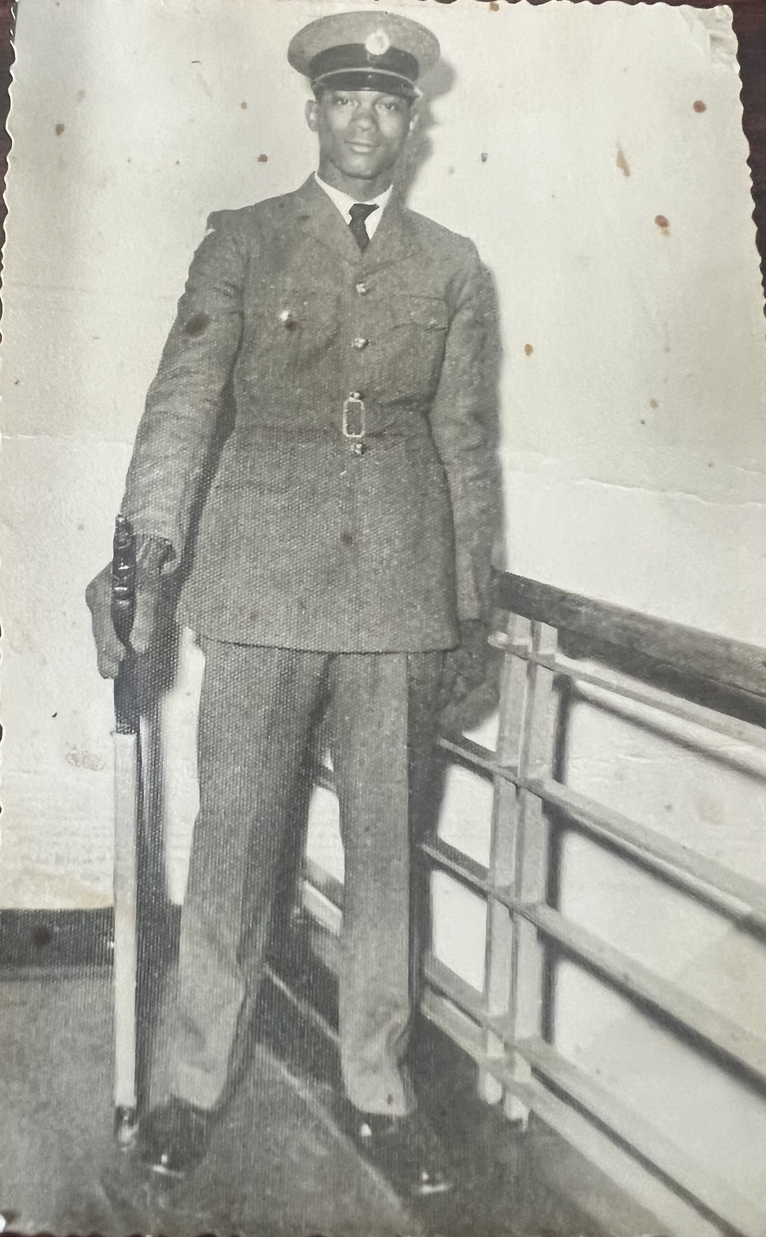
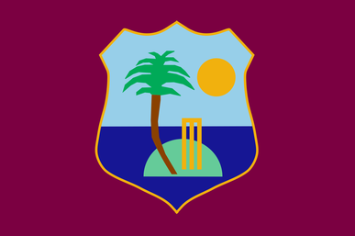
Kenneth at the age of 20 at RAF Swinderby
Notes:
A work colleague forced him to go down to a recruiting office in Wolverhampton where he joined the RAF as groundcrew (people who look after aircraft). He was chosen as a painter and finisher, someone who decorates aircraft. Kenneth had a good career in the RAF. It gave him many opportunities, for example, he rose to captain a cricket team in the air force. He got to play the favourite sport from his home island as part of his job.

Slide 10
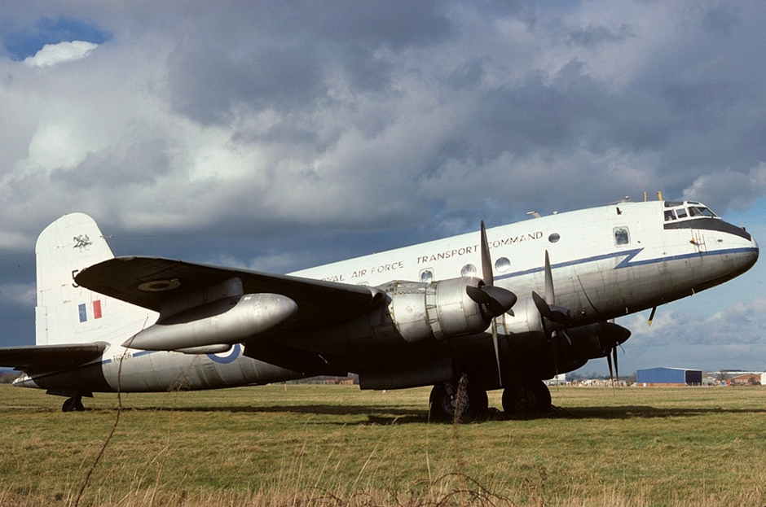
An RAF Hastings aircraft
Notes:
As a young recruit in 1965, Kenneth was sent to Oxfordshire with other airmen. An RAF plane called a Hastings had suddenly crashed killing over 40 passengers. Kenneth`s job was to search for bodies on the crash site. This was sad and upsetting work for a young man. After the crash, Hastings aircraft were replaced by Hercules transport planes instead.

Slide 11
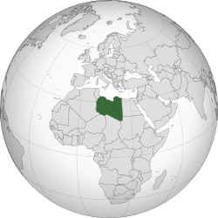
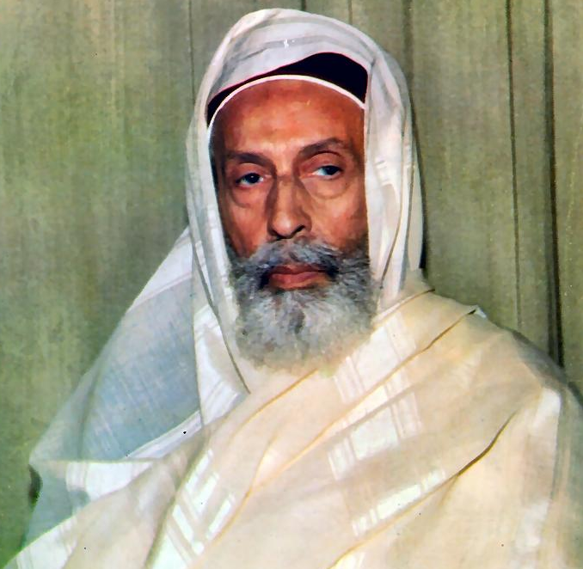
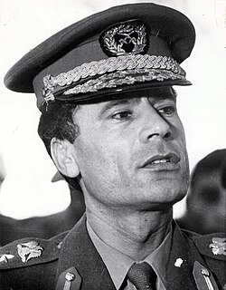
Libya
King Idris
Colonel Gaddafi
Notes:
Between 1968 to 1970 Kenneth was sent to an RAF base called El Adem in the desert of the north African country of Libya. It was one of lots of RAF bases all over the world, left over from the world wars and the days of the British Empire. Kenneth was part of an RAF rescue team who had to go out into the desert to bring back stranded people. On Sept 1st 1969, King Idris of Libya was overthrown by an army officer called Colonel Gaddafi. Kenneth remembers being on a tense guard duty outside RAF El Adem, facing Libyan soldiers, and wondering if he would end up fighting them (Gaddafi was anti-British). In fact, there was no fighting and soon after the British left Libya.

Slide 12
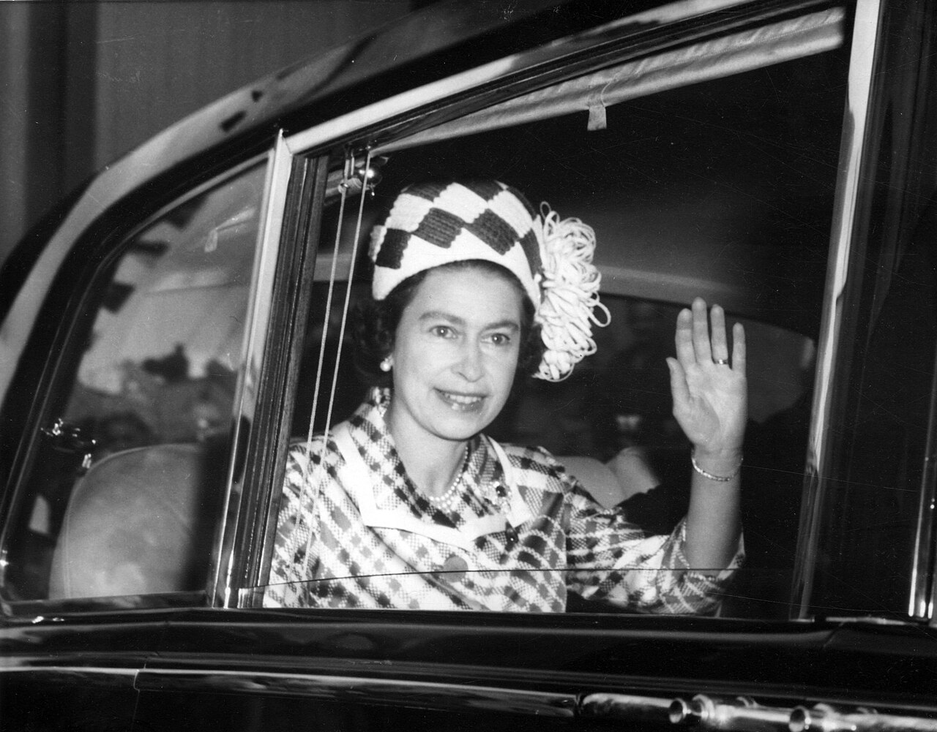
Notes:
From the mid-1970s Kenneth worked on aircraft of the Queen`s Flight, planes set aside for use by the Royal Family and government ministers. This helped him get promotion in the air force.

Slide 13
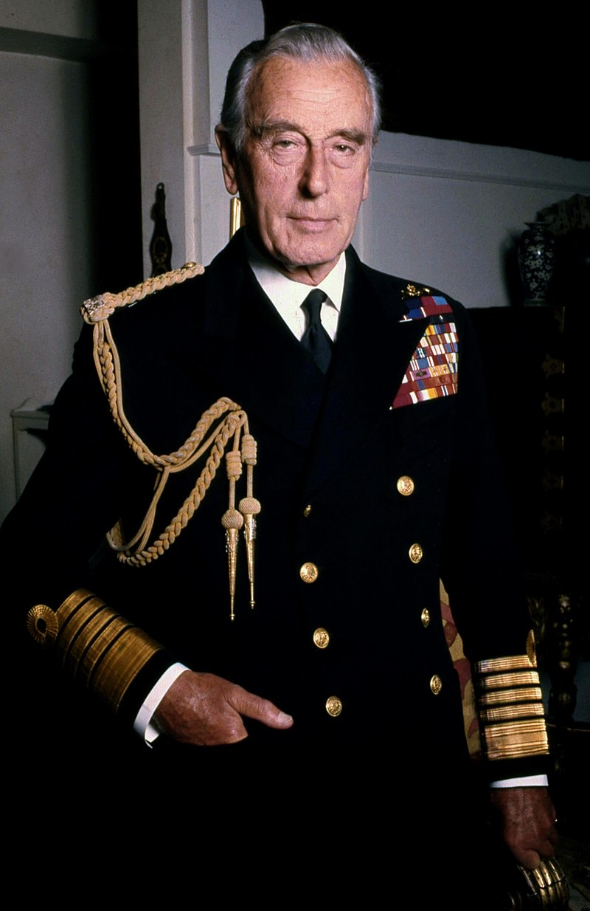
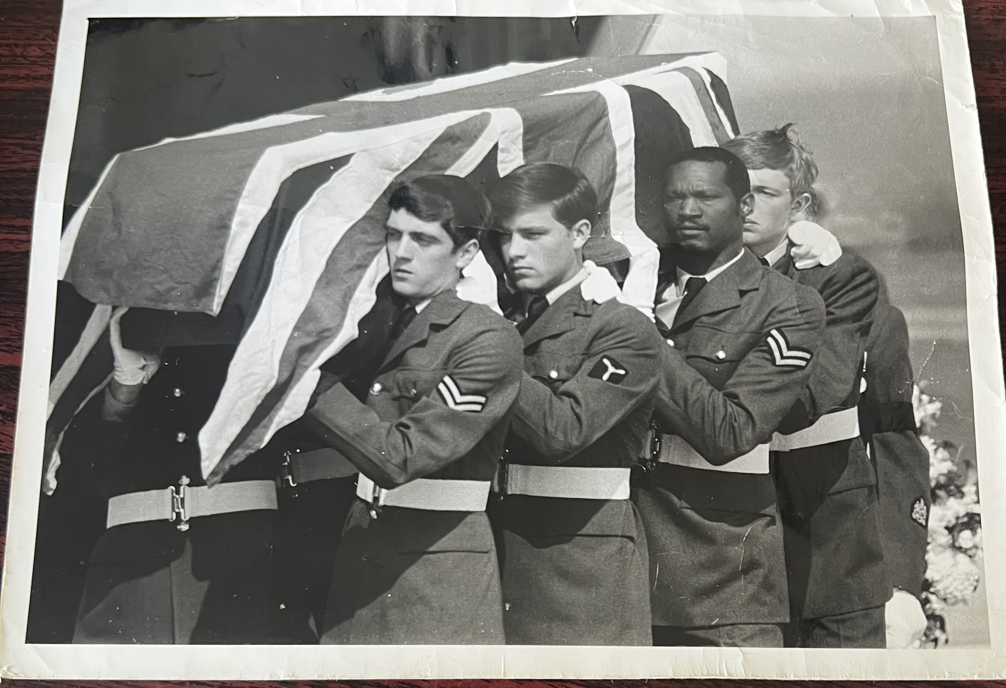
Notes:
On the 27th August 1979, terrorists from the Irish Republican Army blew up and killed Lord Mountbatten, the uncle of Queen Elizabeth the Second. Kenneth was on the RAF plane which flew his body back from Ireland to Britain. Here you can see him helping to carry Mountbatten`s coffin, draped in a union flag.

Slide 14

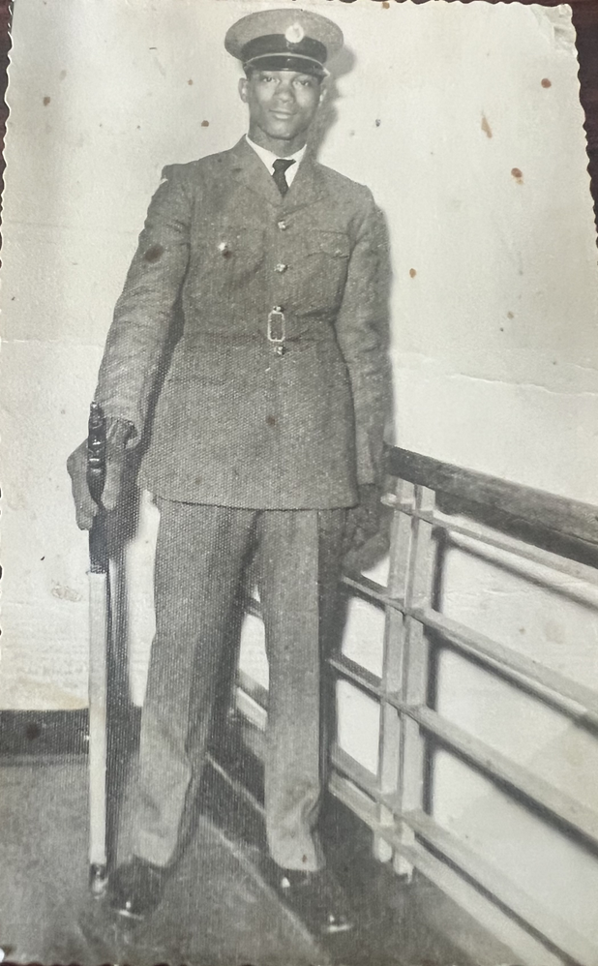
How did a`small islander` from the Caribbean
become a Black Briton?
Thanks to National Lottery players
Notes:
Kenneth ignored any racism he found in the air force and feels he was treated well. His long career gave him valuable skills and knowledge which he used in a later job with an American airline after he retired. The RAF helped Kenneth make the journey from being a “small Islander” from St Kitts to becoming a black Briton.

