Slide 1

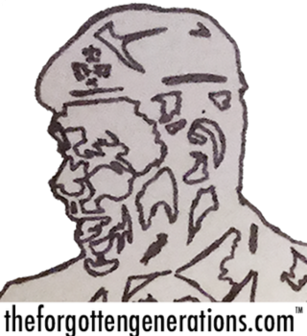
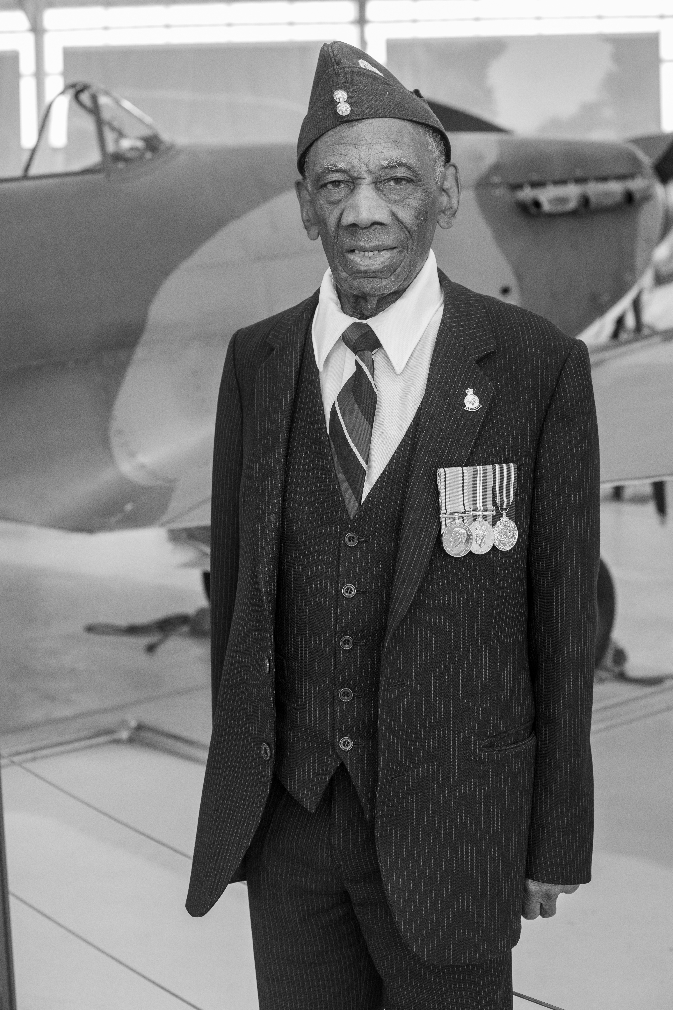
How did a Trinidadian Prince become a black Brummie?

Slide 2
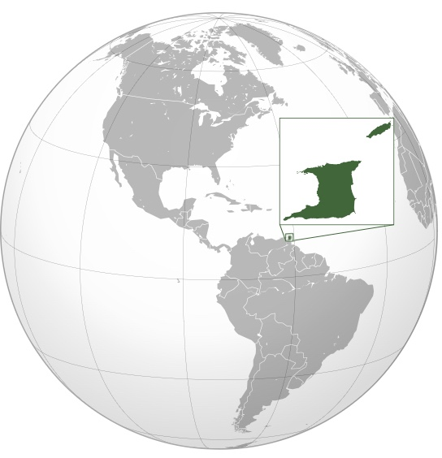

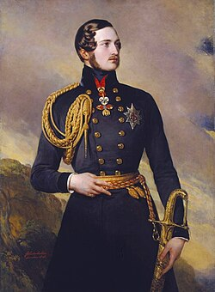

Britain
Trinidad and Tobago
Port of Spain
Queen Victoria`s husband, Prince Albert who died in 1861
Notes:
Prince Albert `Jake` Jacob was born in Port of Spain, the capital city of Trinidad in 1925. Trinidad is a tropical island in the Caribbean Sea in what was then known as the West Indies. Prince Albert`s father was a Roman Catholic headteacher and Jake had thirteen brothers and sisters.

Slide 3


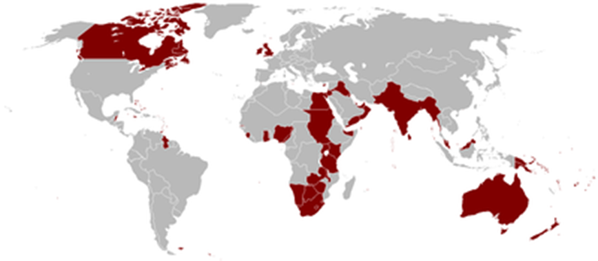
The flag of Trinidad and Tobago when it was a colony of the British Empire
The flag of Trinidad and Tobago today
Notes:
Nowadays Trinidad and Tobago is a proud independent country but in 1925 it was still a colony of the British Empire. This meant that white British people were sent out to rule the island, even though the majority of Trinidadians were black, brown or of mixed backgrounds who had little say in how their country was run.

Slide 4
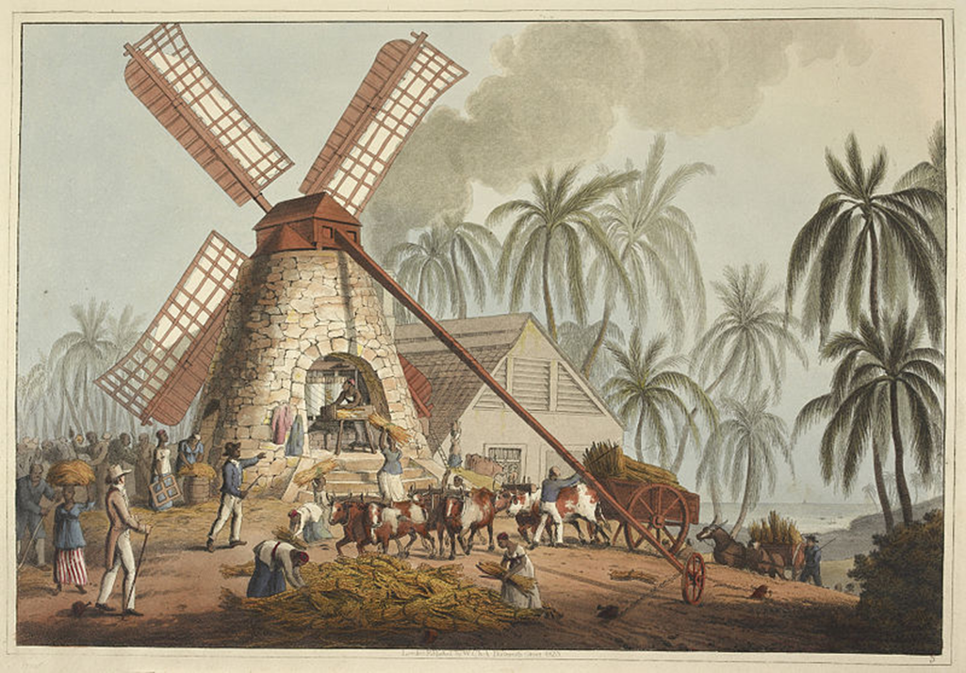
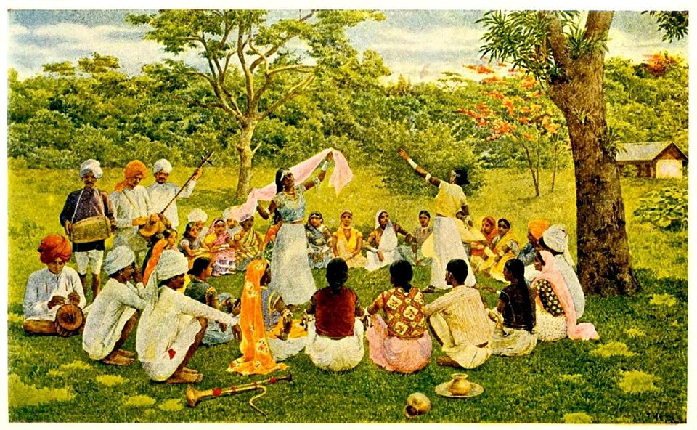
Notes:
The British had often treated Trinidadians badly in the past. It was British traders who made slaves of thousands of Africans and (up to 1807) brought them across the Atlantic Ocean in terrible slave ships. In Trinidad, Jake`s ancestors would have been sold like cattle and forced to work on the land with whips and cruel treatment. After slavery was banned in the British Empire in 1834, enslaved Africans were freed but many refused to work on the island plantations for low wages. The British controlled South Asia (what is now India, Pakistan and Bangladesh) as part of their empire as well as the Caribbean colonies. They brought poor South Asian labourers to Trinidad to work on the plantations instead of the freed Africans. The East Indians (as they were called) agreed to stay and work for a few years but many were treated little better than slaves, wages were low and many people died. Some returned to South Asia while others settled in Trinidad for good.

Slide 5

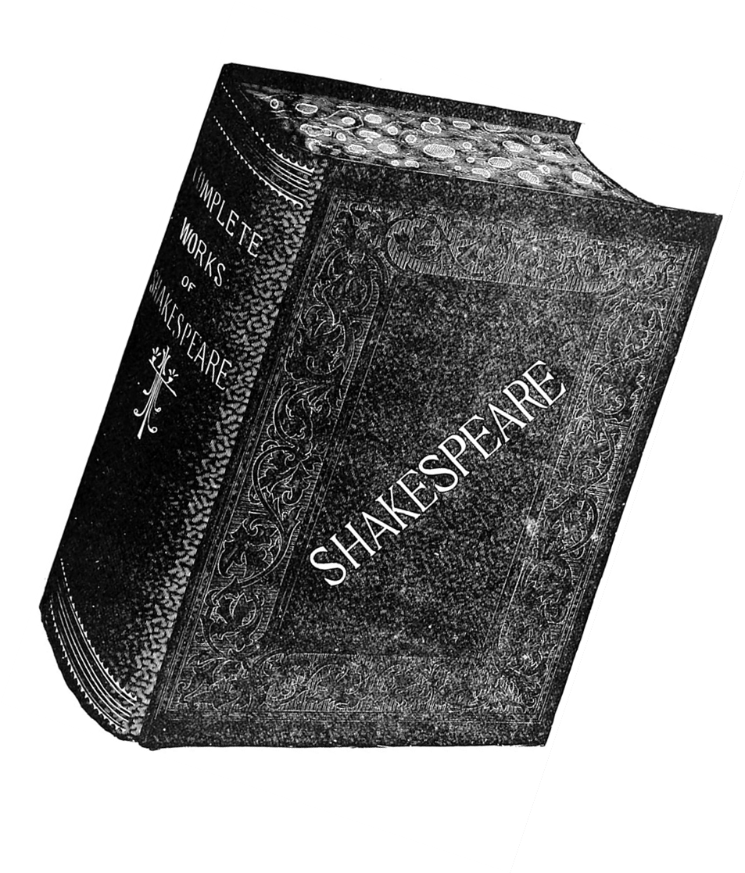
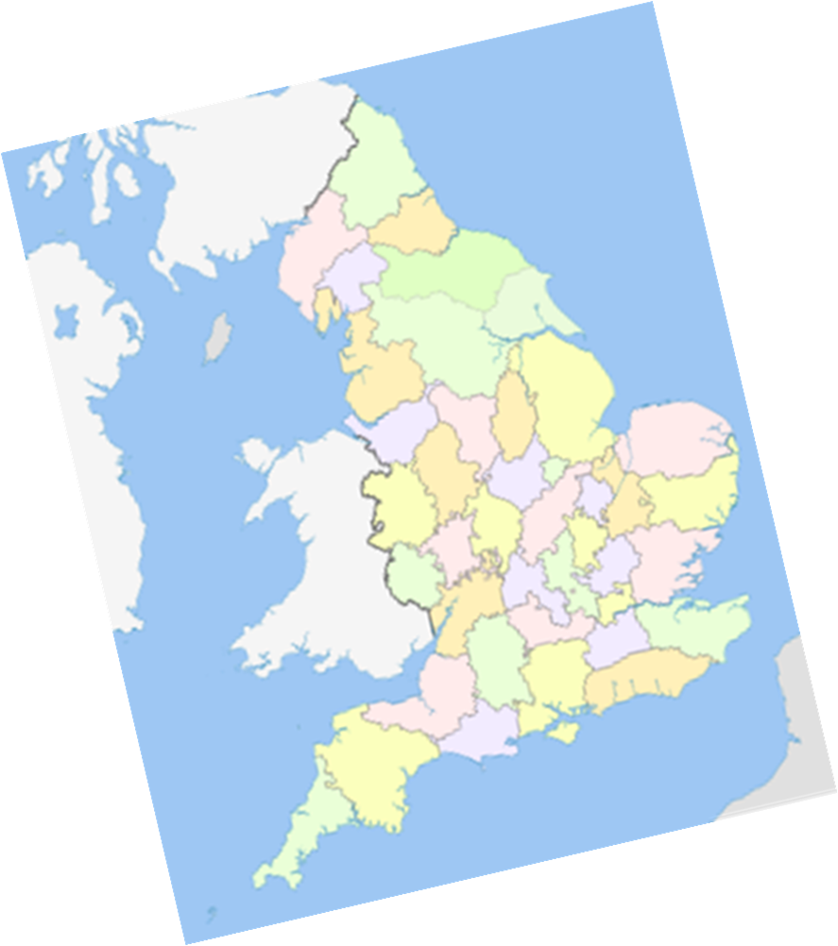
Notes:
Despite the way the British had treated Trinidadians in the past, `Jake` was taught about Britain as the ‘Mother Country`. His education involved learning lots about British history, geography and culture. Jake doesn’t remember being taught much about Trinidad, the Caribbean or his African ancestors. In addition, one of Jake`s grandfather`s was white and Scottish who brought up his family to admire and respect everything about Britain. In young Jake`s mind, there was no doubt. Although he had been brought up in Trinidad, he was proudly and definitely British!

Slide 6
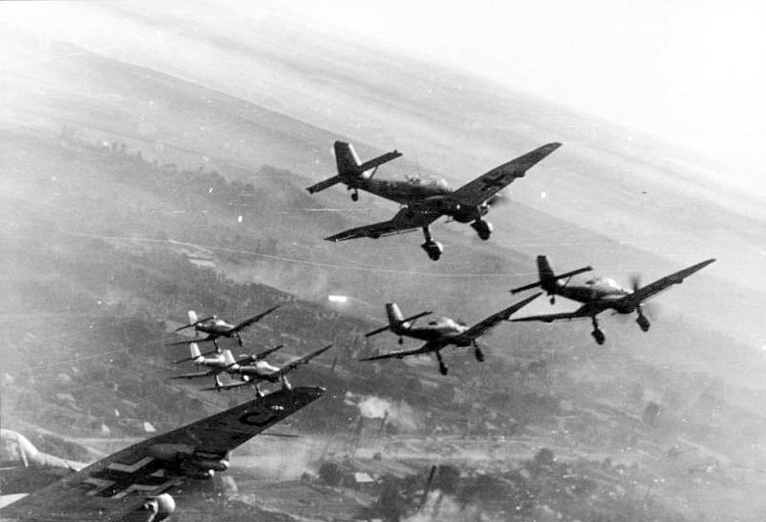
Notes:
`Jake` was fourteen when the Second World War broke out in Europe in September 1939. Hitler and his German forces invaded Poland.

Slide 7
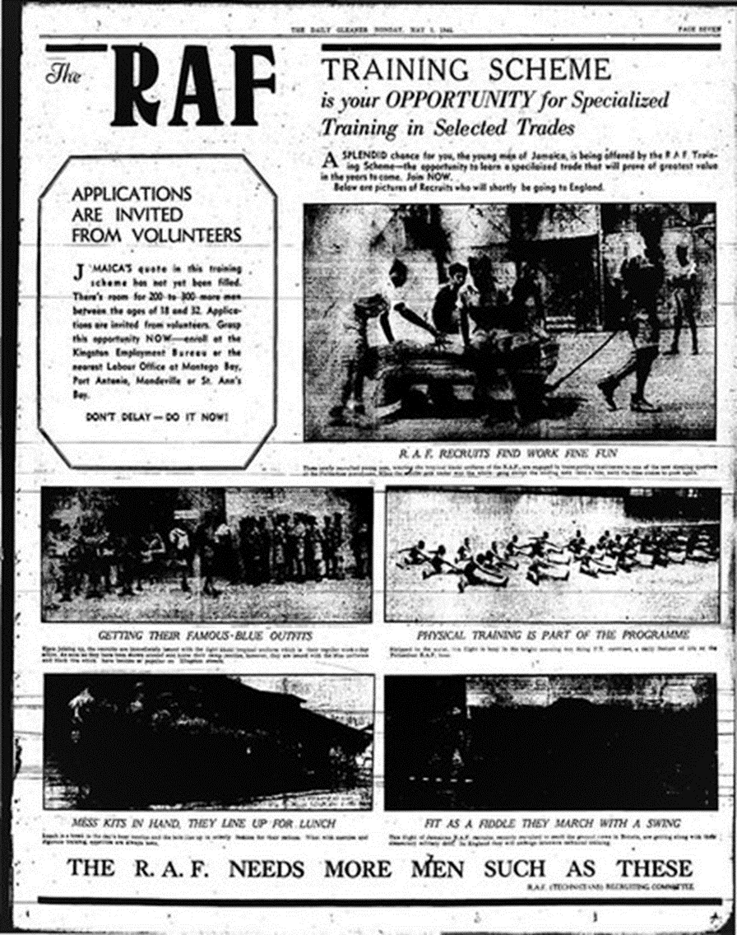
Insert RAF recruitment feature from the Jamaican newspaper the Daily Gleaner from this link
https://twitter.com/JamaicaLeeds/status/1459911499997134850/photo/2
Notes:
As the Second World War dragged on (for months and then years) the Royal Air Force along with the Army and Navy begun recruiting abroad in colonies of the Empire for volunteers to bolster their war effort. By 1943, `Jake` had left school and was working in a printers in Port of Spain but like other young people in British Caribbean colonies, he dreamt of the adventure of joining the war against Germany and of travelling to the Mother Country. `Jake` saw an RAF advertisement like this in a Trinidad newspaper and applied for the air force. But he had to wait until he was old enough in 1944 before he could actually join.

Slide 8
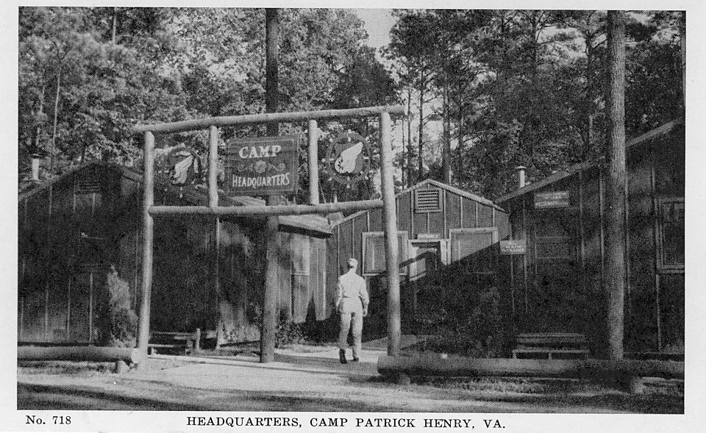

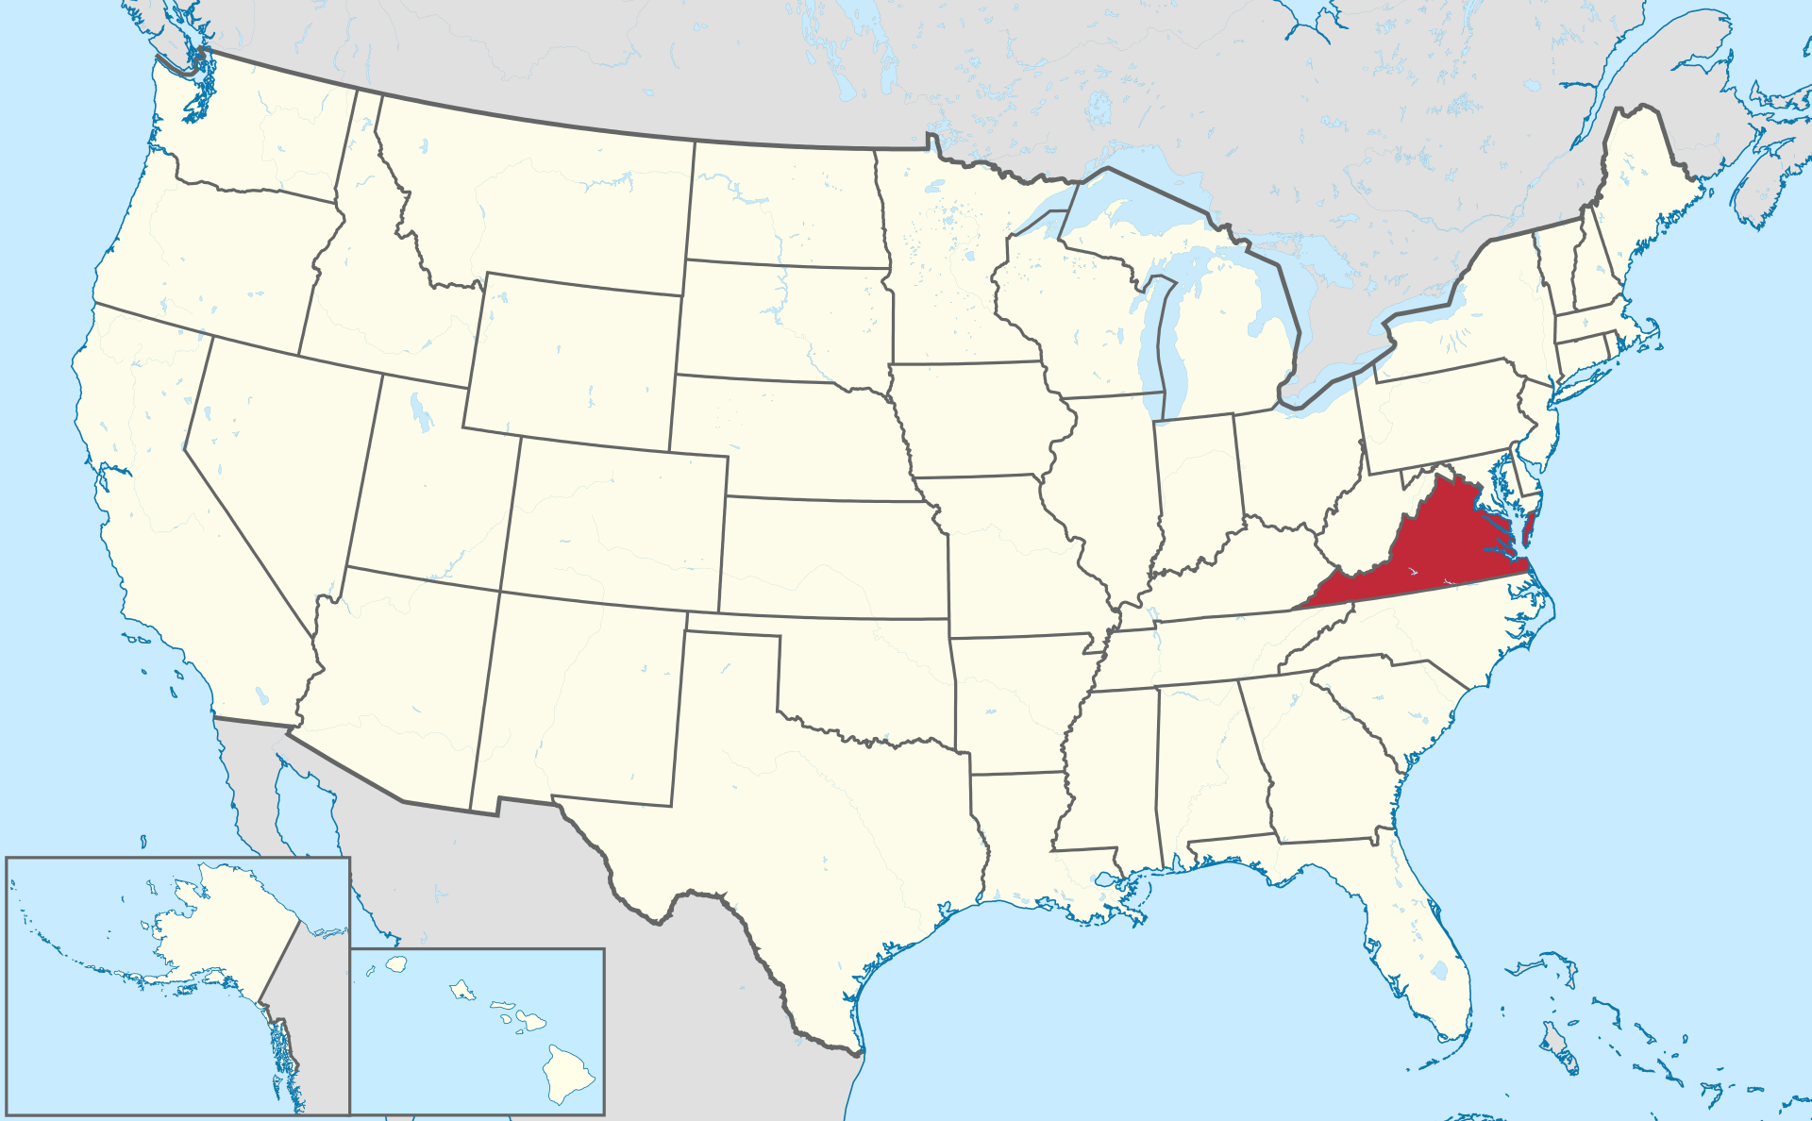
Notes:
In 1944 `Jake` travelled by ship from Trinidad across the sea to Camp Patrick Henry, a US military base in the state of Virginia. Like the other volunteers picked up from colonies across the Caribbean, Jake had never left his home island before. One evening, Jake and some Caribbean friends (dressed in their smart RAF blue-grey uniforms) decided to leave the camp in search of entertainment. They got on a bus that stopped right outside it but the white driver told them he wouldn`t start the journey because they were sitting in seats reserved for white people only. Somebody went back into the camp to fetch the white camp commandant who was friendly towards them. He told the driver that the Caribbean airmen were British and that American laws didn`t apply to allies in the same way. This was the first time `Jake` was ever discriminated against just because of the colour of his skin.

Slide 9

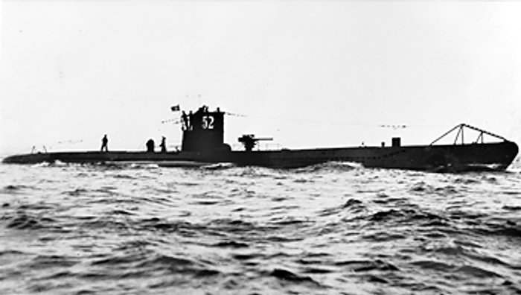
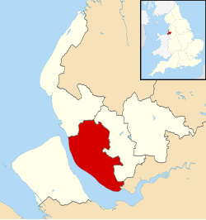
Liverpool
Notes:
In November 1944, `Jake` joined a troop ship carrying Caribbean volunteers across the Atlantic Ocean. It zigzagged its way in a convoy of other ships to protect it from being sunk by dangerous German U-boats or submarines. Arriving in Liverpool in North- West England, the volunteers were greeted by a military band and given hot drinks by British Ladies of the WRVS (Womens Royal Voluntary Service). The grey, cold wartime winter was very different to the tropical heat of Trinidad.

Slide 10
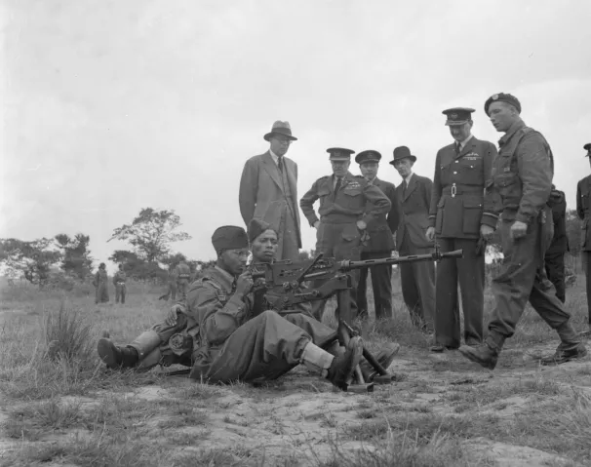
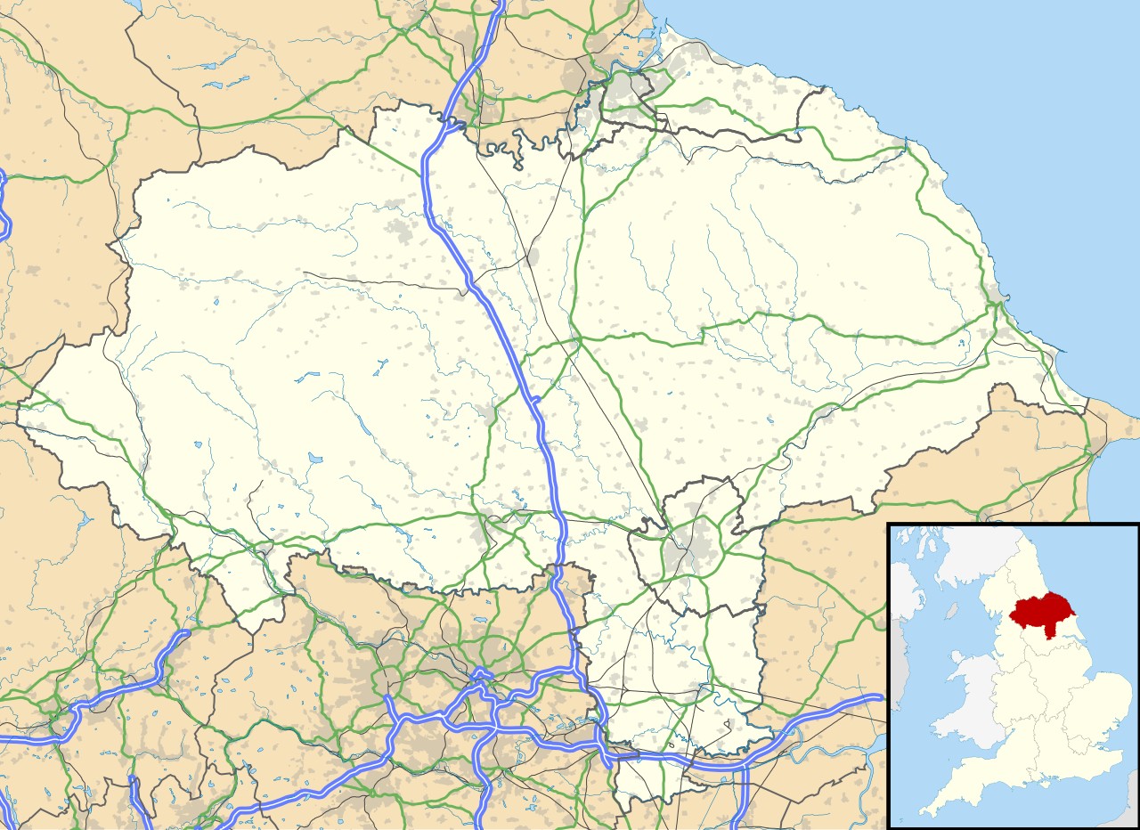
Filey
Notes:
Volunteers like `Jake` trained at RAF Hunmanby Moor, a former holiday camp on the East Yorkshire coast at Filey. They lived in a chalet or hut with a washbasin and two central heating pipes. It was so cold in the huts that the men slept with extra blankets and sometimes their own thick RAF great coats on top of them. Local white people were curious and generally friendly towards these black volunteers who had come all the way from the Caribbean to fight for Britain. Most had never seen a black person before. `Jake` noted that `We knew more about you, than you did about us`. Volunteers were sometimes invited into local homes for meals and refreshments. British food was rationed because of the war and seemed strange compared to a Caribbean diet.

Slide 11
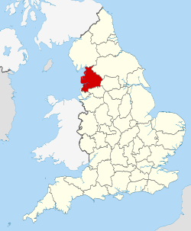
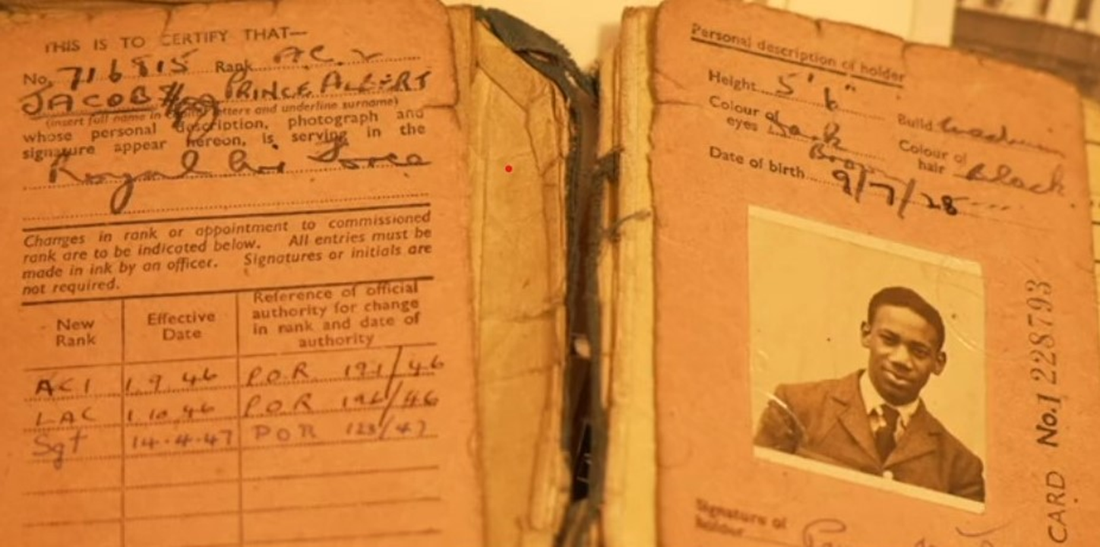
Carlisle
Jake`s RAF identity card
Kirkham,
West Midlands
Lancashire
Notes:
`Jake` was sent first to RAF Kirkham in Lancashire to work as an equipment assistant before being moved to the RAF base near Carlisle in Cumbria (RAF Kingstown). He was assigned to the Number 14 Maintenance Unit who maintained anything from engine parts to uniforms and furniture to firearms. On Christmas Eve 1946 eight Caribbean airmen from the base went to a dance at a local casino. There were white soldiers and sailors from the Army and Navy there too who resented black men dancing with white women. A fight broke out and the police burst in with whistles and truncheons, bustling away the black RAF airmen to their police station. However, the police did not arrest them or lock them up in cells. The Caribbeans were taken to the station for their own protection from assault by white British soldiers and sailors! What kind of Mother Country had Jake come to?

Slide 12
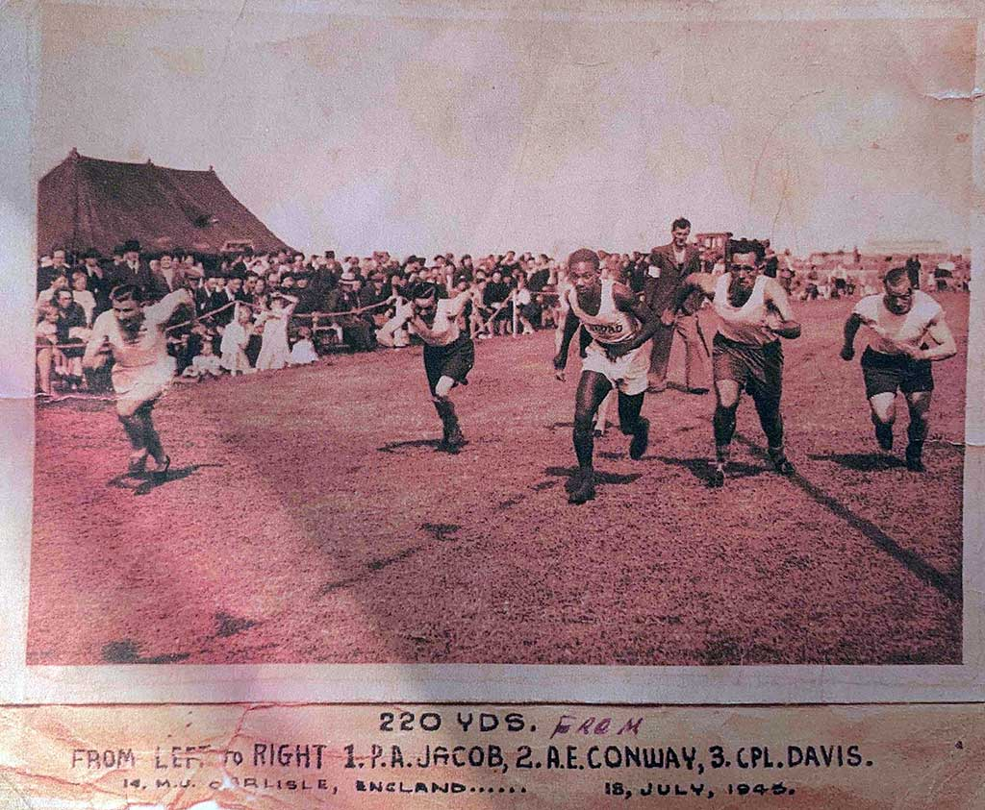
Insert photograph of Jake Jacobs in a running race from this link (second photograph down page)
https://solihulllife.org/2022/10/03/jake-jacob-nothing-was-easy/
Notes:
Whilst stationed in Cumbria, Jake began racing in armed forces athletic events such as this one. He was a sprinter who took part in the shorter races like this 220 yards one which took place in July 1945 just before the Second World War ended.

Slide 13
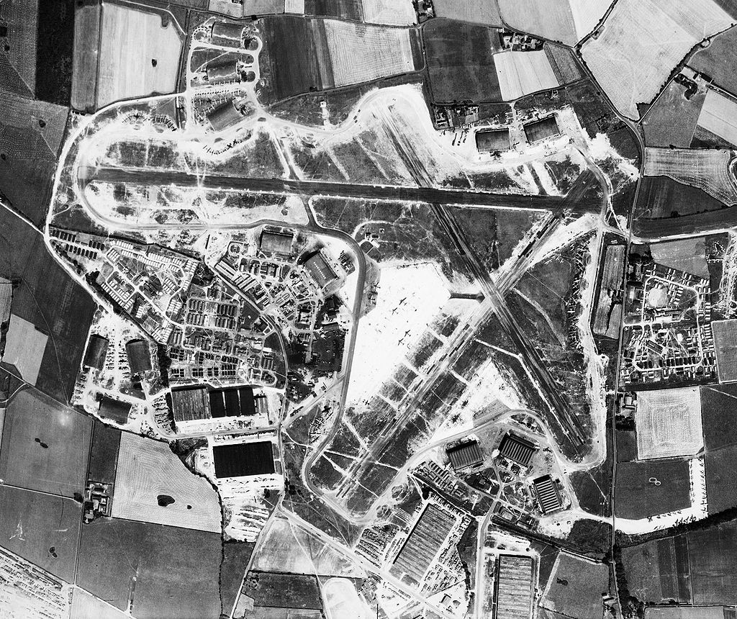
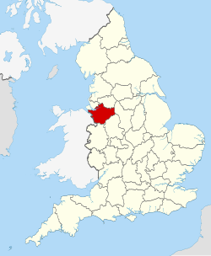
RAF Burtonwood, Cheshire
Notes:
Jake moved again and was stationed at RAF Burtonwood near Warrington in Cheshire. Upon arrival, he and several other young airmen were sent to a local technical college to further their education and training. Little did Jake know that this decision was to change the course of his entire life!
For it was here he met a local white, Jewish girl Mary, who was studying shorthand and typing in a neighbouring classroom. They immediately hit it off: Jake particularly impressed young Mary by quoting Shakespeare in their first conversations.
Yet, the relationship proved tricky almost from the start. Only a few weeks later Mary’s father, Claude discovered she had been seen with Jake. He flew into a rage and immediately tried to ban her from seeing him again, purely due to the colour of his skin.

Slide 14
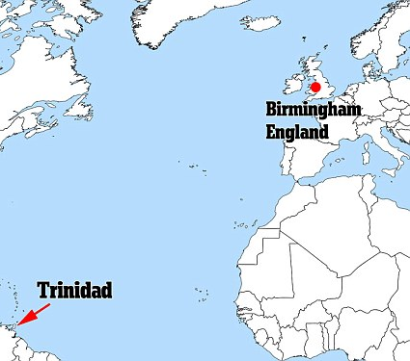


Notes:
By 1947, the war had been over for two years. The RAF expected black airmen to return to their home colonies, even though they had the right to stay in Britain if they liked. When `Jake` asked Mary if they might ever marry, she replied that it was “possible but not probable”. `Jake` returned to his former job at the Government Printing Office, but soon found that there was little chance of promotion. His dream job at the airport in Port of Spain (Trinidad’s capital) also didn’t happen. There seemed to be few opportunities in Trinidad. However, Britain was inviting foreign workers to help rebuild the country after the devastation caused by German bombing during the Second World War. Jake decided to return swiftly to England. He had only been back in Trinidad for around 6 months.

Slide 15
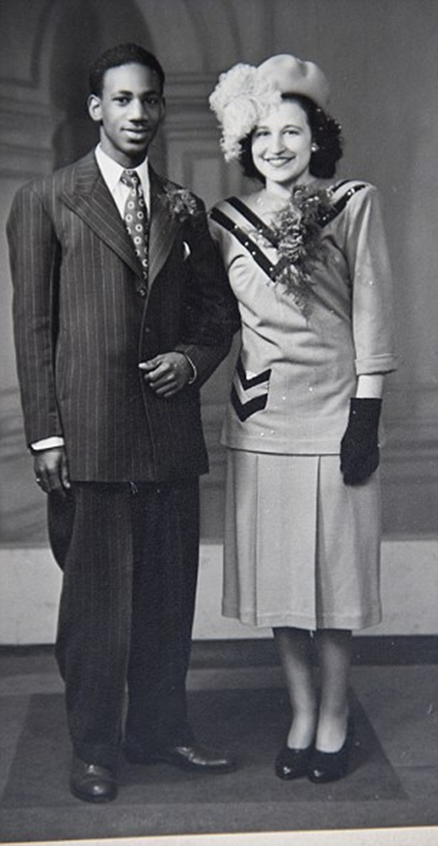

Insert Jake and Mary`s 1948 wedding photograph here
Notes:
During his brief time at home in Trinidad, `Jake` and Mary continued exchanging letters. At the time neither of them knew whether they had a future together, especially as Mary’s father, Claude opposed the match.
However, when `Jake` returned to the UK and settled in Oldbury near Birmingham they soon reunited in person. Her father insisted that Mary would never again enter the family home if she married `Jake` but he reluctantly granted permission for them to get married. They did this on the 17th of April 1948 against his express wishes. Sadly, this meant there were no members of Mary`s family present at the ceremony- only friends. (It was too far away for any of Jake`s family to come from the Caribbean).

Slide 16
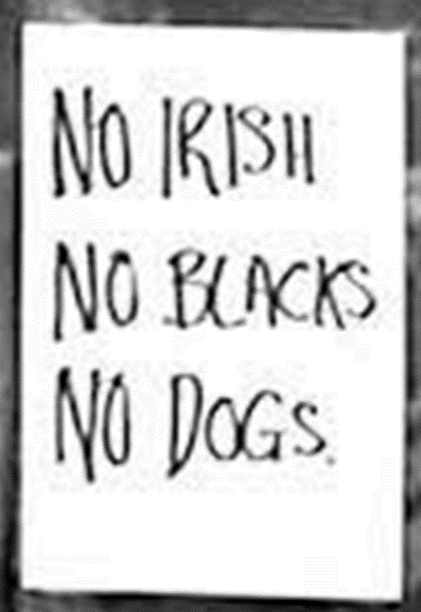


Insert photograph of boarding house sign reading `No Irish No Blacks No Dogs` from this link
https://www.theguardian.com/world/2015/oct/28/no-reason-to-doubt-no-irish-no-blacks-signs
Notes:
`Jake` struggled to find work that matched his level of education and experience in post-war Birmingham. Although there were plenty of jobs, black migrants were largely unwelcome. It was fine for Caribbean volunteers to have served in the war but it was another thing entirely for them to settle for good in Britain afterwards. It was considered even worse if a white woman married a black man. White people shouted across the street that Mary should not be with `Jake` .`Jake` and Mary struggled to find accommodation. It was common to see racist notices in boarding houses reading `No Irish, No blacks, No Dogs`. Pubs, restaurants and dance halls could bar people of colour attending. So much for a welcome back from his Mother Country! Only basic jobs were open to migrants like `Jake`. So, he began work at the Accles and Pollock steel tube factory in Oldbury. However, Jake was determined to improve his prospects and he studied engineering and maths at night and on the weekends. Soon he moved jobs and went to work in the accounts department of BSA in Birmingham looking at costs and estimating – a step up from making steel tubes. He got on well with his colleagues but was shocked by the racism he experienced.

Slide 17
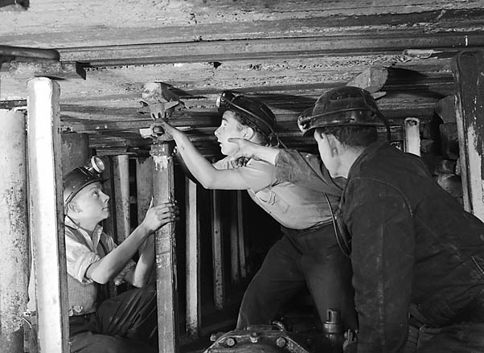





Mining ?
Railways?
General Post Office?
Notes:
`Jake` was fed up by the lack of opportunities for promotion at BSA so he approached the local RAF Association about getting a better job. RAF associations include people who have served in the RAF in the past. They know what it is like to be a veteran and how hard it can be for veterans to return to ordinary life after service in the air force. The association valued RAF veterans like `Jake`. They could see the talented person beyond the colour of his skin. The association arranged an interview for `Jake` at the Labour Exchange (a place where you looked for jobs). He was offered the choice of working for the mines, railways or the Post Office.
He chose the Post Office and after passing the relevant exam began work in the telecommunications sector.
This was the start of a very successful 32 year career for Jake in the Post Office, and the later telecommunications company BT. It resulted in Jake being an inspector at Acocks Green with 120 staff working beneath him. In his own words joining the Post Office was a great move because he found, ‘The harder you work, the luckier you get and the better promotions you get.’

Slide 18
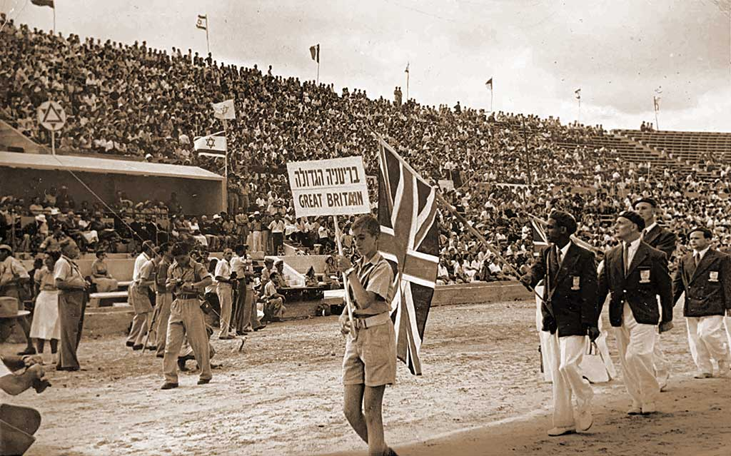
Notes:
`Jake` and Mary found good friends in Birmingham`s Jewish community. `Jake` converted to Judaism and was proud to lead the British Jewish team to compete in the International Jewish Maccabiah Games in Israel in 1950. `Jake` also took part in local athletics for as long as he was fit enough.

Slide 19
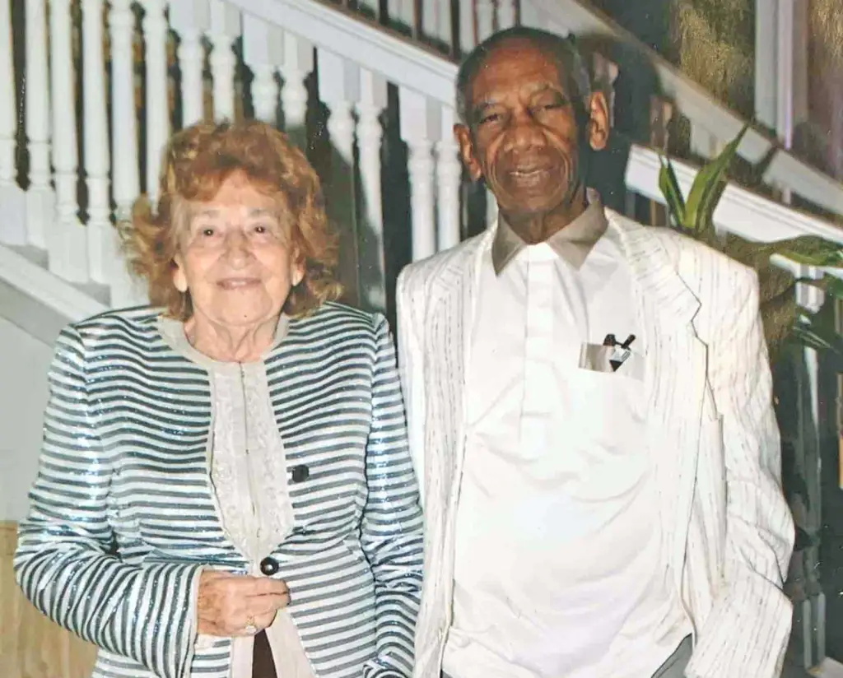
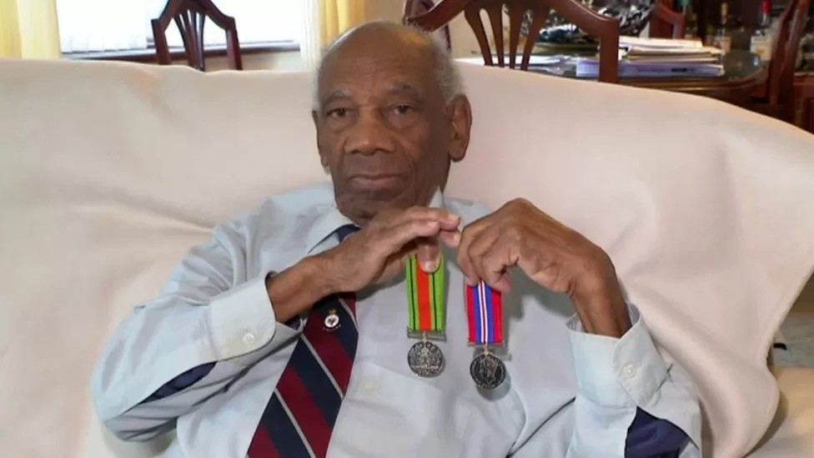
`Jake` showing his medals at 97 in 2022
`Jake` and Mary in their 80s
Notes:
While `Jake` worked at the Post Office, Mary worked as a teacher then a deputy headteacher until they both retired in the mid 1980s. They lived together in Knowle near Solihull, on the outskirts of Birmingham (unfortunately Mary died in 2024). A kind neighbour helped `Jake` claim the medals he was owed for his service in the RAF. He was at last awarded them in 2023, 76 years after he left the RAF. `Jake` celebrated his 100th birthday in 2025 and took part in a national BBC programme about the ending of the Second War for the eightieth anniversary of VE Day (Victory in Europe Day 1945).

Slide 20


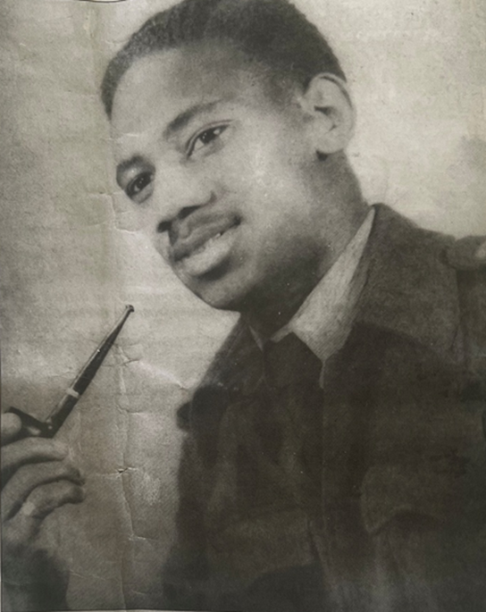
How did a Trinidadian Prince become a black Brummie?
Notes:
And that is how `Jake` became a proud Brummie from Trinidad, who always regarded himself as British and who bravely served his Mother Country.

